Slide 1
К 80- летию Ю.Н. Парийского
Ю. Н. Парийский родился в Москве 23.05.1932г. в семье известного геофизика и астронома, члена корреспондента АН СССР, Н.Н. Парийского и Лидии Викторовны Парийской (урожд. Птицыной), членов коммуны на Сивцевом Вражке

Slide 2
Корни и крылья
Члены коммуны на Сивцевом Вражке (1922 г): М.А. Леонтович (физик, академик, «Минька»), Н.Н. Парийский (астроном, чл.-корр., Коля), А.А. Андронов (физик, академик, «Шурка»), П.С. Новиков (математик, академик, «Петр, который еще умнее Шурки»), А.А. Витт, (физик, д.ф-м. наук погиб в 1938г.), Л.В. Келдыш (д.ф-м наук), Е.А. Леонтович (д.ф-м наук), сестры Свешниковы, И.В. Арнольд (математик), Л.В. Птицына, брат и сестра Старокадомские. Несколько наособицу стоял И.Е. Тамм, который был старше основной компании на 6 лет. Любили литературу, живопись, театр; ходили в походы зимой и летом

Slide 3
Ю.Н. Парийский окончил 1955г. МГУ по специальности астрономия (И.С. Шкловский начал читать лекции с 1953г.) и по распределению вместе с Н.Соболевой был направлен в только что созданный отдел радиоастрономии в Пулково, которым руководил С.Э. Хайкин

Slide 4
Наблюдения на БПР начались в декабре 1956г. Создание широкополосных радиометров с усилителями на лампах бегущей волны Создание модели намагниченных горячих плазменных мешков над солнечными пятнами (совместно с Н.С. Соболевой, Д.В. Корольковым) 1961г. –первые наблюдения центра Галактики(обнаружена тонкая структура р/и в центре галактики размером < 1 мин.дуги 1962г. –распределение радиояркости по диску Венеры, наблюдения на 8мм (весь коллектив участвовал в подготовке улучшения качества отр. поверхности щитов и методов юстировки 1962г. - защита кандидатской диссертации, Руководитель отдела радиоастрономии

Slide 5
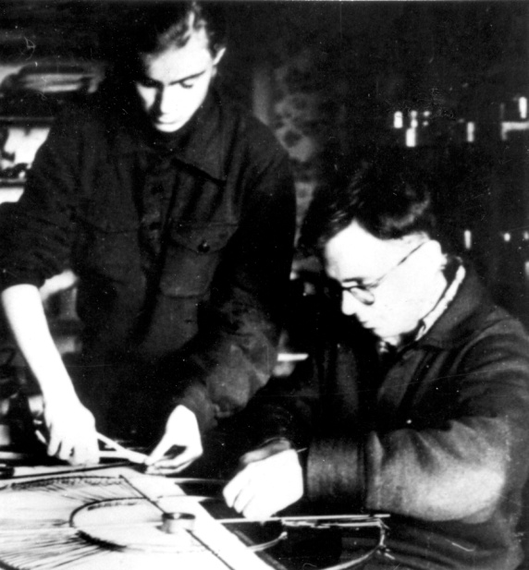
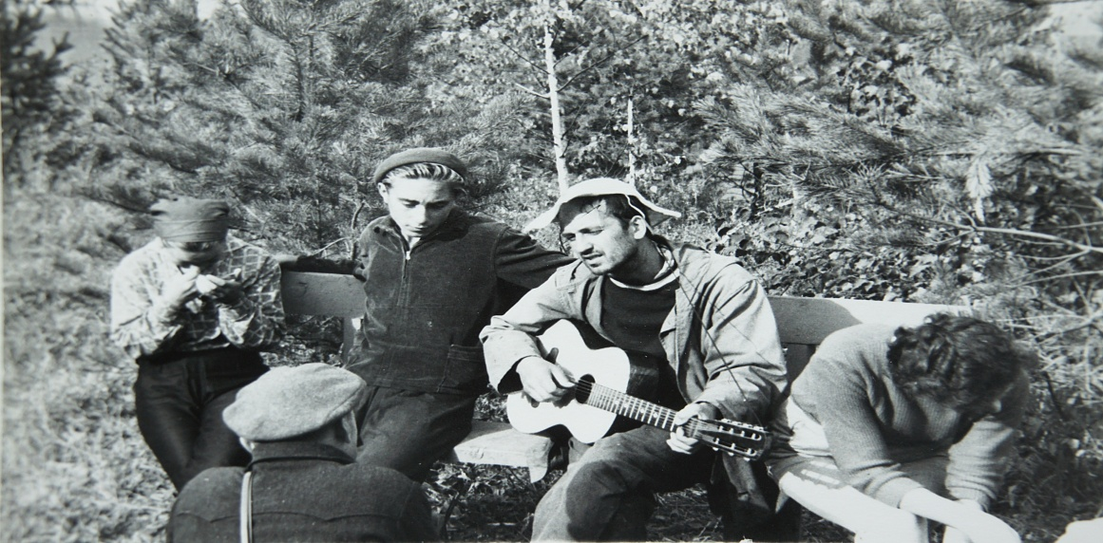
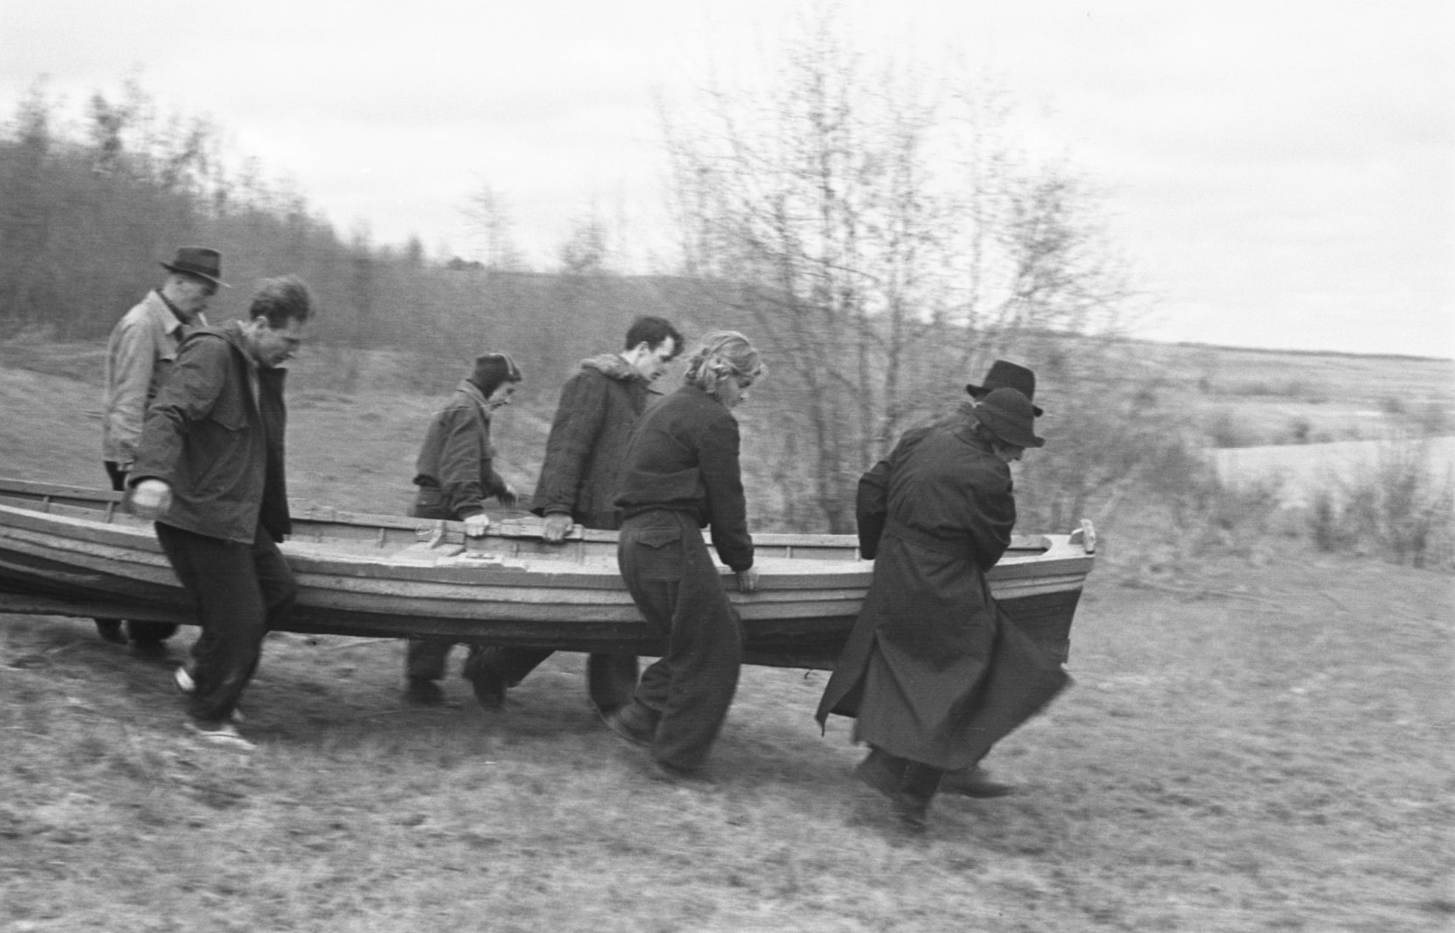
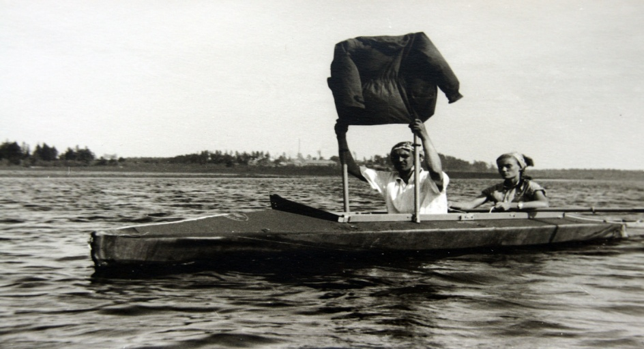

Slide 6
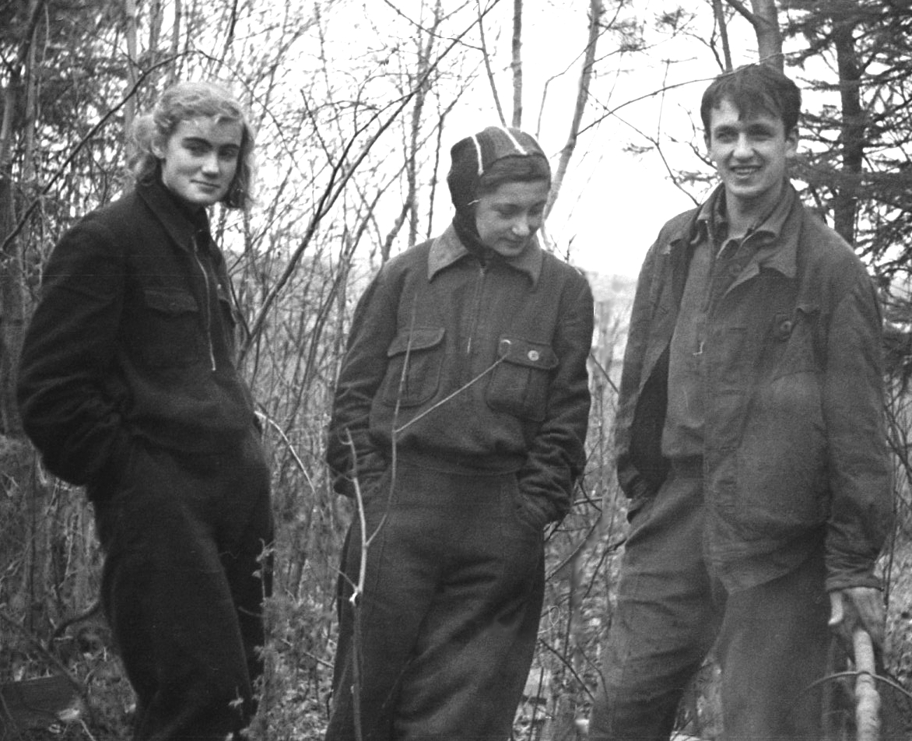

Slide 7
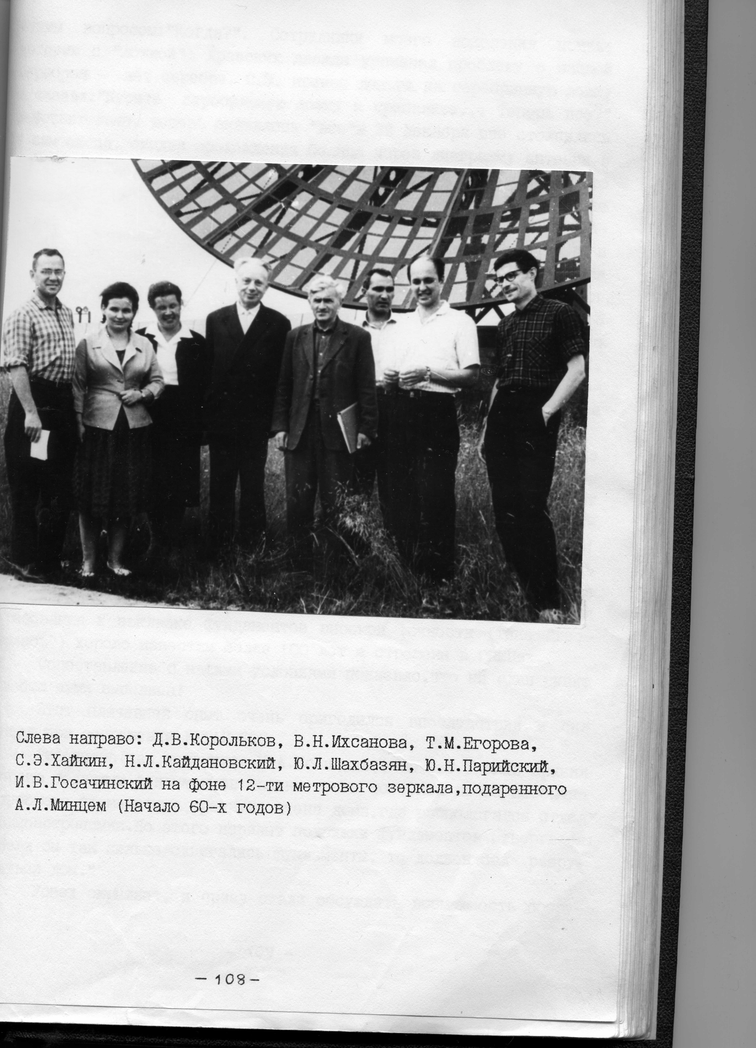

Slide 8
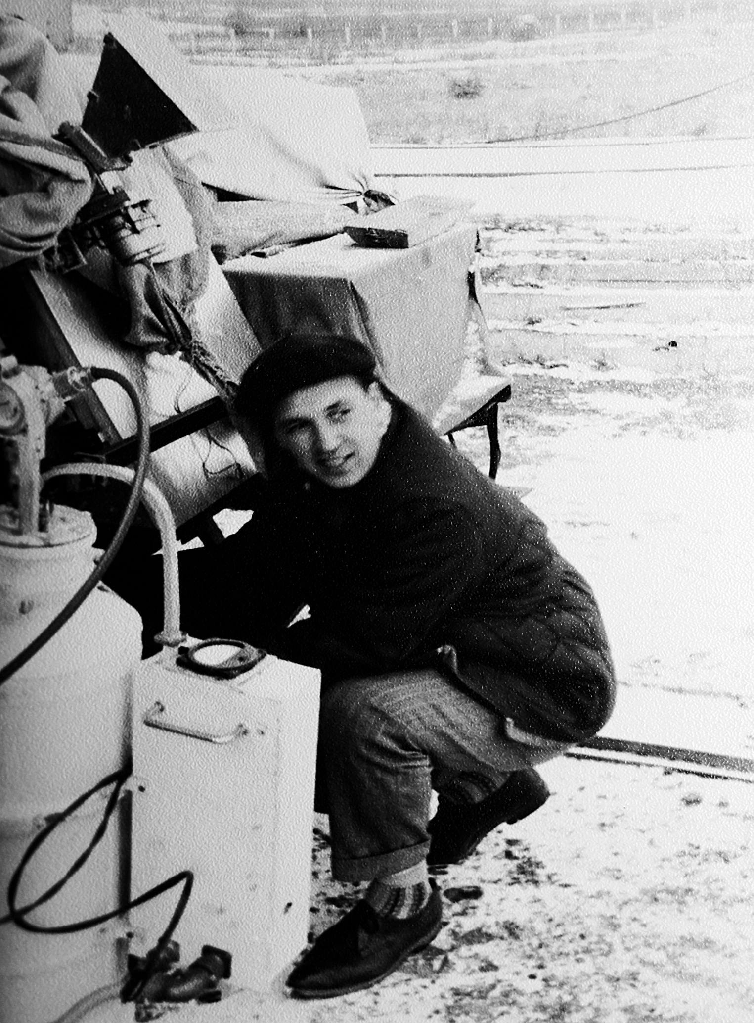

Slide 9
Ю.Н. Парийский и Н. Соболева (1963г.

Slide 10
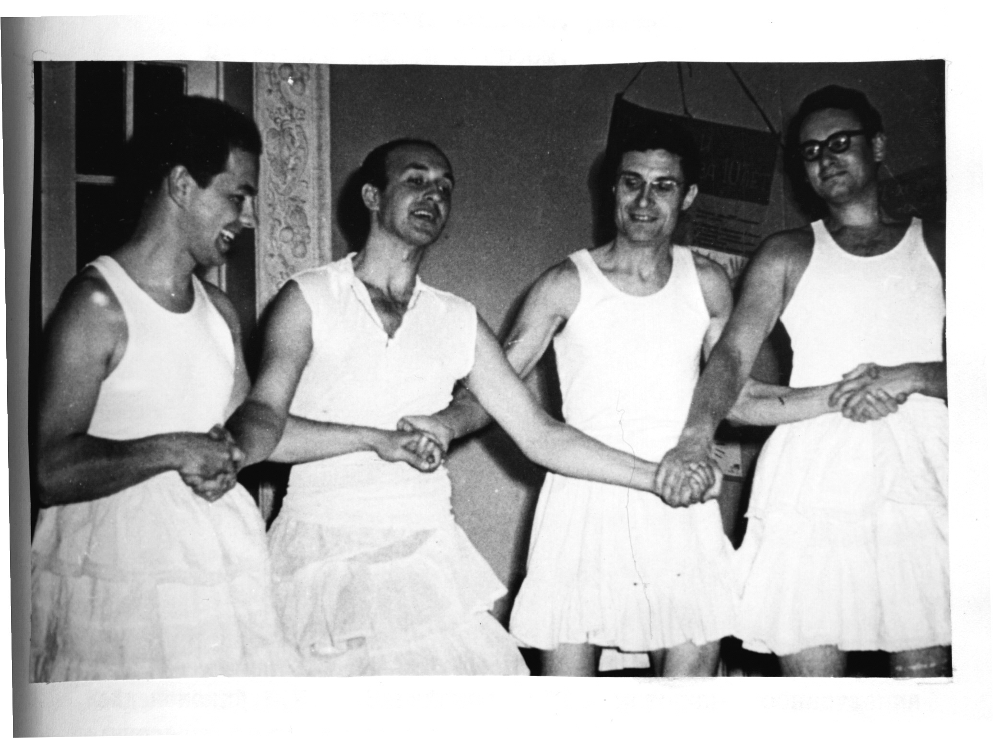
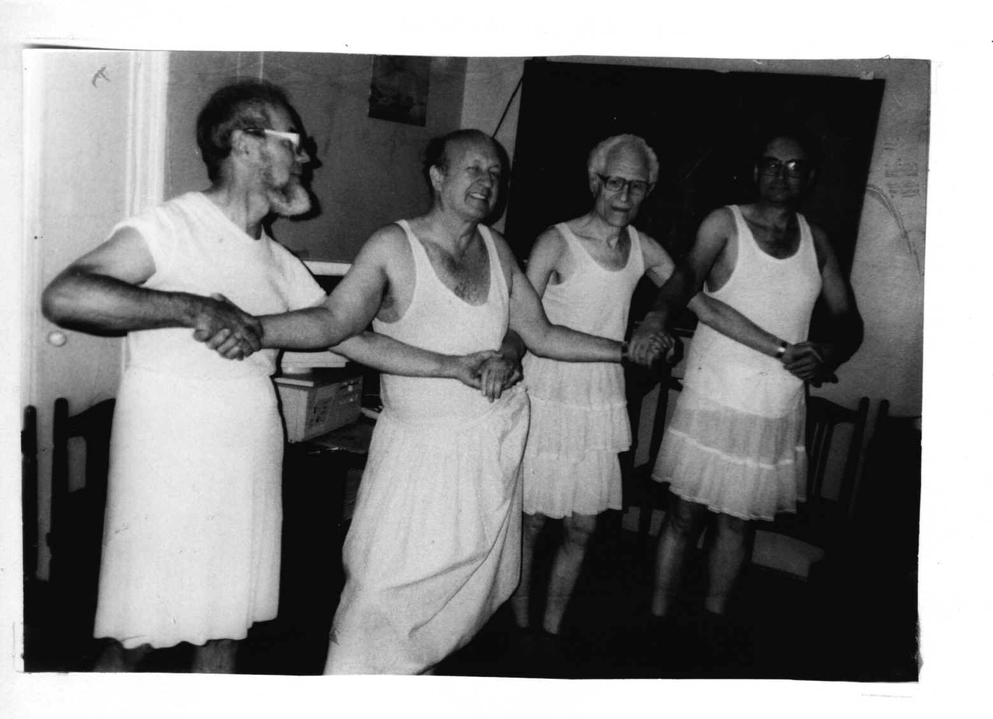
Празднование 10-летия БПР
1964г.
30 лет спустя

Slide 11
60-80гг. -Поиск методов построения больших радиотелескопов (соавтор первого межд.проекта SKA с площадью 5 км² и с разрешением 1".
Ю.Н. Парийский –активный участник проекта российской РСДБ сети( проект «Квазар КВО)
1969г. – защита докторской диссертации
1969г. -САО, ответственный ученый по РАТАН-600, (строительство и ввод в эксплуатацию которого он все время курировал)

Slide 12
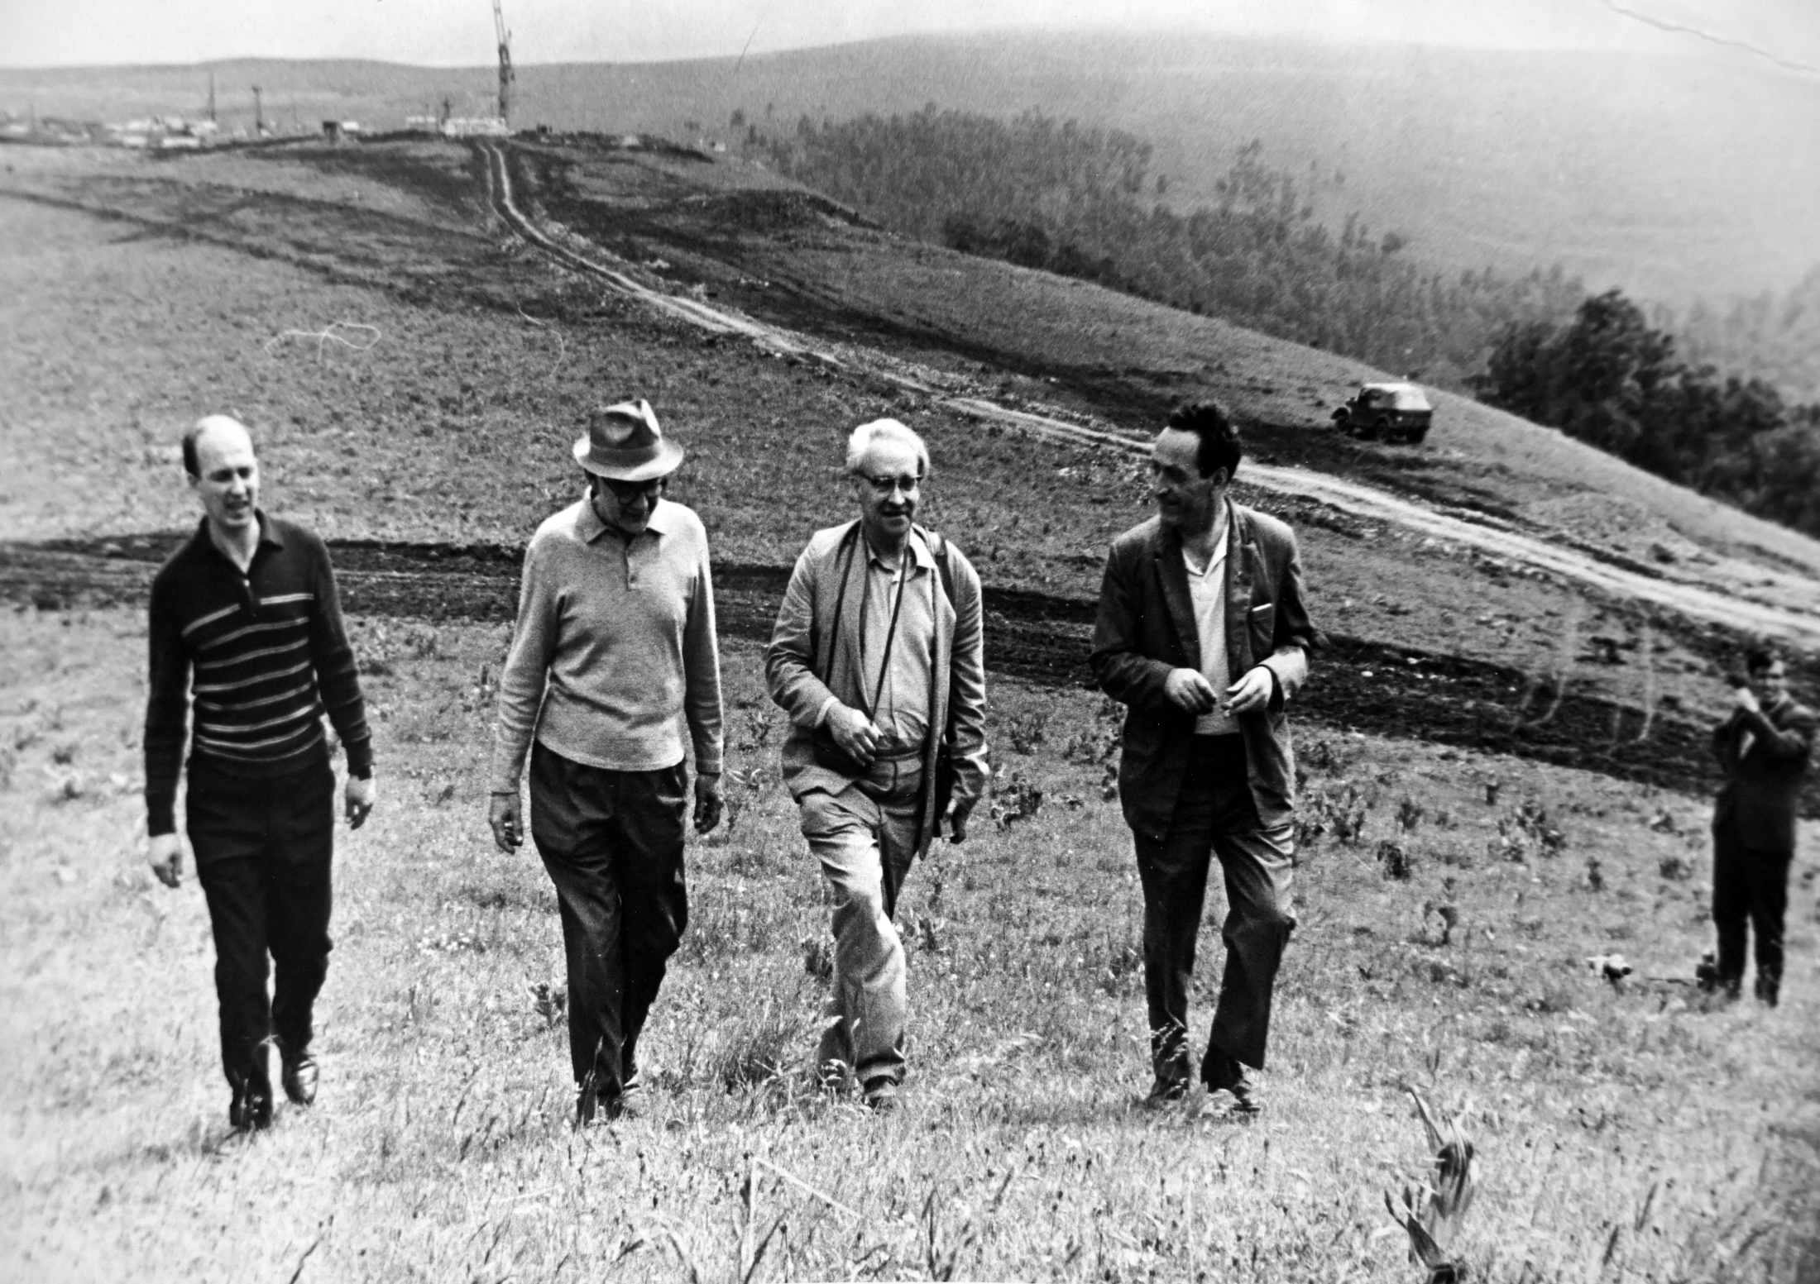

Slide 13
Начало и окончание строительства РАТАН-600

Slide 14
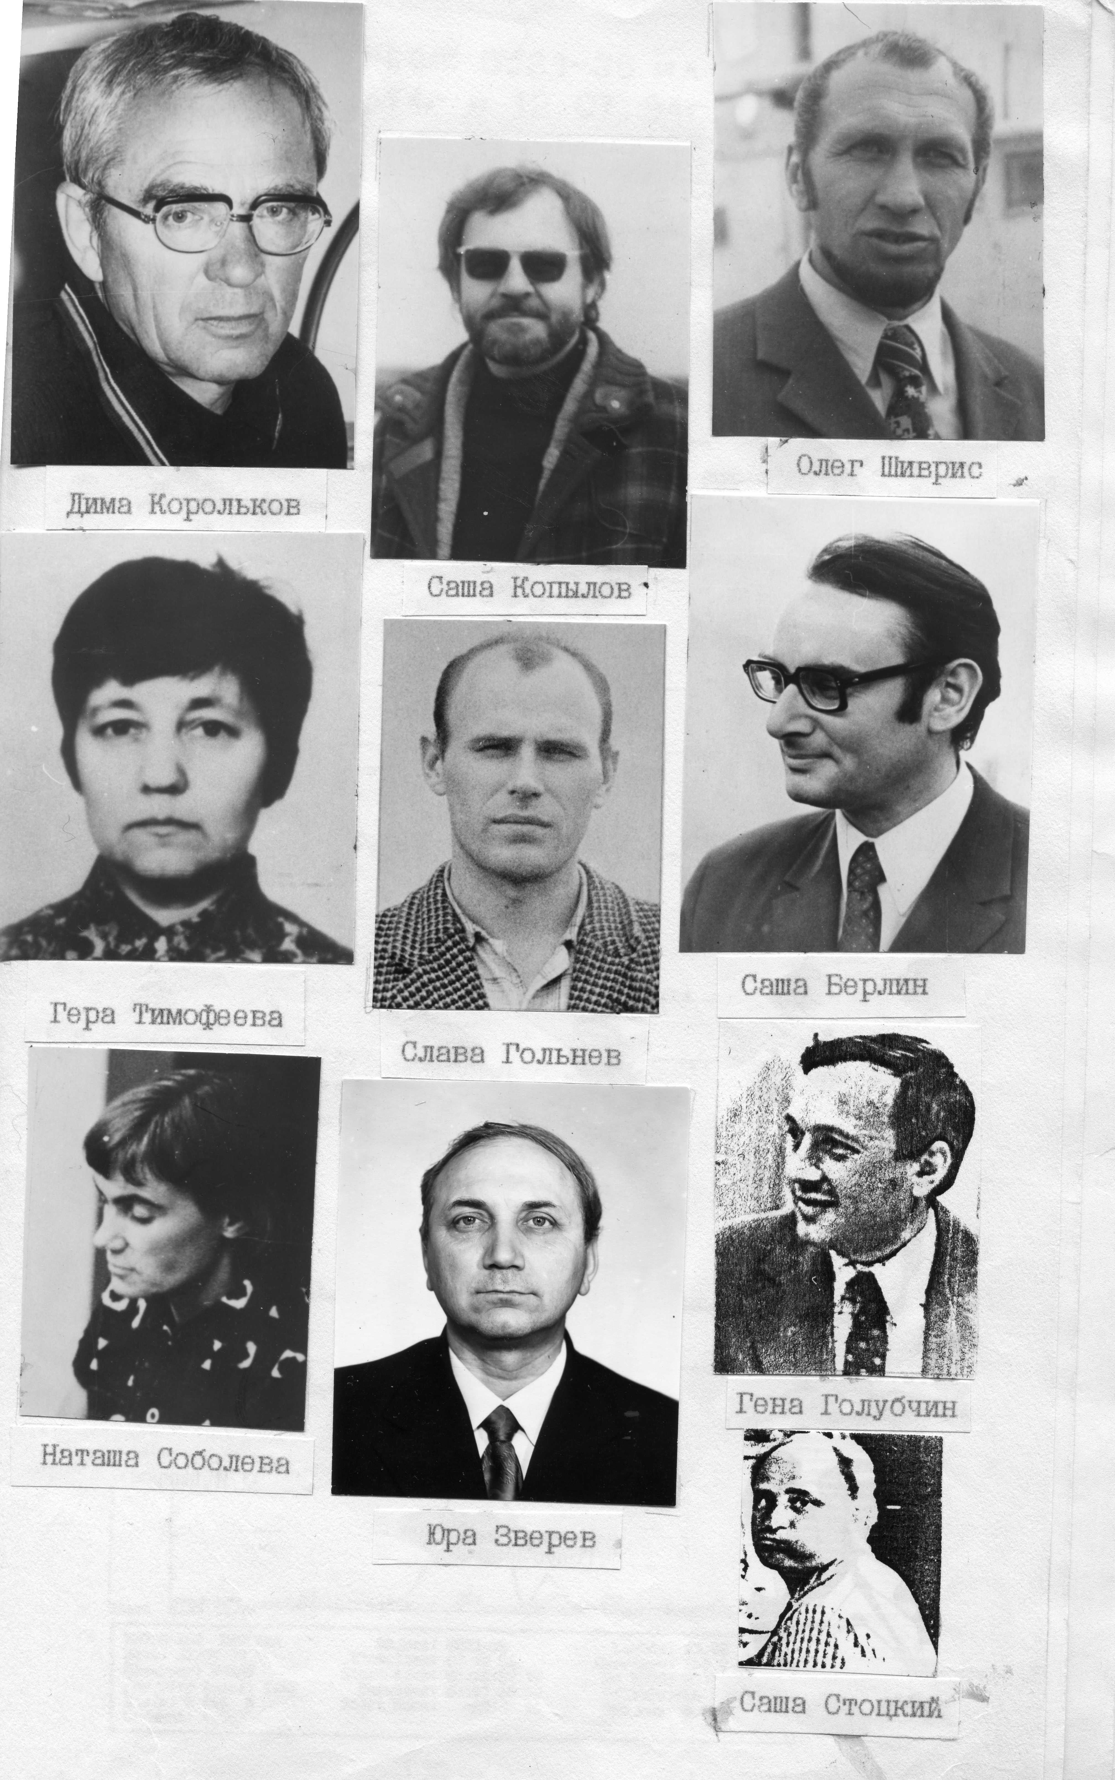
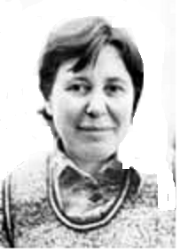

Slide 15
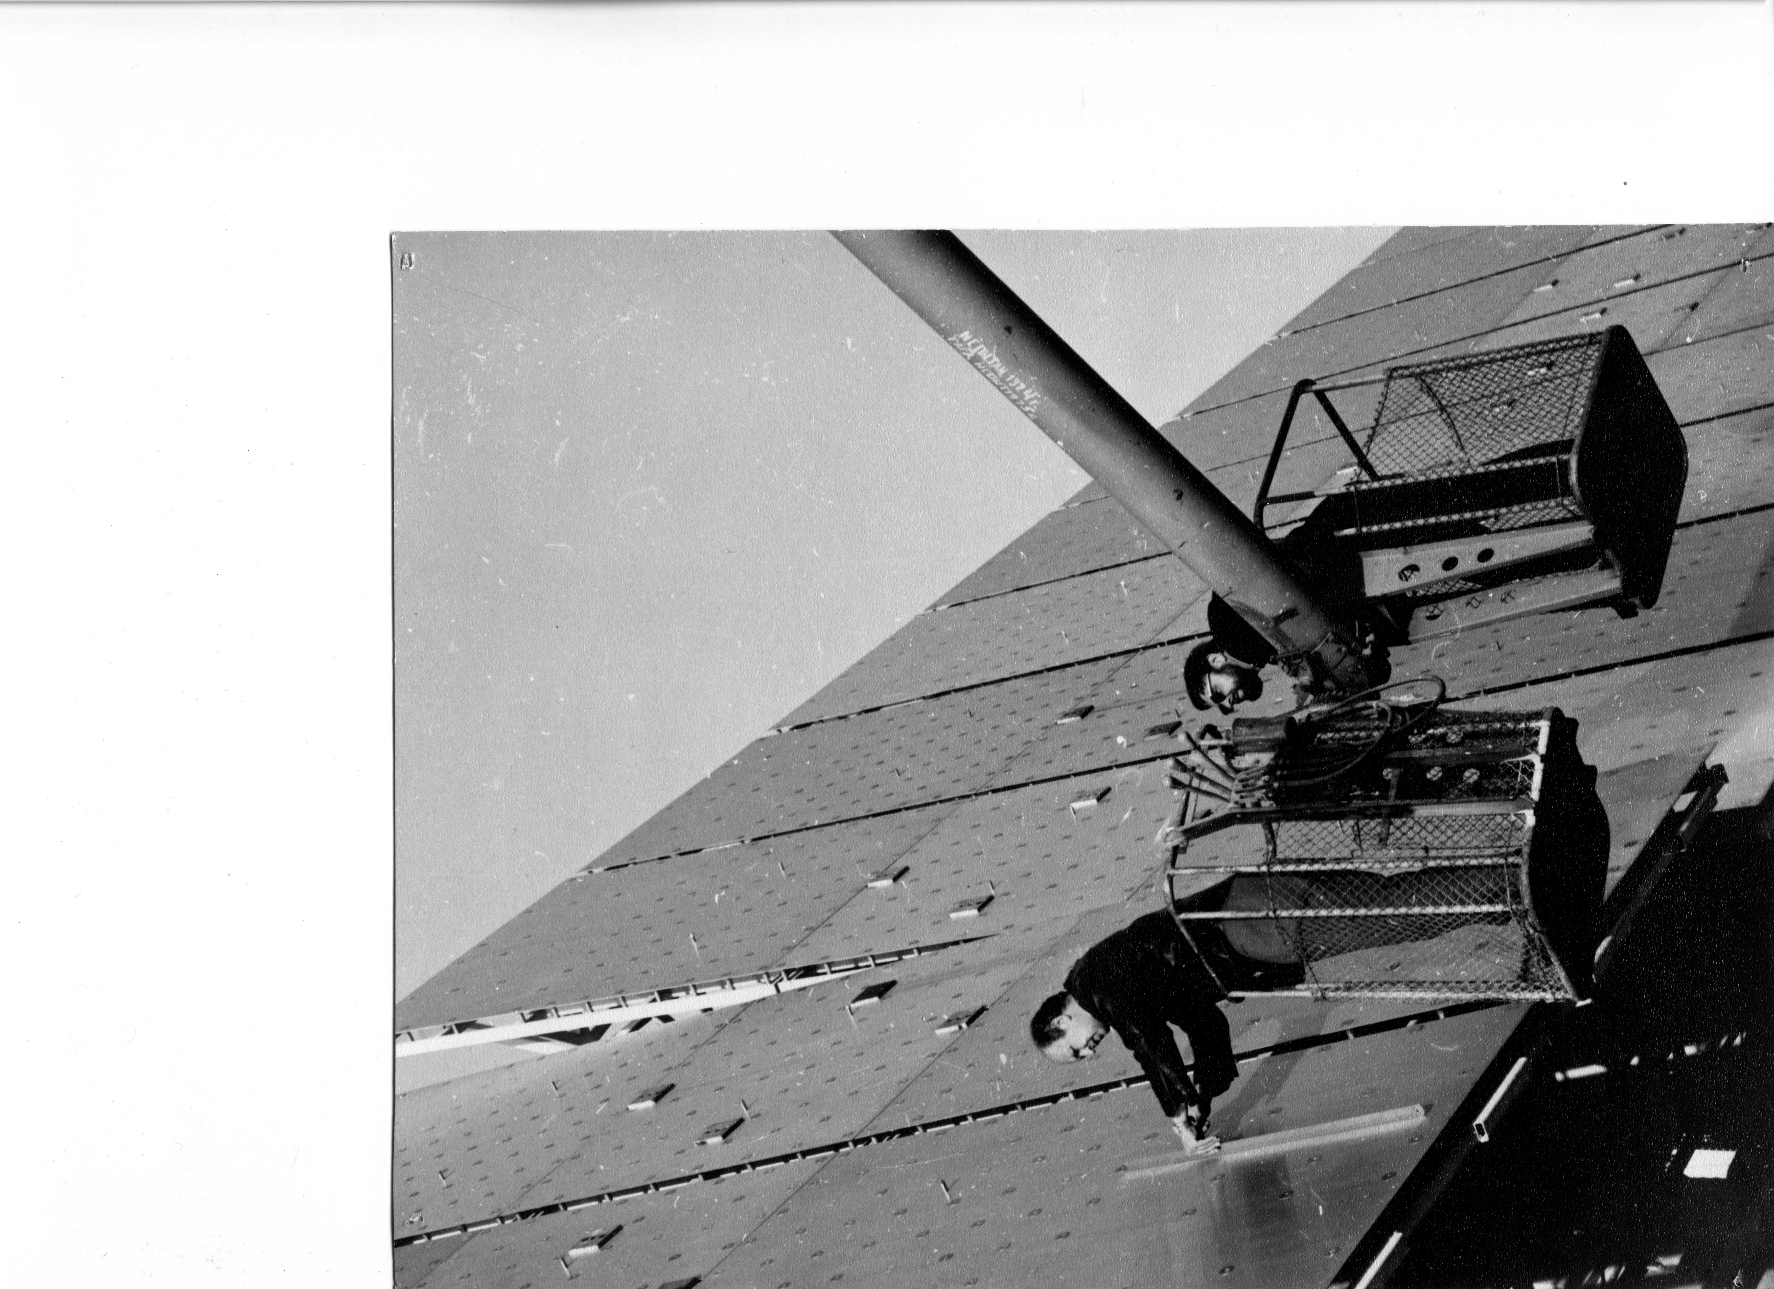
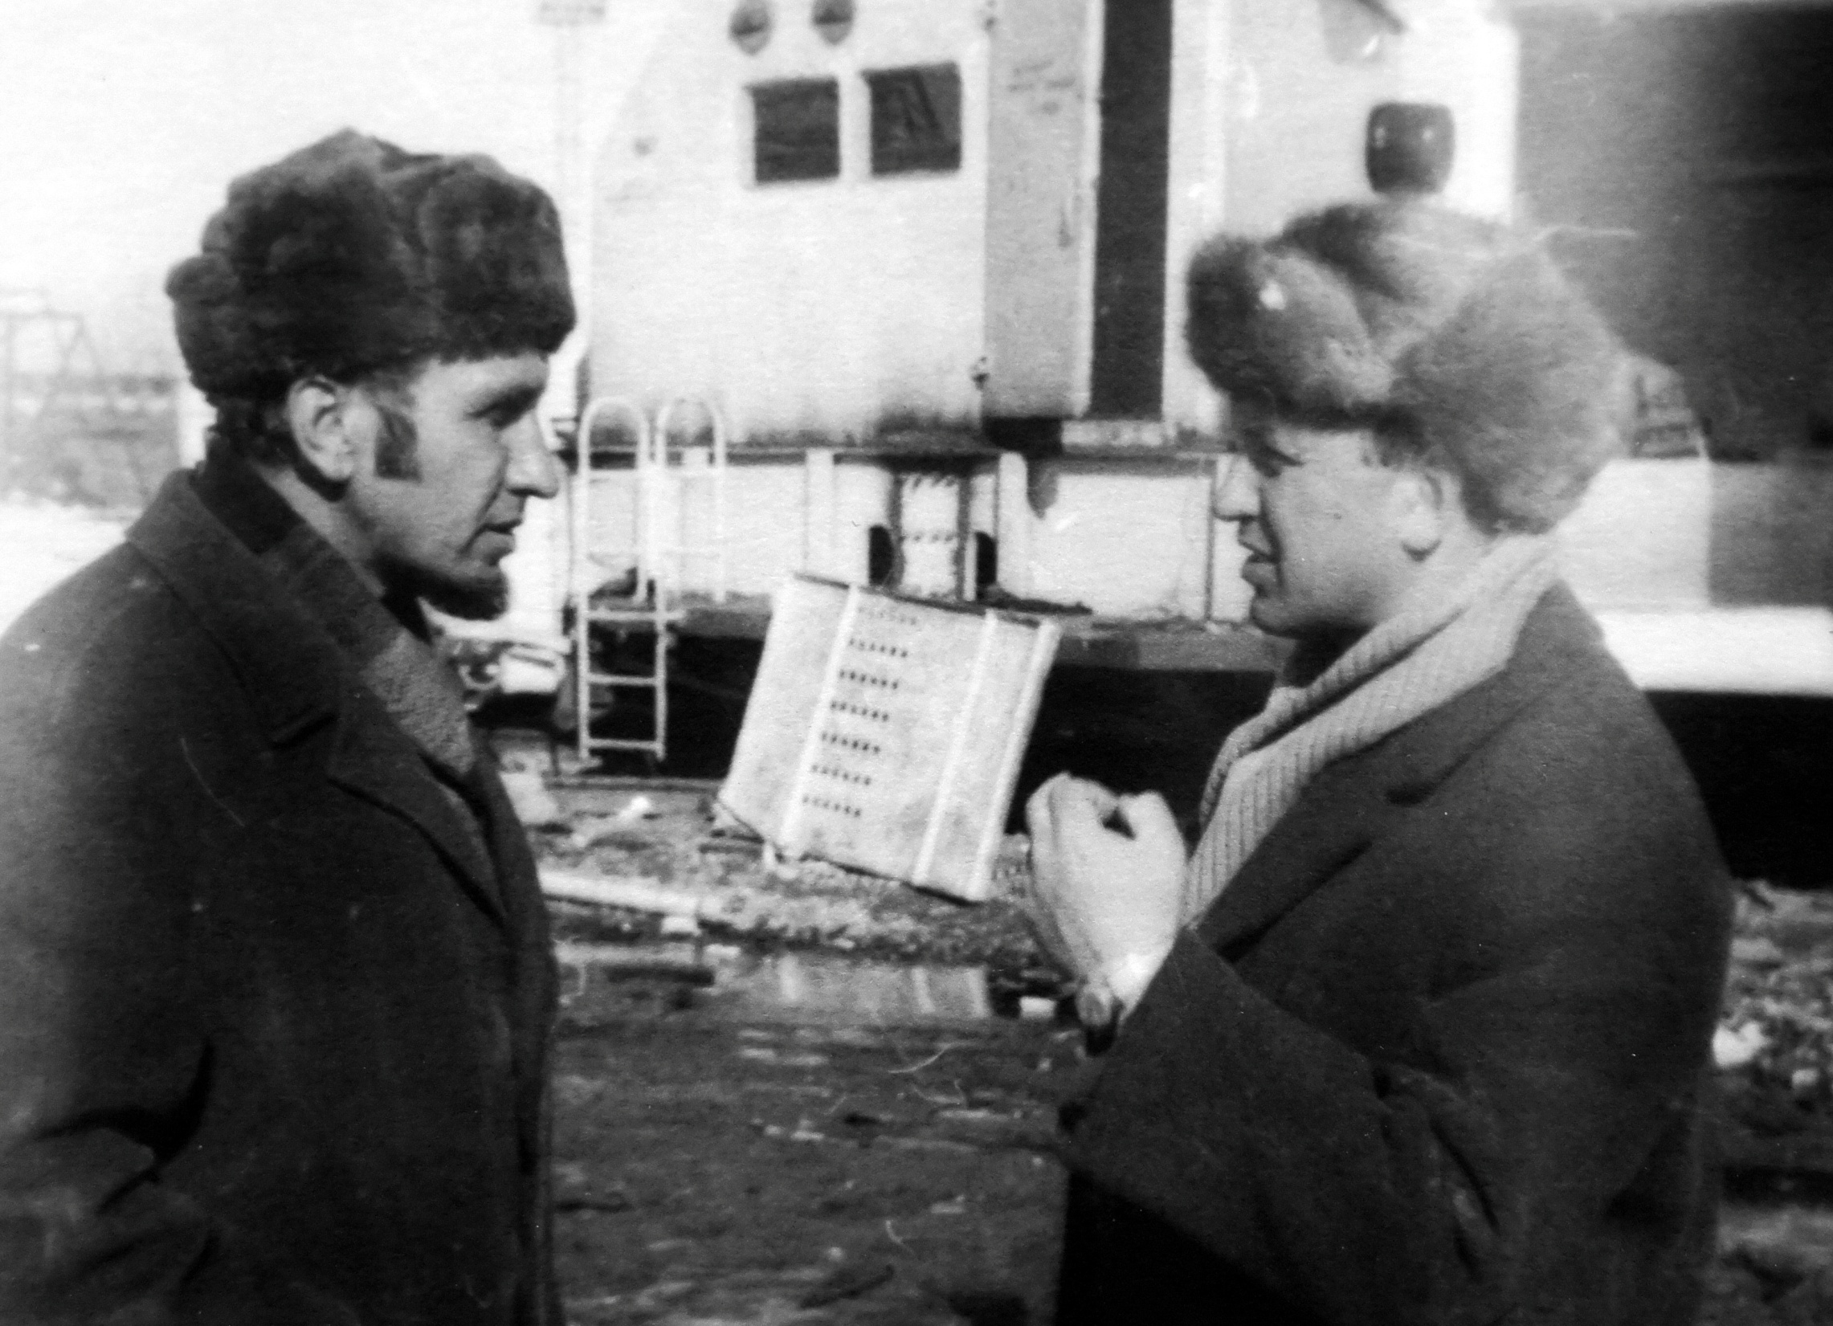

Slide 16
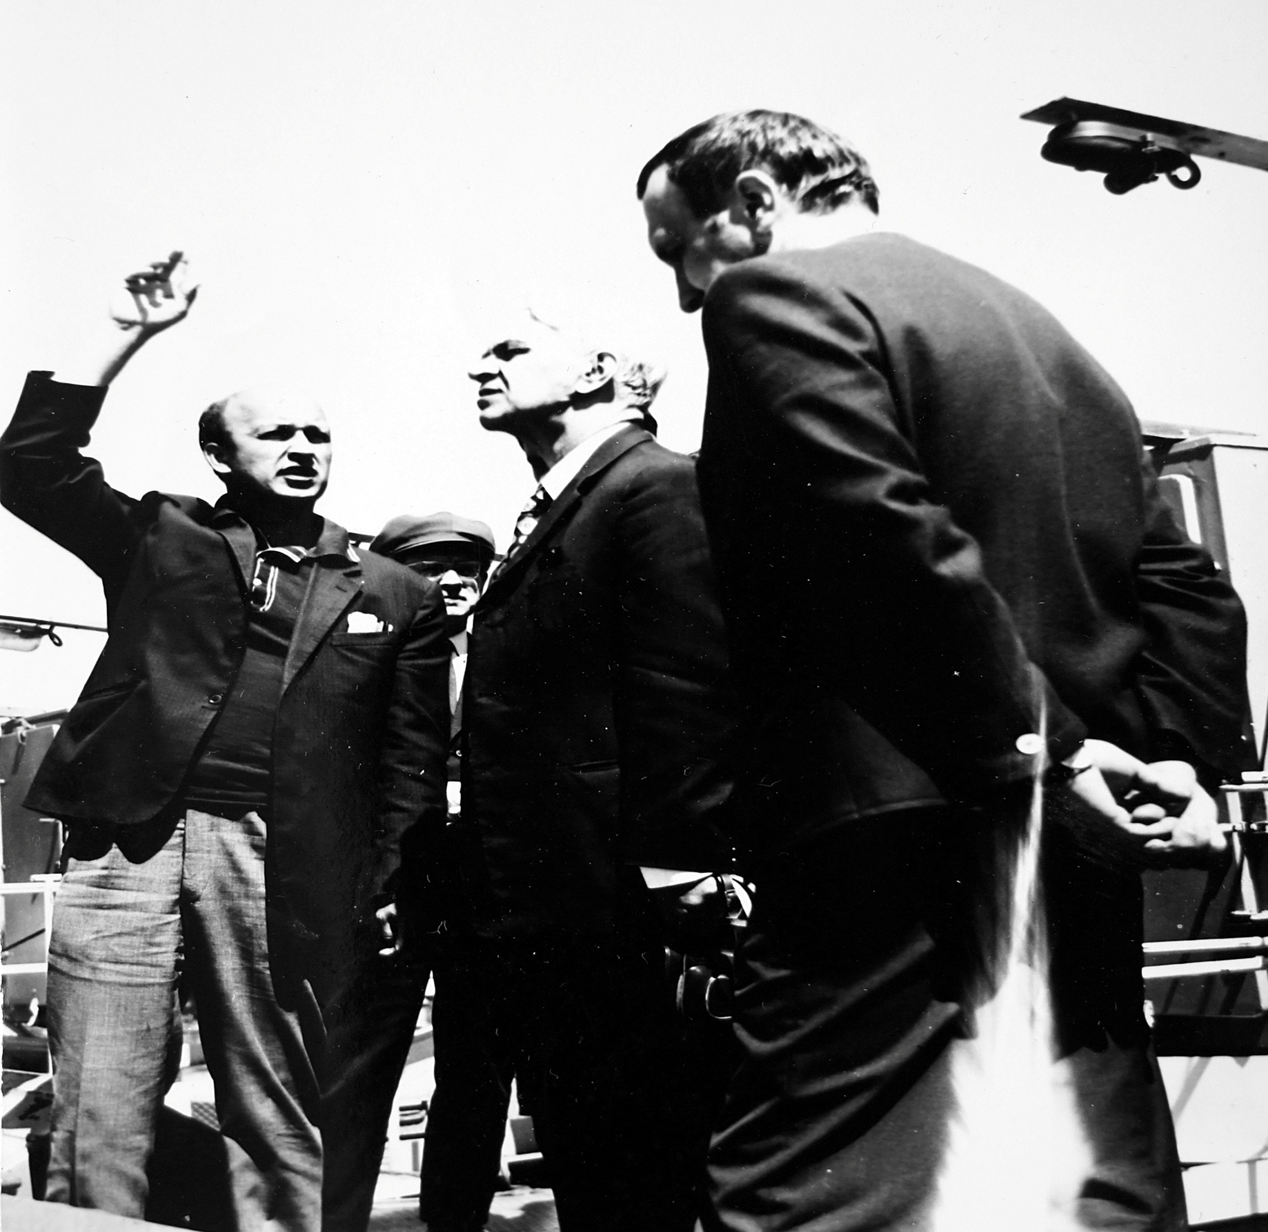

Slide 17
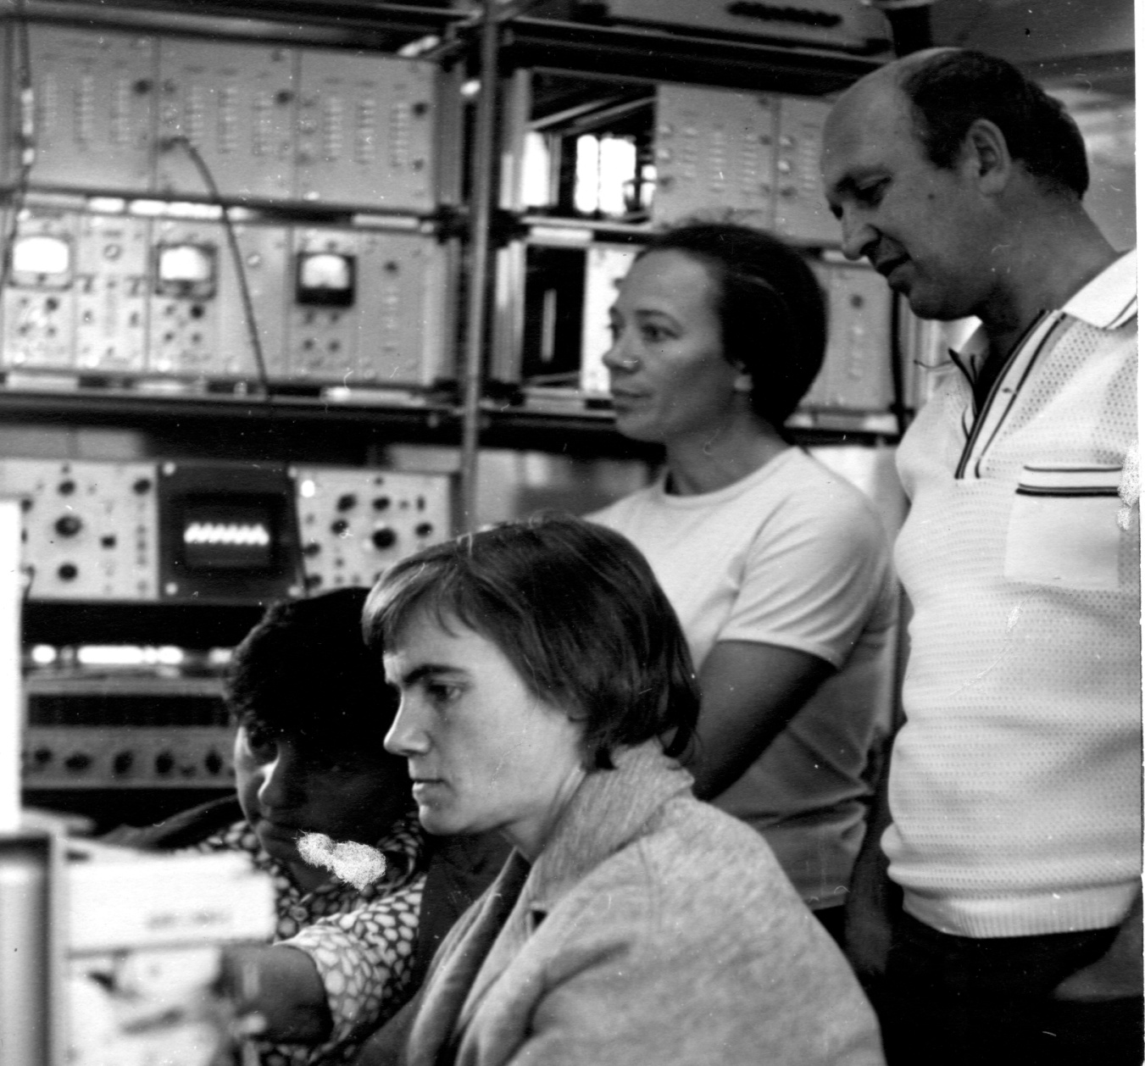
В кабине облучателя во время первого наблюдения на РАТАН-600 12.07.1974 г.

Slide 18
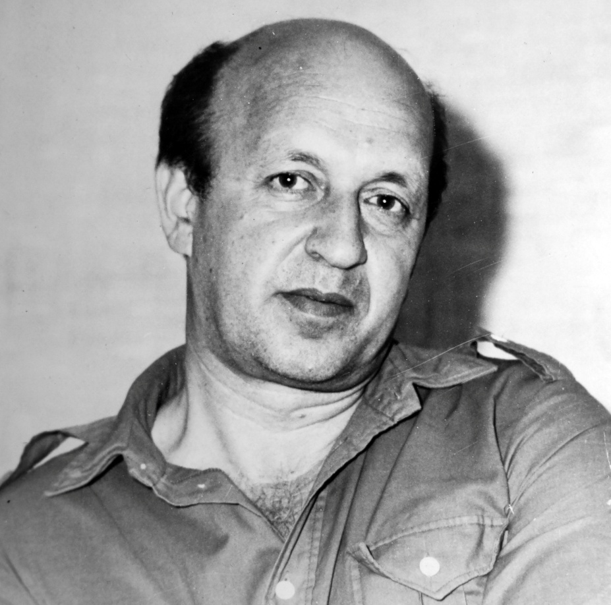
Изучение Ранней Вселенной, проект «Генетический код Вселенной (1998)
Проект «Большое Трио» (РАТАН-600,-VLA-6м телескоп САО РАН)
Обнаружение одной из самых далеких галактик
RCJ0311+0507 c z=4.514

Slide 19
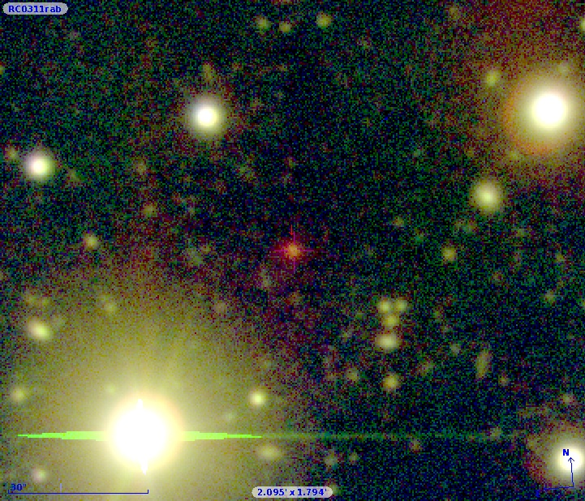
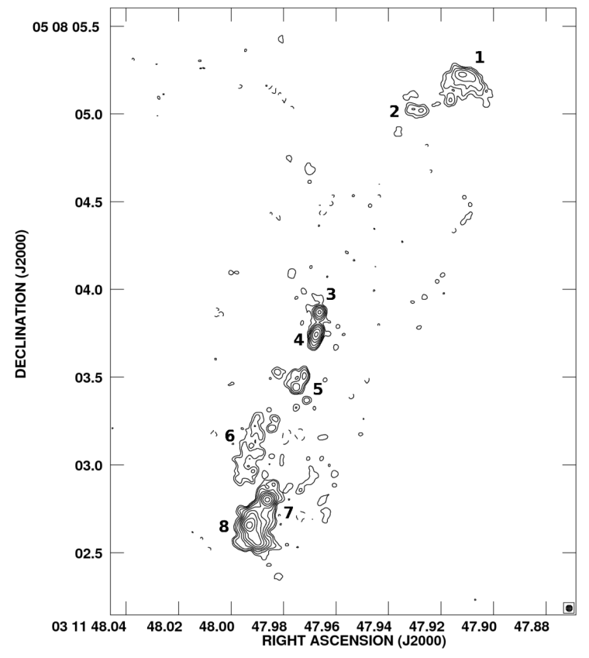
RC J0311+0507 is the most distant radio galaxy from the USS sample of the catalogue RC has firstly defined with BTA (SCORPIO) Z=4.514. It is the most powerful FR-II type radio galaxy in cm radio range. Estimated by total and core radio luminosities its SMBH has mass above 10¹⁰ M⊙.
With the best evolution model fitting (http://sed.sao.ru/cgi-bin/age_z.pl) by PEGASE (1997A&A...326..950F) for E-galaxy we estimated the stellar population age in 800 Myr on BTA (SCORPIO, 2003-2008) and new UKIRT K-band (2011) points.
The 2′x 2′ image of the sum of the R, I, SED665 bands (BTA/SCORPIO)
MERLIN + e-VLBI, 0.035″x0.035″
MERLIN + e-VLBI, 0.035″x0.035″
The 2′x 2′ image of the sum of the R, I, SED665 bands (BTA/SCORPIO)
How so massive object can form in
the first 0.5 Gyr of the Universe existing?
Notes:
RC J0311+0507 was recognized as a Ultra Steep Spectrum (known selection criteria of distant radio galaxies) radio source in the first steps of the “RATAN-VLA-BTA” project. On 2004 we obtained with the 6m telescope and SCORPIO the best-quality spectrum of the host galaxy with a total exposure time of 3600 s in long-slit observations at 1” seeing. Although Z=4.514 is considerably lower than the limiting redshifts detected to date, for galaxies, quasars and gamma-bursts RCJ0311+0507 belongs to extremely luminous radio galaxies a redshift higher than 4. Only a few such (7) galaxies are known and have been studied more or less adequately. On the slide we present sum of the best images in 3 bands. We can see near the host galaxy a few weak objects which might consider as possible sign of protocluster but to confirm this assumption need more deep images. High total and core radio luminosities suggest the presence of very massive BH if use the standard correlations (L_core_radio~M_BH^2.5). Multicomponents structure of RG is not very rear phenomena. We have to point, that in our case the radio luminosity of each sub-components comparable with the luminosities of the main bubbles luminosity for the most powerful FRII RG.
The age of the Universe at z=4.515 is 1.1 Gyr only. If we suggest the standard epoch of galaxies formation about redshift 7-10, less than 0.5 Gyr available for the formation of the object with extremely high radio luminosity, as RCJ0311+0507. The quick growth of BH mass by merging only is under question yet, and it was suggested, that instead of early simple evolution from several solar masses to 10^10 M_sun in the less than 1 Gyr time scale looks very improbable. To escape from the time deficit, primordial black holes were suggested (with at least 10^3 -10^5 M_sun) or Black Holes which seem to be are growing faster as Treister et al. reported in Nature Vol. 474, P. 356 (2011). They measured of the amount of black hole growth in galaxies at redshift z = 6–8 (0.95–0.7 billion years after the Big Bang), based on optimally stacked, archival X-ray observations. They find that most copiously accreting black holes at these epochs are buried in significant amounts of gas and dust that absorb most radiation except for the highest-energy X-rays. This suggests that black holes grew significantly more during these early bursts than was previously thought, but because of the obscuration of their ultraviolet emission they did not contribute to the re-ionization of the Universe.

Slide 20
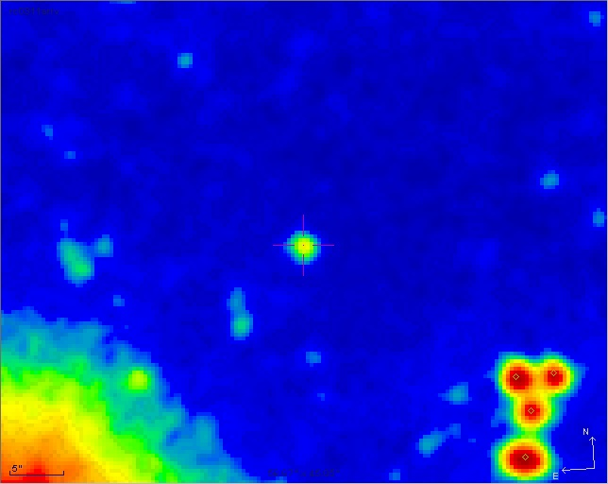
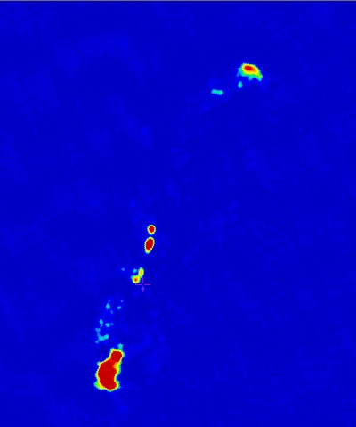
RC J0311+0507 is the most distant radio galaxy from the USS sample of the catalogue RC has Z=4.514 firstly defined with BTA (SCORPIO). It is the most powerful FR-II type radio galaxy in cm radio range. Estimated by total and core radio luminosities its SMBH has mass above 10¹⁰ M⊙.
With the best evolution model fitting (http://sed.sao.ru/cgi-bin/age_z.pl) by PEGASE (1997A&A...326..950F) for E-galaxy we estimated the stellar population age in 800 Myr on BTA (SCORPIO, 2003-2008) and new UKIRT K-band (2011) points.
The sum of the R, I, SED665 band images (BTA/SCORPIO)
MERLIN + e-VLBI, 0.035″x0.035″
How so massive object can form in
the first 0.5 Gyr of the Universe existing?
Notes:
RC J0311+0507 was recognized as a Ultra Steep Spectrum (known selection criteria of distant radio galaxies) radio source in the first steps of the “RATAN-VLA-BTA” project. On 2004 we obtained with the 6m telescope and SCORPIO the best-quality spectrum of the host galaxy with a total exposure time of 3600 s in long-slit observations at 1” seeing. Although Z=4.514 is considerably lower than the limiting redshifts detected to date, for galaxies, quasars and gamma-bursts RCJ0311+0507 belongs to extremely luminous radio galaxies a redshift higher than 4. Only a few such (7) galaxies are known and have been studied more or less adequately. On the slide we present sum of the best images in 3 bands. We can see near the host galaxy a few weak objects which might consider as possible sign of protocluster but to confirm this assumption need more deep images. High total and core radio luminosities suggest the presence of very massive BH if use the standard correlations (L_core_radio~M_BH^2.5). Multicomponents structure of RG is not very rear phenomena. We have to point, that in our case the radio luminosity of each sub-components comparable with the luminosities of the main bubbles luminosity for the most powerful FRII RG.
The age of the Universe at z=4.515 is 1.1 Gyr only. If we suggest the standard epoch of galaxies formation about redshift 7-10, less than 0.5 Gyr available for the formation of the object with extremely high radio luminosity, as RCJ0311+0507. The quick growth of BH mass by merging only is under question yet, and it was suggested, that instead of early simple evolution from several solar masses to 10^10 M_sun in the less than 1 Gyr time scale looks very improbable. To escape from the time deficit, primordial black holes were suggested (with at least 10^3 -10^5 M_sun) or Black Holes which seem to be are growing faster as Treister et al. reported in Nature Vol. 474, P. 356 (2011). They measured of the amount of black hole growth in galaxies at redshift z = 6–8 (0.95–0.7 billion years after the Big Bang), based on optimally stacked, archival X-ray observations. They find that most copiously accreting black holes at these epochs are buried in significant amounts of gas and dust that absorb most radiation except for the highest-energy X-rays. This suggests that black holes grew significantly more during these early bursts than was previously thought, but because of the obscuration of their ultraviolet emission they did not contribute to the re-ionization of the Universe.

Slide 21
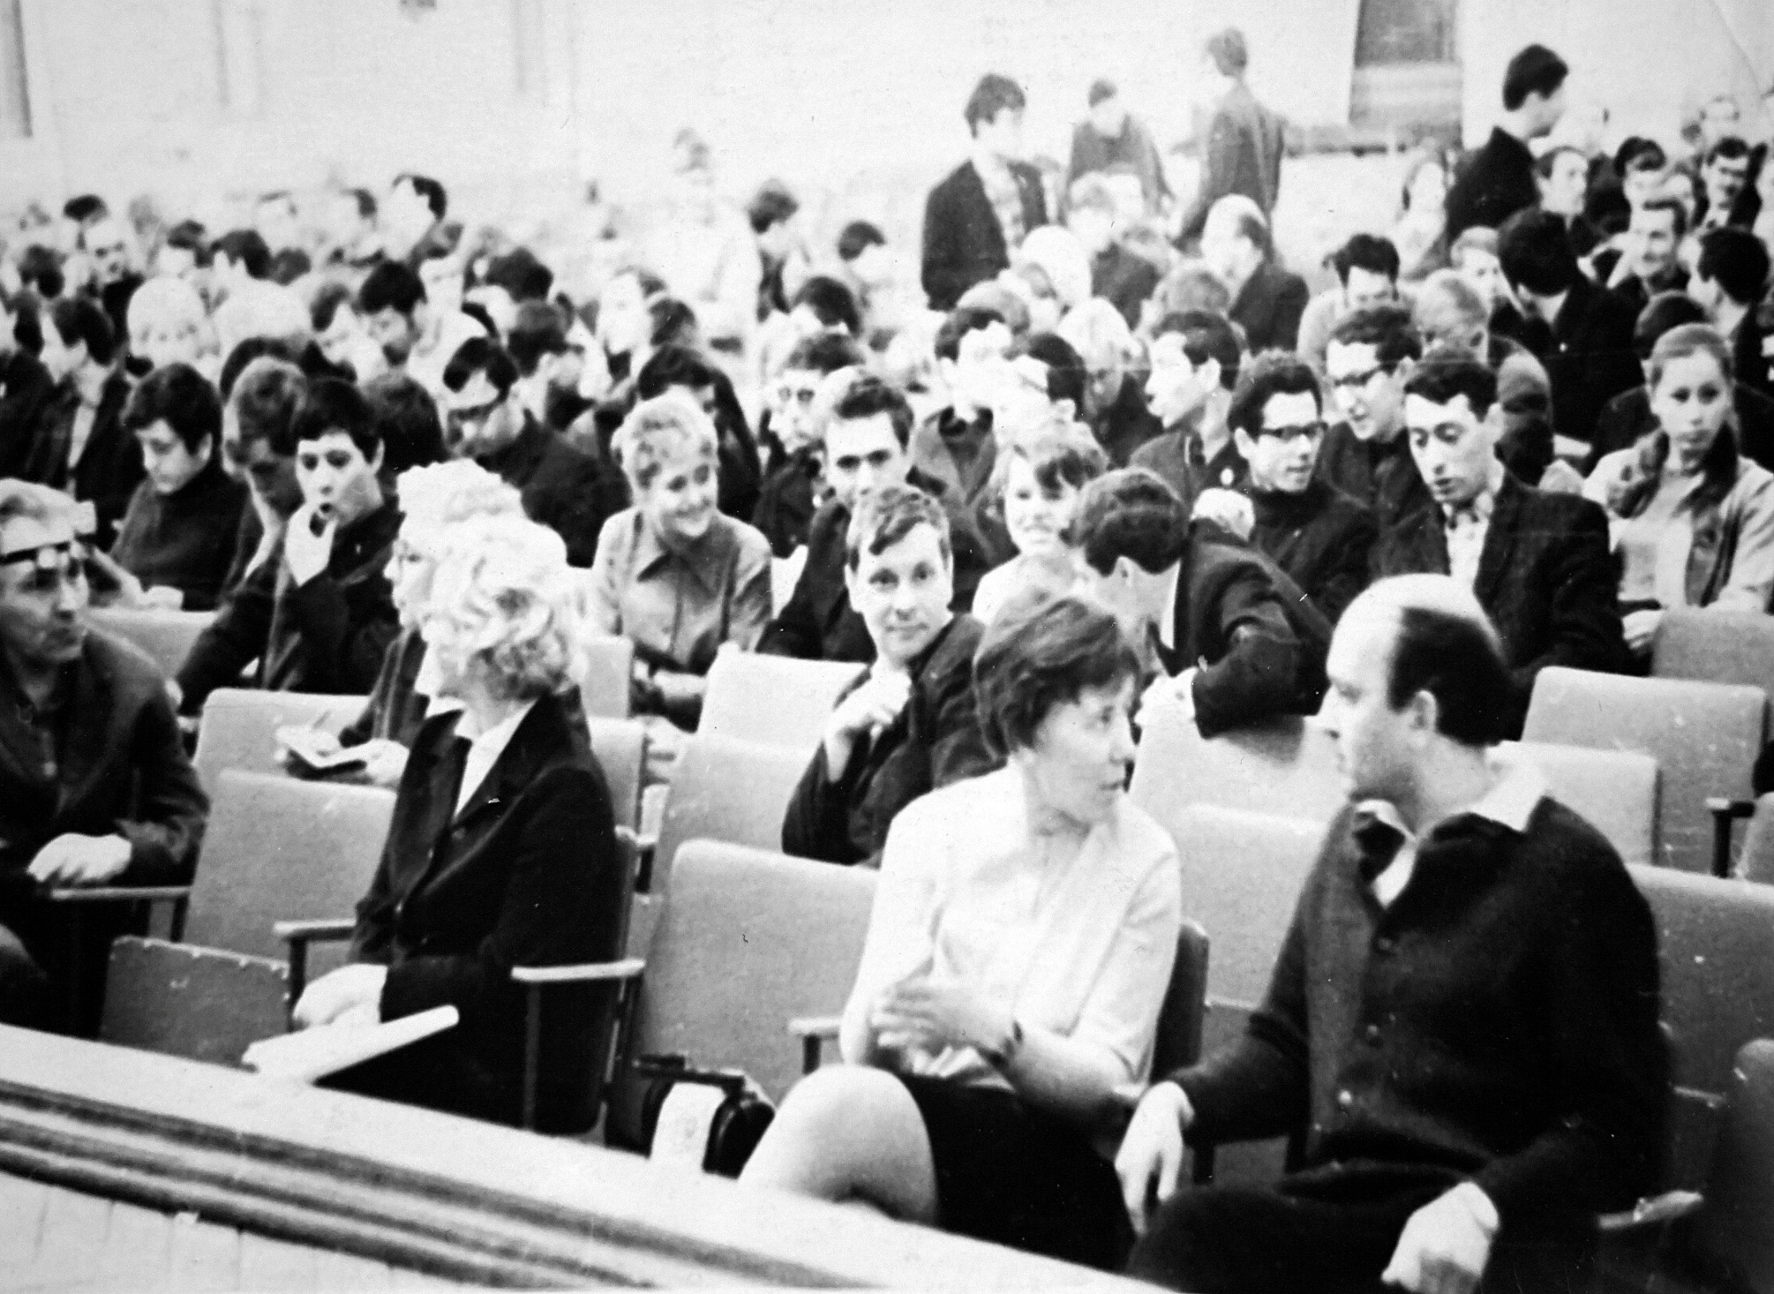

Slide 22
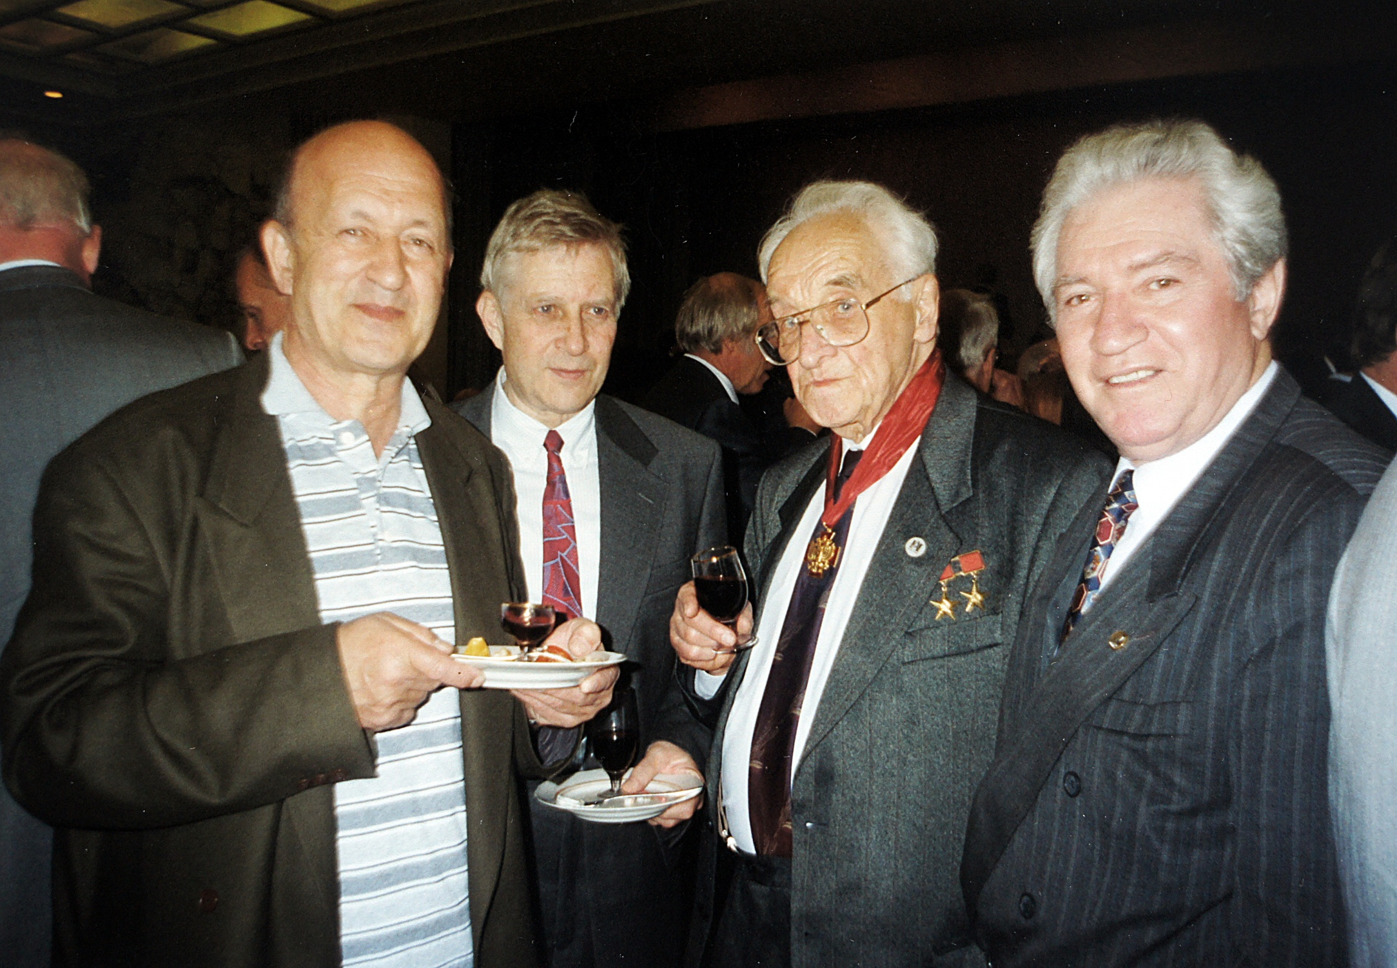

Slide 23
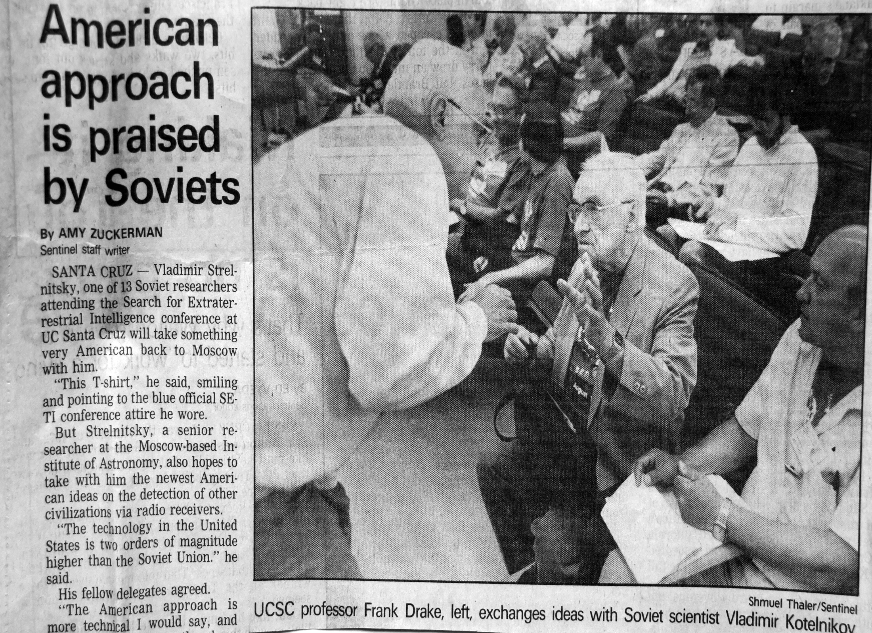

Slide 24
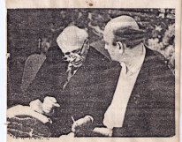
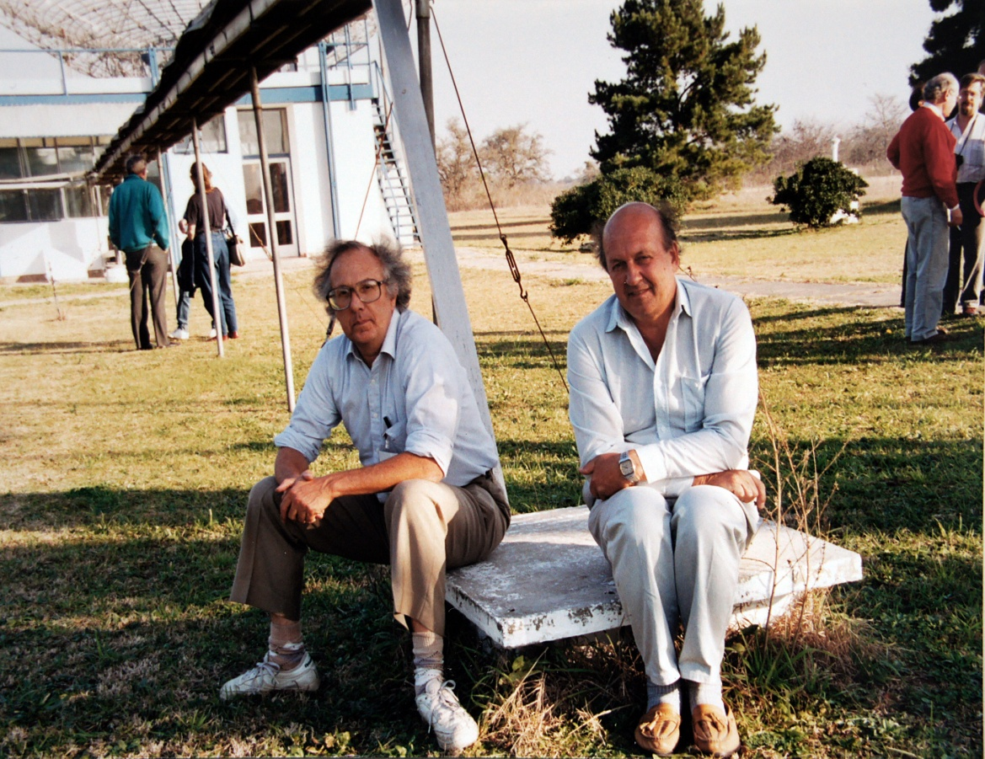
Обсуждение проблем космологии

Slide 27
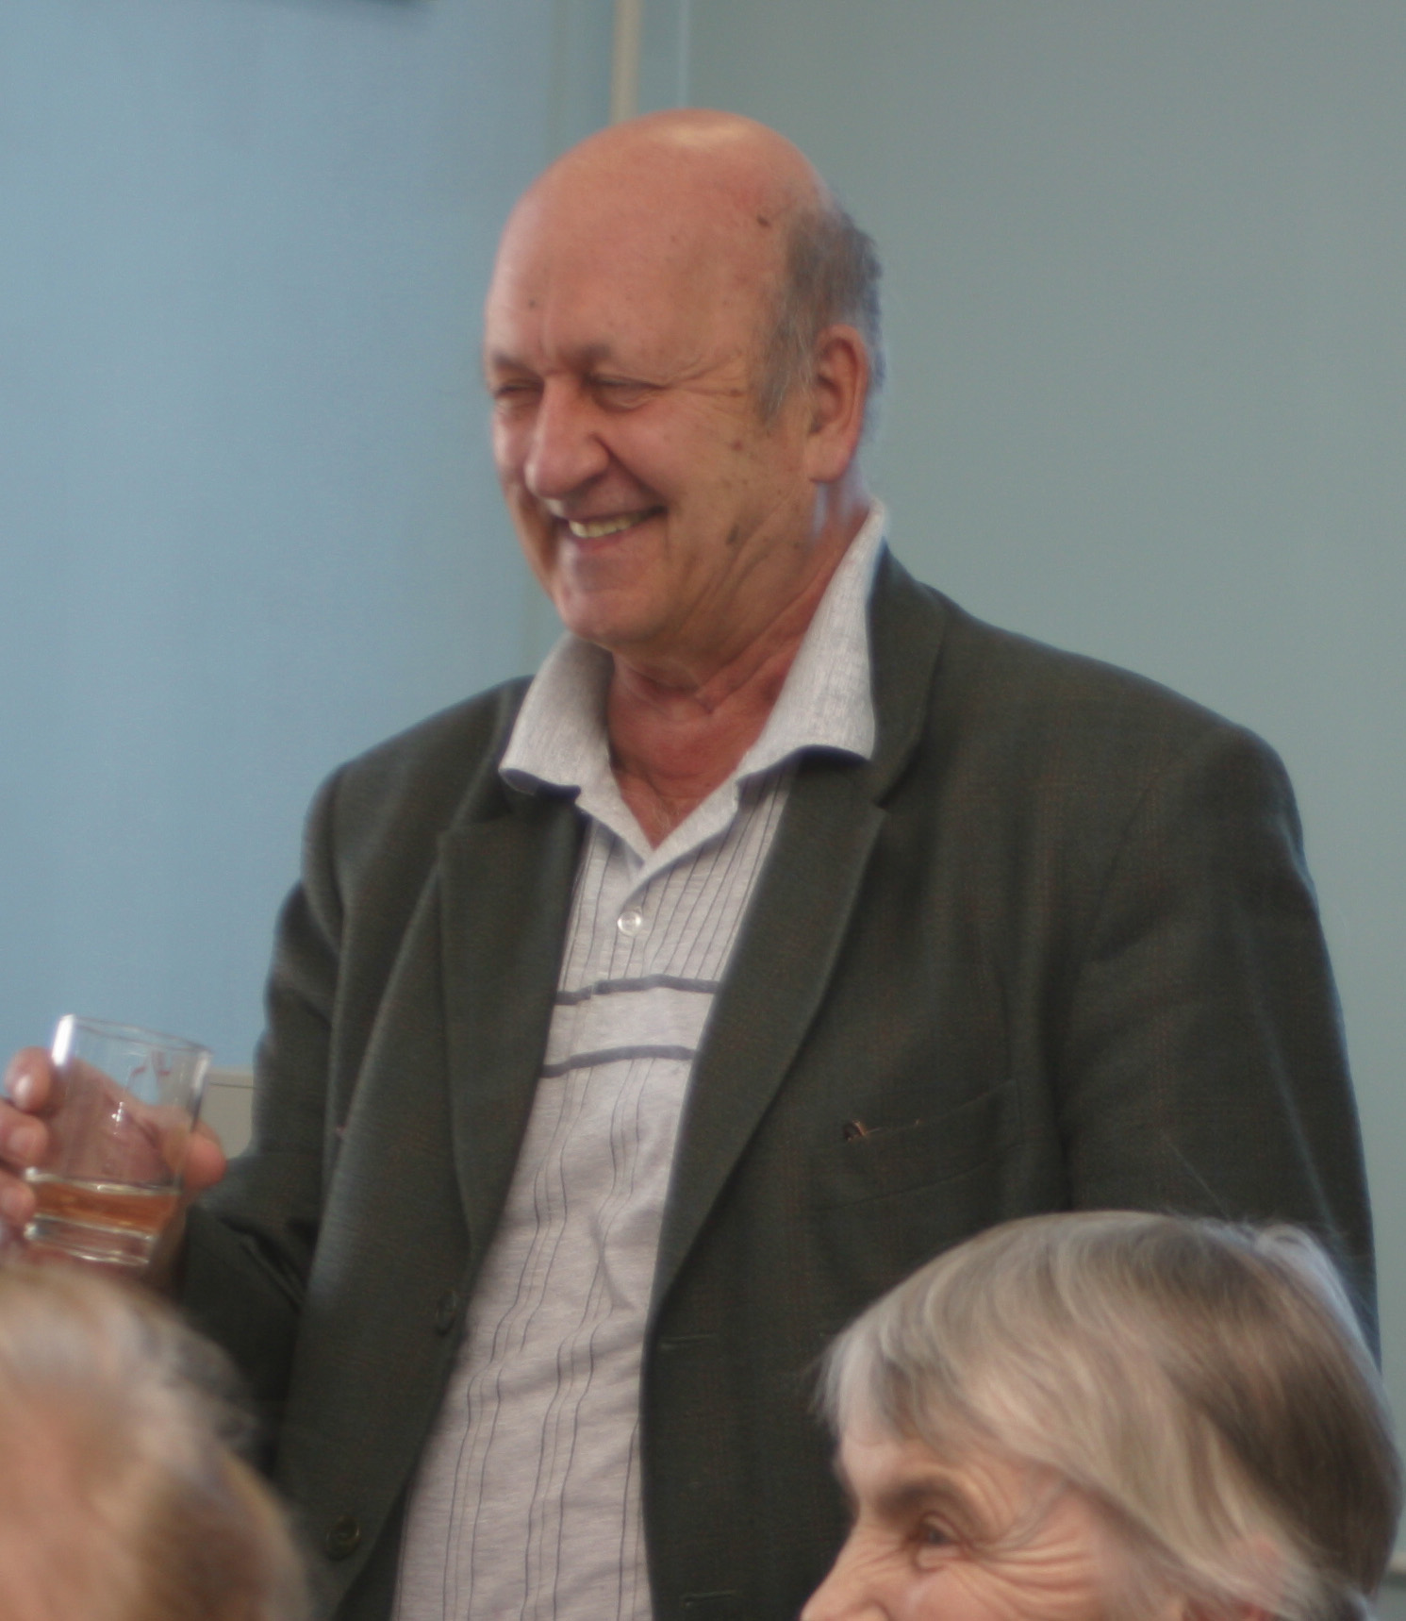

Slide 28
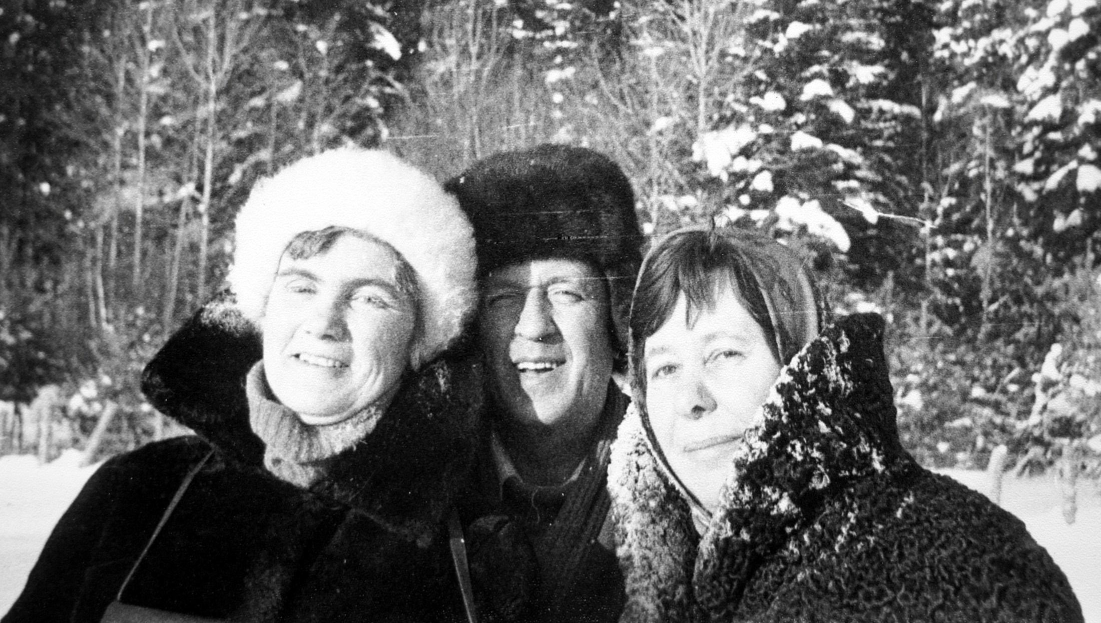

Slide 30
Сначала жил отдел за сценой… Здесь был Рыжков неутомимый И Корольков непогрешимый, И Копылов неуловимый Здесь был Шмаонов – ум и лень И Кайдановский – Шефа тень. Здесь был Апушкинский, узревший Весь мир в приемнике своем, Здесь был Парийский , все забывший, «Костер» в Галактике открывший. И как устроено на свете Здесь появились также дети.

Slide 33
Желаем Юрию Николаевичу здоровья и творческого долголетия!:

