Slide 1
Первые результаты определения всемирного времени по наблюдениям двухэлементного радиоинтерферометра нового поколения
Иванов Д.В., Ипатов А.В., Ильин Г.Н., Смоленцев С.Г., Гаязов И.С., Мардышкин В.В., Федотов Л.В., Стэмпковский В.Г., Вытнов А.В., Сальников А.И., Суркис И.Ф., Михайлов А.Г., Маршалов Д.А., Курдубов С.Л., Мельников А.Е., Безруков И.А., Носов Е.В., Кен В.О.
ИПА РАН
VIII МЕЖДУНАРОДНЫЙ СИМПОЗИУМ
"МЕТРОЛОГИЯ ВРЕМЕНИ И ПРОСТРАНСТВА"
14-16 сентября 2016 г.
Санкт-Петербург

Slide 2
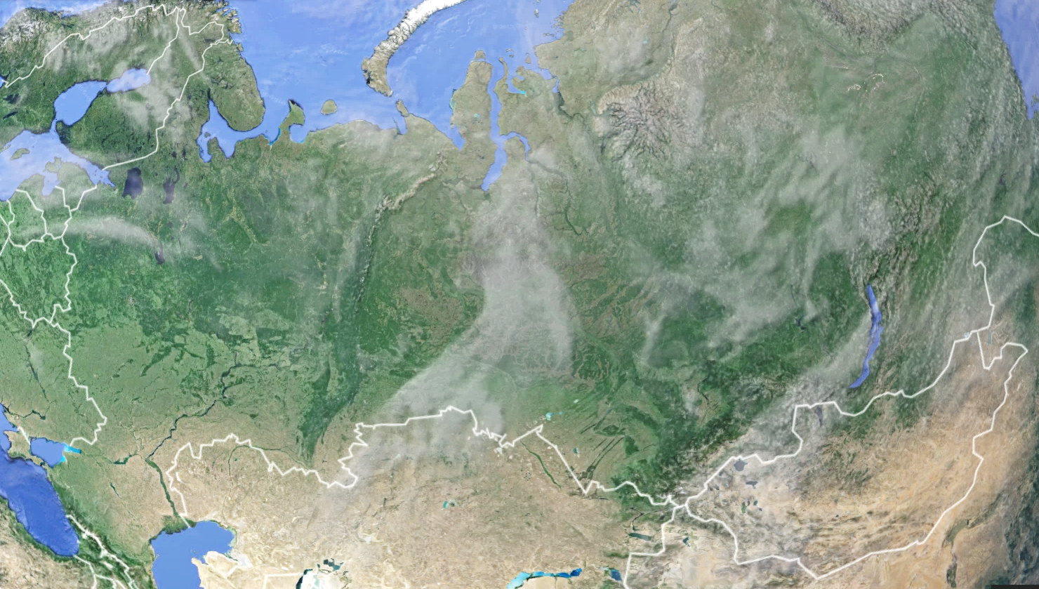
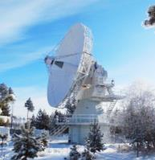
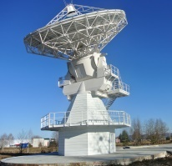
Двухэлементный радиоинтерферометр
Обсерватория
«Бадары»
Обсерватория
«Зеленчукская»
4404.9 км

Slide 3
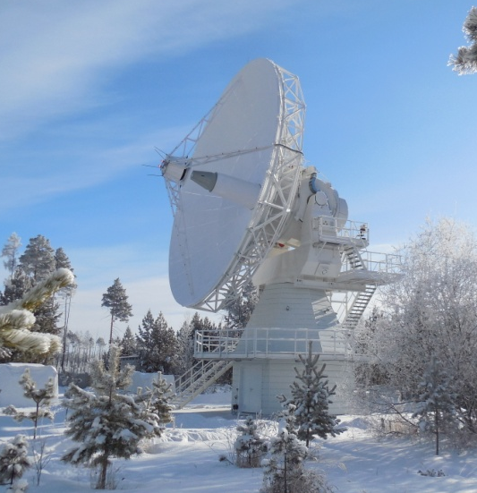
Antenna Systems of RT-13 radio telescopes
Specifications
Main mirror diameter | 13.2 m
Mount | alt-azimuth
Sub-reflector scheme | Ringfocus
Sub-reflector Mount | Hexapod
Azimuth speed | 12 °/sec
Elevation speed | 6 °/sec
Limits by Az; El | ±270°; 0° – 110°
Operation | 24h/7d
Tracking accuracy | ±15 arcsec
Surface accuracy (RMS) | Bv 0.053 mm | Zv 0.057 mm
Frequency range | 2-40 GHz
The surface efficiency | > 0.7
Polarization | LCP and RCP
Ambient temperature | –35°C to +50°C
Humidity | up to 100%
Snow load | 100 kg/m2
Wind velocity | 50 m/sec

Slide 4
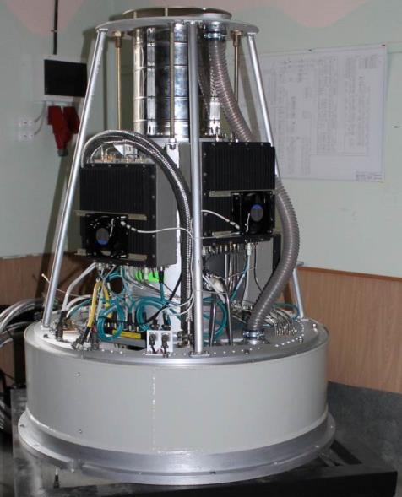
Front end system
Triband S/X/Ka feed
Band | S (13 cm) | X (3.5 cm) | Ka (1 cm)
Frequency (GHz) | 2.2-2.6 | 7.0-9.5 | 28.0-34.0
Polarization | RCP+LCP
Results of on-site measurements, 14.04.2014, Badary, 60°
Tsys (K), | 35 | 25 | 70
SEFD (Ja) | 1000 | 670 | 2100
Surface efficiency | 0.7 | 0.8 | 0.7

Slide 5
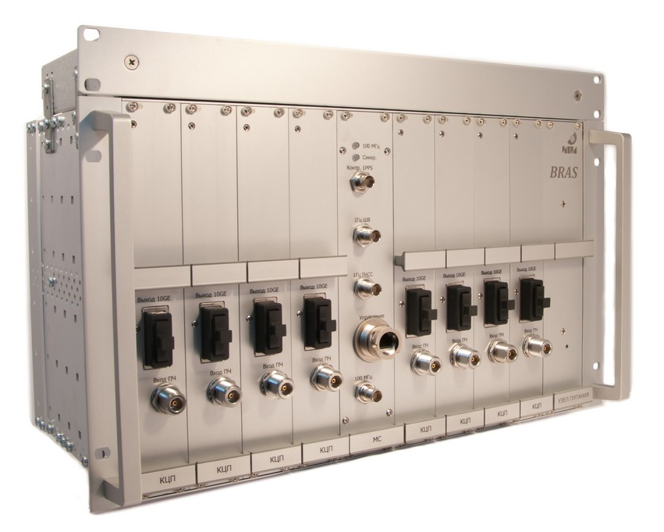
Broadband Digital Data Acquisition System (BRAS)
8 parallel ADC with 512 MHz bandwidth.
Power measurement in each channel.
2-bit sampling.
Overall data rate 16 Gbps.
VDIF format.
10G Ethernet output.
IF Input
8
8
7
7
10GE
6
6
5
4
5
3
4
2
3
2
Digital Converter Channel
1
. . .
Ref.
Synchronization Unit

Slide 6
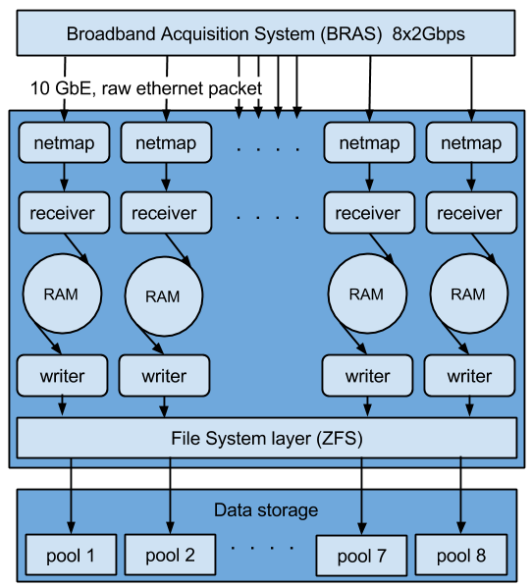
Data Transmitting and Recording System
Recording 16 Gbps (8x2Gbps BRAS, each digital backend channel processed separately);
Data stored as VDIF file;
e-transfer simultaneous with the data recording;
Test recording 32 Gbps (8x4Gbps netmap packat generator);
6

Slide 7
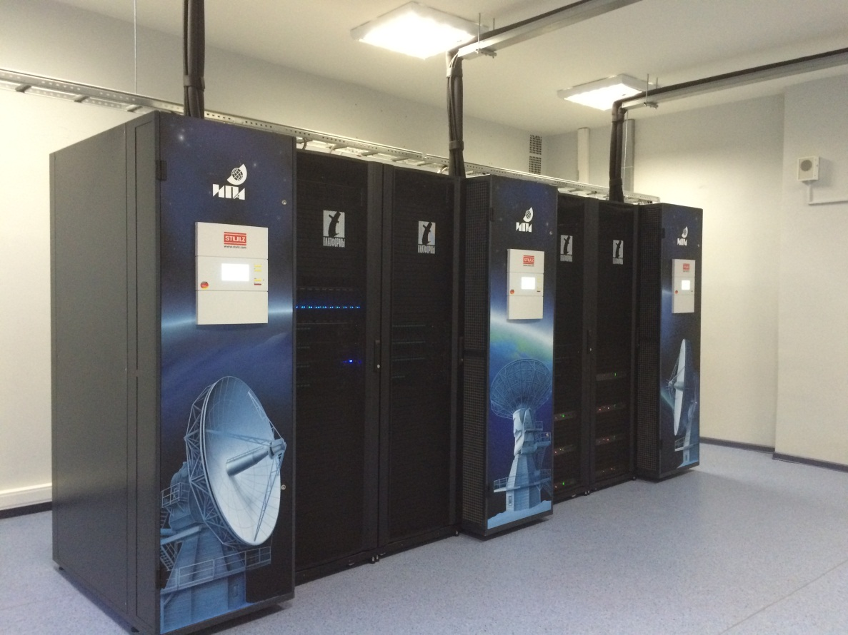
VGOS
GPU based
Software Correlator
Near-real time processing:
  96 Gbps input data streams
  total from 6 observatories
  Computes 312
  cross-spectra (4 frequency
  bands, 2 polarizations,
  6 stations), 4096 spectral channels each
  Extracting 32 phase calibration tones for each frequency channel of each station
FX software correlator
Usage of Graphical Processing Units (GPUs) NVIDIA Tesla® K20
Correlator’s cluster based on the hybrid blade servers (CPU+GPU), consists of 80 GPUs NVIDIA Tesla® K20 and 80 Intel E5-2670 processors (8-core, 2.6 GHz)

Slide 8
UT1-UTC sessions features
Individual channel correlation (synthesis not necessary for 512 MHz channels)
Up to 6 independent UT1-UTC estimations for each session (with 8 channels in 2 polarisations)
2 Gbps internet – four 1-h sessions per day, 8 or 16 Gbps (4 or 8 frequency channels)
UT1 sessions solution: UT1-UTC offset, linear clock, linear WZD, 15ps delay formal error floor

Slide 9
UT1-UTC differences with IERS

Slide 10
 | RT13 | RuU
 | Rms (мкс) | Rms(мкс)
Ноябрь 2015 | 25 | 57
Декабрь 2015 | 34 | 35
Январь 2016 | 33 | 41
Февраль 2016 | 35 | 59
Март 2016 | 27 | 59
Апрель 2016 | 26 | 31
Май 2016 | 27 | 39
Июнь 2016 | 30 | 38
Июль 2016 | 28 | 39
Август 2016 | 34 | 61

Slide 11
Спасибо за внимание !

Slide 12
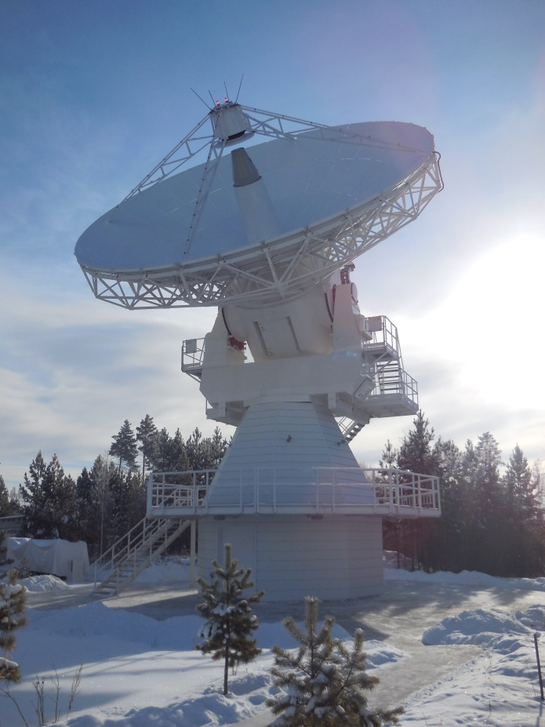
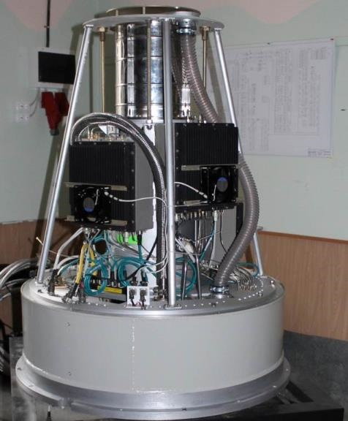
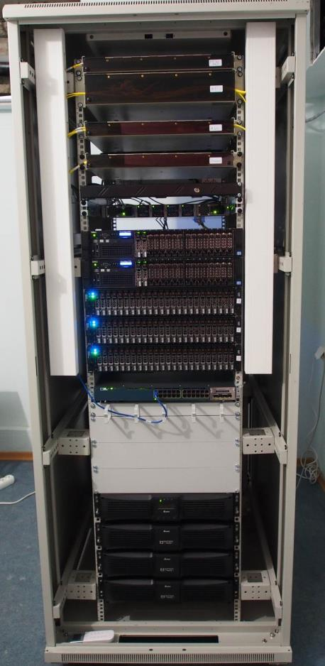
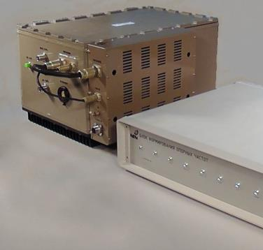
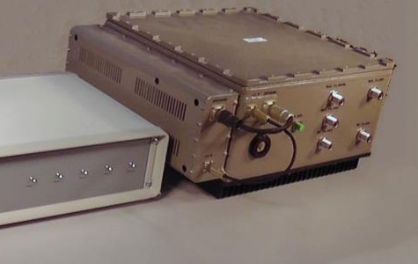
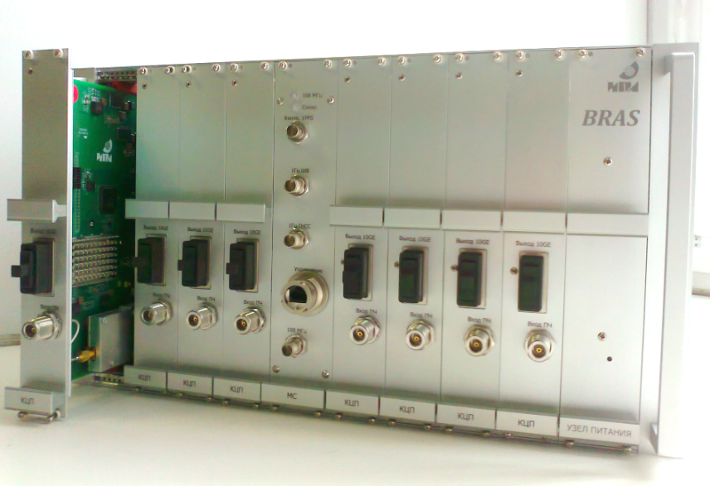
Созданные комплексы аппаратуры

