Slide 1
VLBI at ShAO
Div. of Radio Astronomy Science and Technology
Shanghai Astronomy Observatory,CAS
Zhong Chen

Slide 2
Contents
Introduction of ShAO
CVN VLBI network
VLBI in Chang’E mission
e-VLBI work
VGOS Station
Conclusion
Notes:
My contents are including ……

Slide 3
Shanghai Astronomical Observatory
Officially established in 1962
Five divisions
- Research Center for Galaxies and Cosmology
- Research Center for Astro-geodynamics
- Division of Radio Astronomy Science and Technology
- Division of Optical Astronomical Technologies
- Division of Time-frequency Technologies
Main facilities
- Seshan & Tianma radio telescope
- 1.56m optical telescope
- 60 centimeter SLR telescope and GPS
Notes:
The main observational facilities include a 25-meter and a 65-meter radio telescope with a VLBI data processing center, a 1.56-meter optical telescope, and a 60-centimeter satellite laser ranging (SLR) telescope and GPS.
SHAO is among the seven observatories that possess VLBI, SLR and GPS techniques. SHAO also manages the Chinese VLBI Network and the Chinese SLR Network.

Slide 4
DRAST Tech Dev
Technologies Developements
- Receivers
- Holographic antenna measurement
- Telescope control system
- Digital baseband system
- Data transfer system
- Software correlator
- Hardware correlator

Slide 5
DRAST Research Directions
- VLBI and single-dish observations
- Developing and promoting space radio science projects, scheming
the scientific objectives and key techniques for the Space Millimeter-
wavelength VLBI Array (SMVA) and the Space-based Ultra-Low
Frequency Radio Observatory
- VLBI tracking system for the Chinese Lunar Exploration Project
(CLEP, Phase I/II/II) and other deep space probe
- Operating and processing the data observed with the Chinese VLBI
Network (CVN), and also extending the data correlation to other
VLBI arrays in the future
- Construction of the Sheshan VGOS station equipped with fast
slewing antenna and broadband receiving system
- Scientific research on the VLBI applications in radio astronomy
astrometry and deep space exploration;
- Molecular line survey, pulsar searching and timing using the Tianma
65-m Radio Telescope.

Slide 6
CVN VLBI Network
Stations
Sh – Shanghai Sheshan, 25m, 1987
Ur – Xijiang Urumuqi, 25m, 1993
Bj – Beijing Miyun, 50m, 2006
Km – Yunnan Kunming, 40m, 2006
Tm – Shanghai Tianma, 65m, 2013
Data Center
Shanghai new VLBI data center, 2013
New Telescopes
FAST: 500m,Under construction, Guizhou Province
QTT: 110m,Proposal stage, Xinjiang Province
6
Notes:
CVN have 5 stations
New data center at Sheshan area, with control hall and main server room and auxiliary facilities
Applications include real time and e-transfer and disk-based.
Real time clep, e-EVN, for e-transfer ,typical application is IVS INT3 sessions ,
For the disk based observation, usually we carry out five minutes fringe detection ,
Just as others do , to improve the success rate of VLBI experiments.
Crustal Movement Observation Network of China

Slide 7
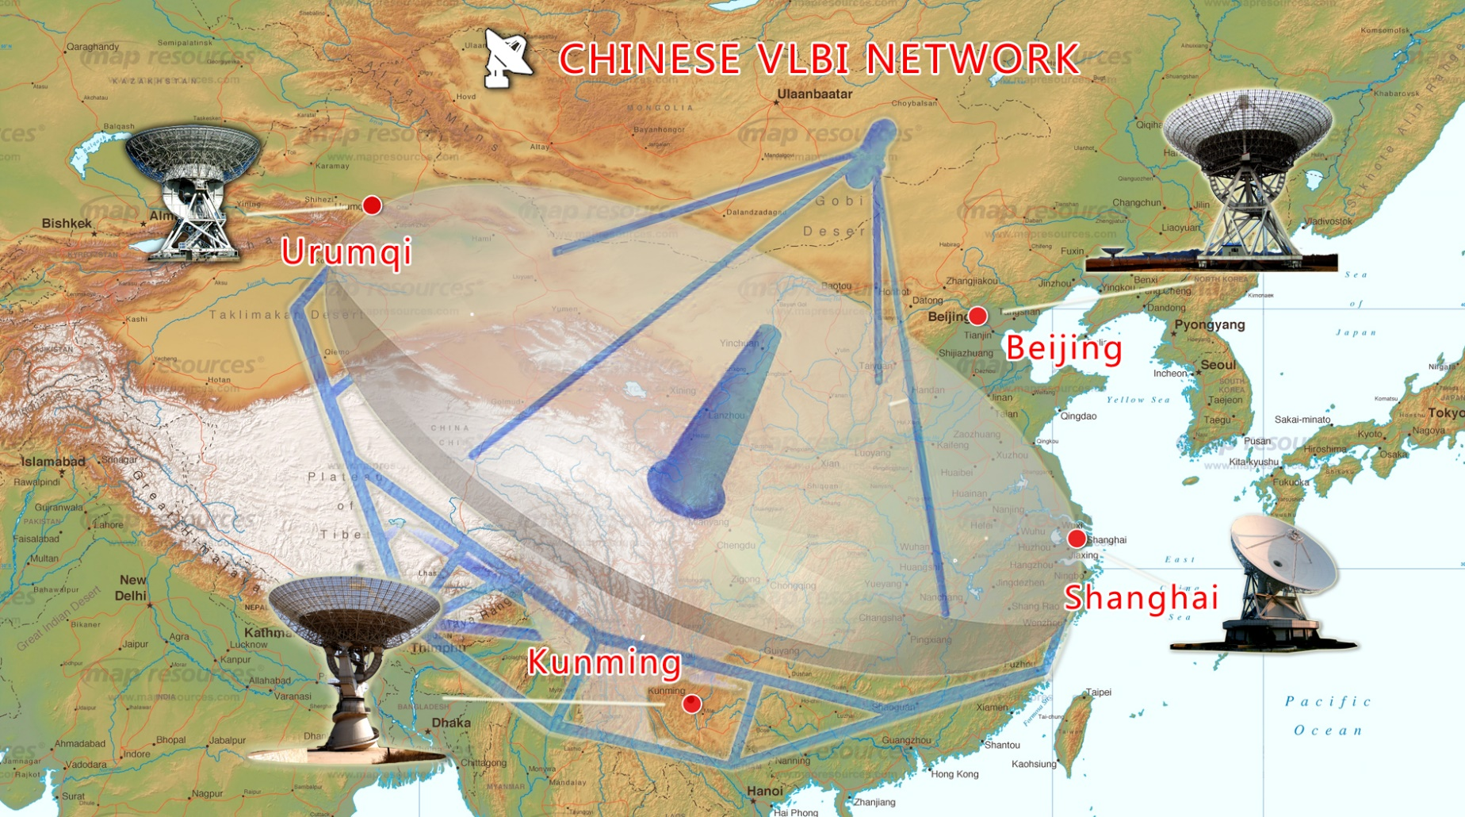
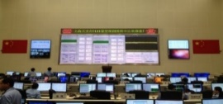
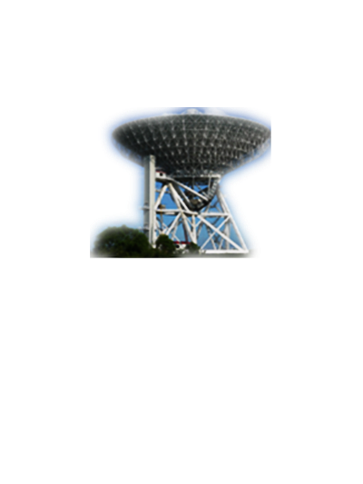
CVN Map
Beijing
50m
Urumqi
25m
VLBI Center
Kunming
40m
Tianma
L、S、C、X、Ku、K、Ka、 Q
Sheshan
25m

Slide 8
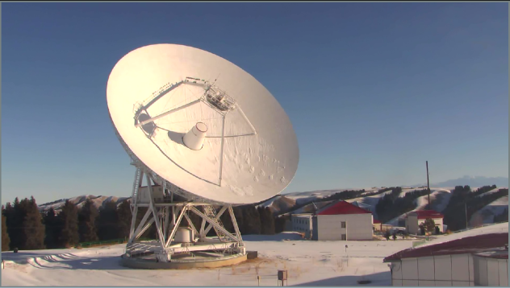
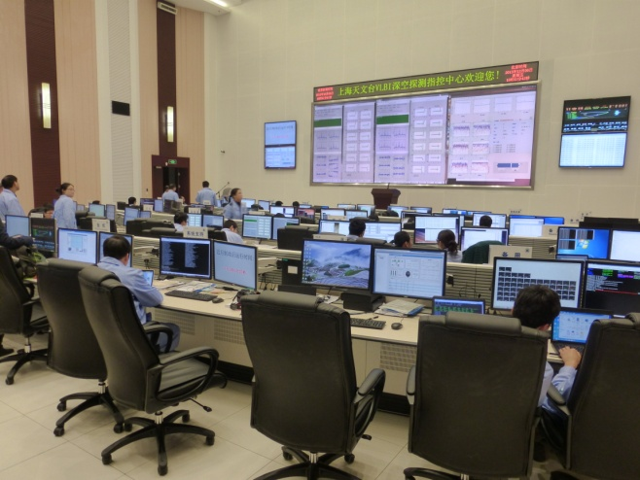
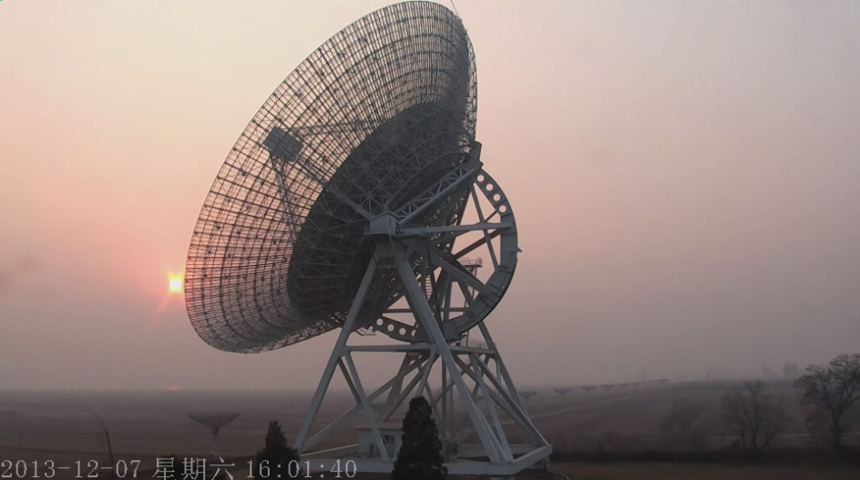
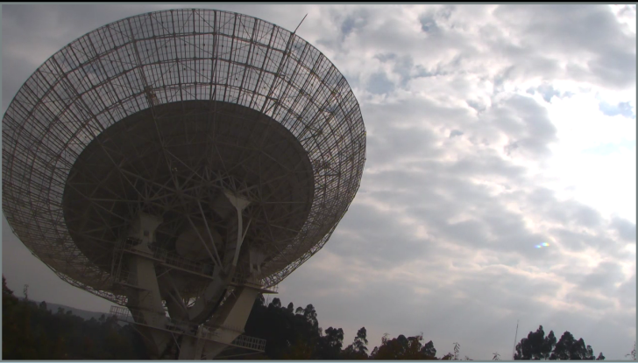
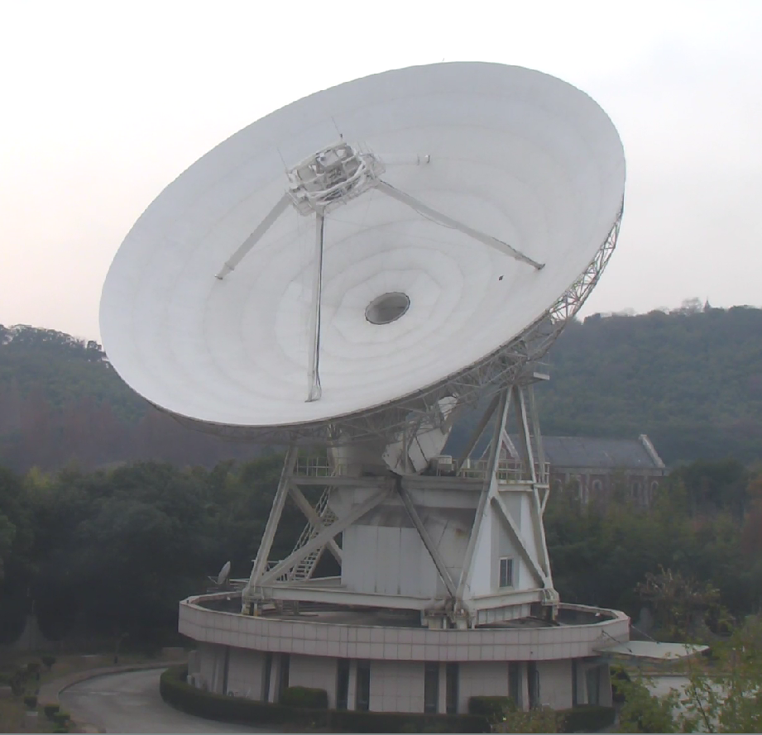
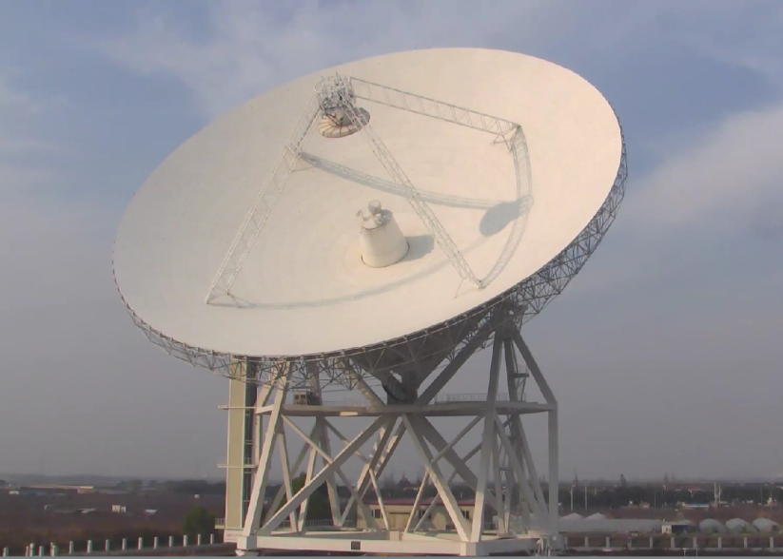
Sites View
Ur, XAO
VLBI C&C Hall
ShAO
Bj, NAOC
Km, NAOC
Sh, ShAO
Tm, ShAO
Notes:
View of station and hall.
At back of hall , web camera installed on the wall, so the stations staff can easily see the real time fringe on the led screen wall. success rate

Slide 9
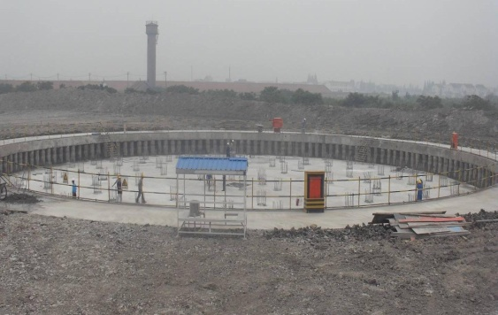
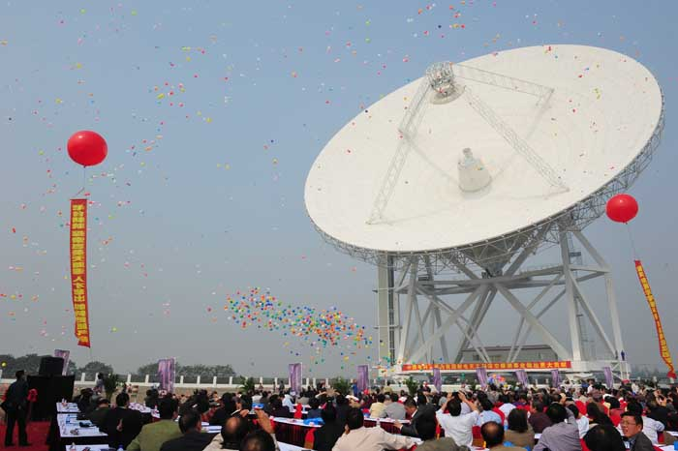
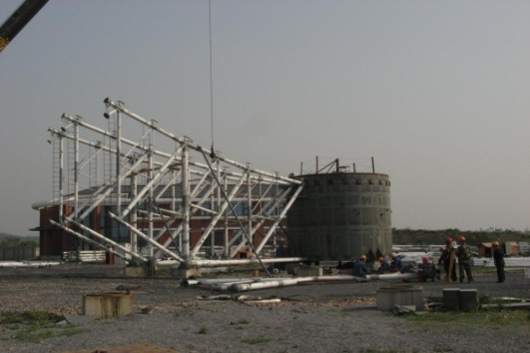
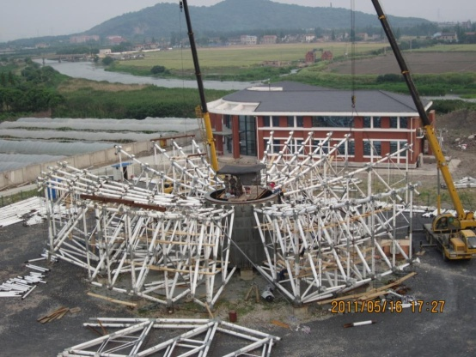
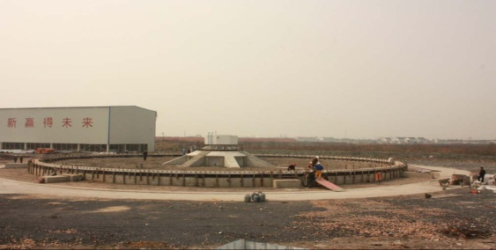
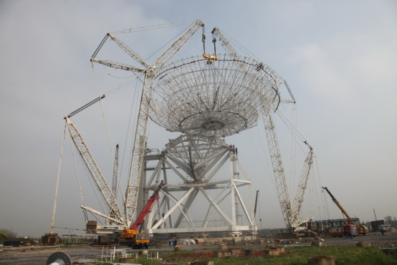
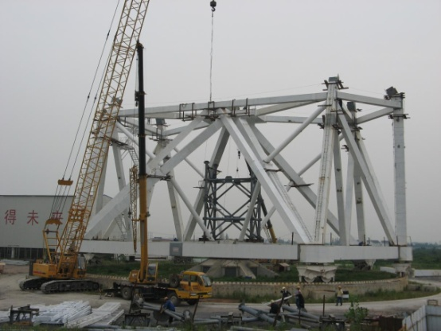
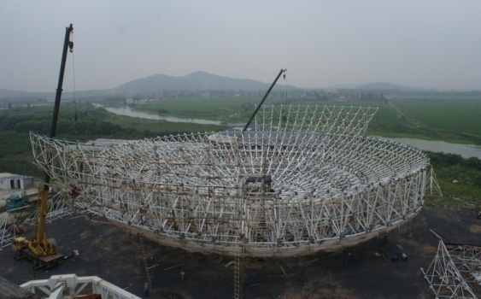
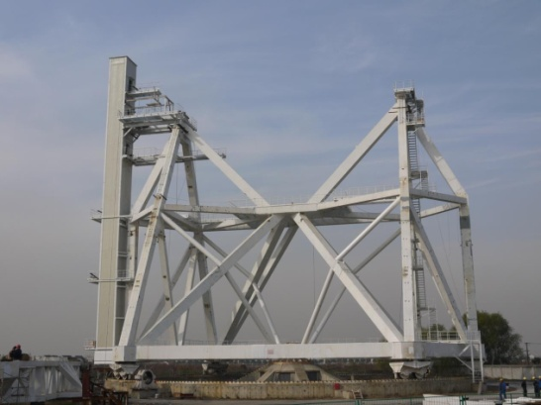
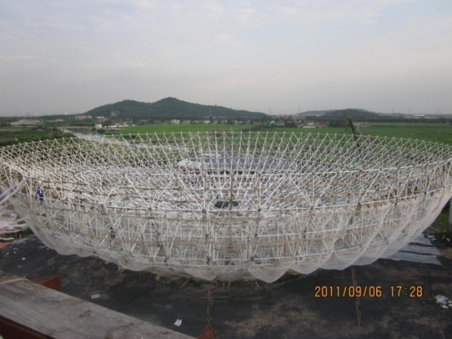
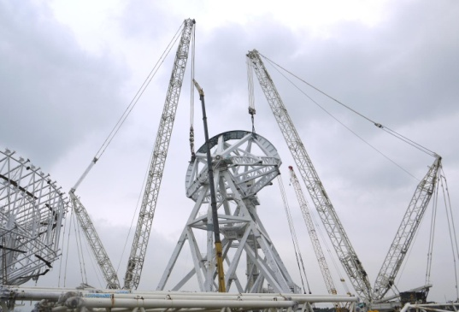
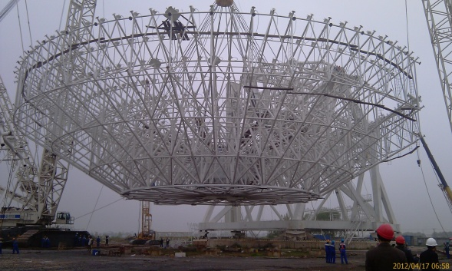
Timeline of Tianma construction

Slide 10
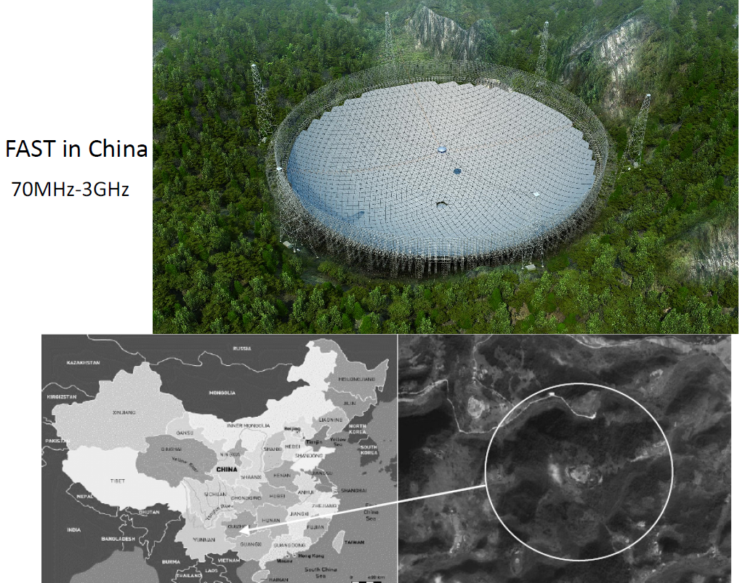
FAST
Five-hundred-meter Aperture Spherical Telescope

Slide 11
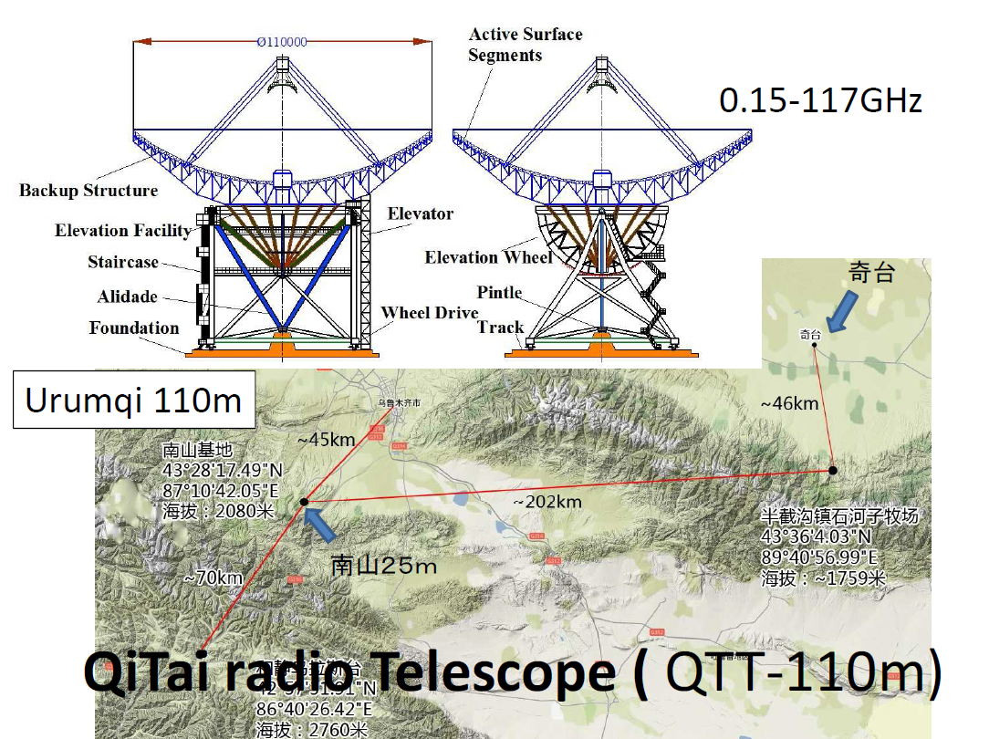
QiTai Telescope

Slide 12
The Chinese Lunar Exploration Program
The CLEP contains three phases:
Orbiting:
Chang'e 1 (CE-1, 2007 )
Chang'e 2 (CE-2, 2010)
2. Landing (CE-3)
3. Surface sampling and return ( CE- 5 )
CE-5T1(2014) : experiment satellite,
technology validation
Telemetry, Tracking, and Command System
TT&C = UXB + VLBI

Slide 13
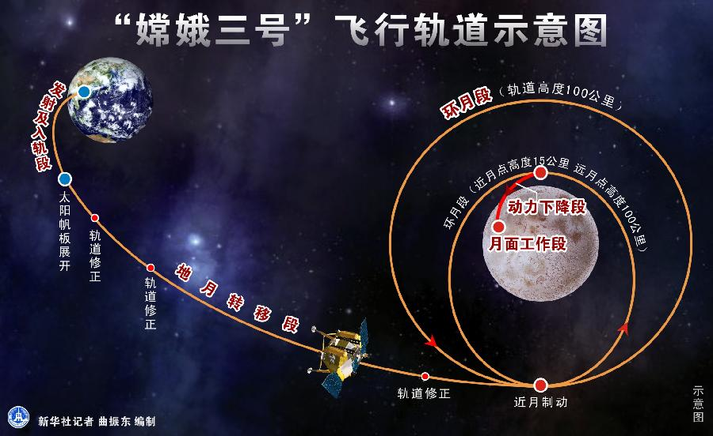
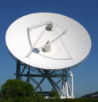
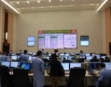
VLBI for CLEP CE-3
New Mission：
Earth-moon transfer & Circumlunar orbit tracking
Sattllie power decline landing period tracking
Moon Surface accurate positioning of CE-3 Lander / YuTu Rover
3-way measuring data processing
Before and after orbit maneuver orbit forecast and determination in 30 minitue
New Challenge（Compared to CE-1、CE-2）
Moon Surface accurate positioning of Lander(CE-3) and Rover(Yutu)
New X band DOR signal
△DOR and Same Beam Interferometry technology
Time delay accuracy improvement
Real time delay 10min →1min
New Tianma station and New center

Slide 14

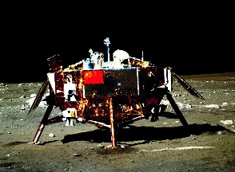
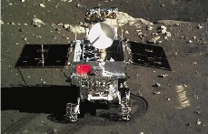
e-VLBI for CLEP CE-3 missions
Chinese Lunar Exploration Project Phase II(CE-3,2013)
Service for measurement and control system
Real-time Challenge
VLBI Observation System:10min->1min
e-VLBI subsystem: 10 seconds, including failure recovery time
Additional Function
In data center, receiving & distributing data to 2 Correlators
Recording data
Data Rate
CE-3, CE-5T1: 64Mbps/stations
CE-5: 128Mbps/stations(2017~2018)
14
Notes:
Real time space probe tracking system . VLBI stations and command control center providing service in critical phases, such as ….
CE-3 new challenges, …..
E-vlbi addition fucnctions, like ….
Future…..

Slide 15
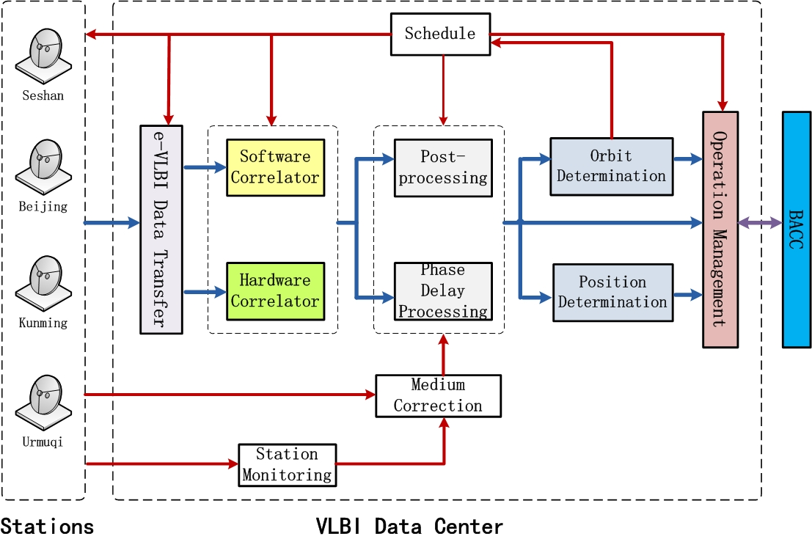
Realtime Data Processing System

Slide 16
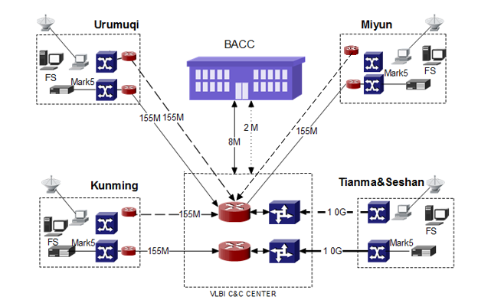
CE-3 e-VLBI Network Topology

Slide 17
e-VLBI CE-3 Network Topology
Km, Ur, Bj
Long Range Network
Backbone unscheduled network situation: Link down，routing and router switch to backup without informed
Reliability Design play and important role for uninterrupted transfer
Open Shortest Path First Interior Gateway Protocol/Bidirectional Forwarding Detection

Slide 18
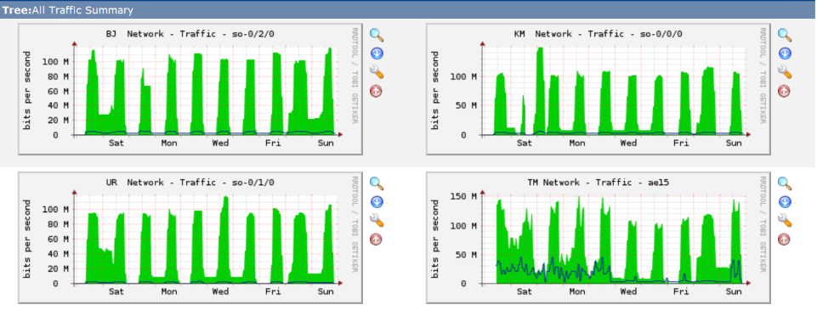
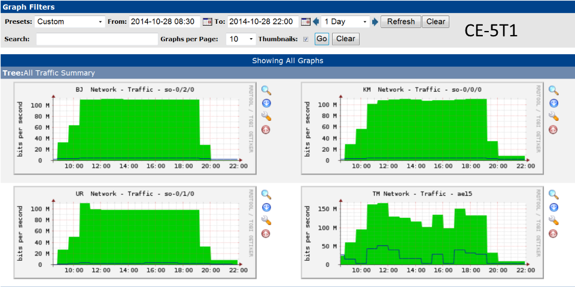
e-VLBI tracking mission Netflow
e-VLBI

Slide 19
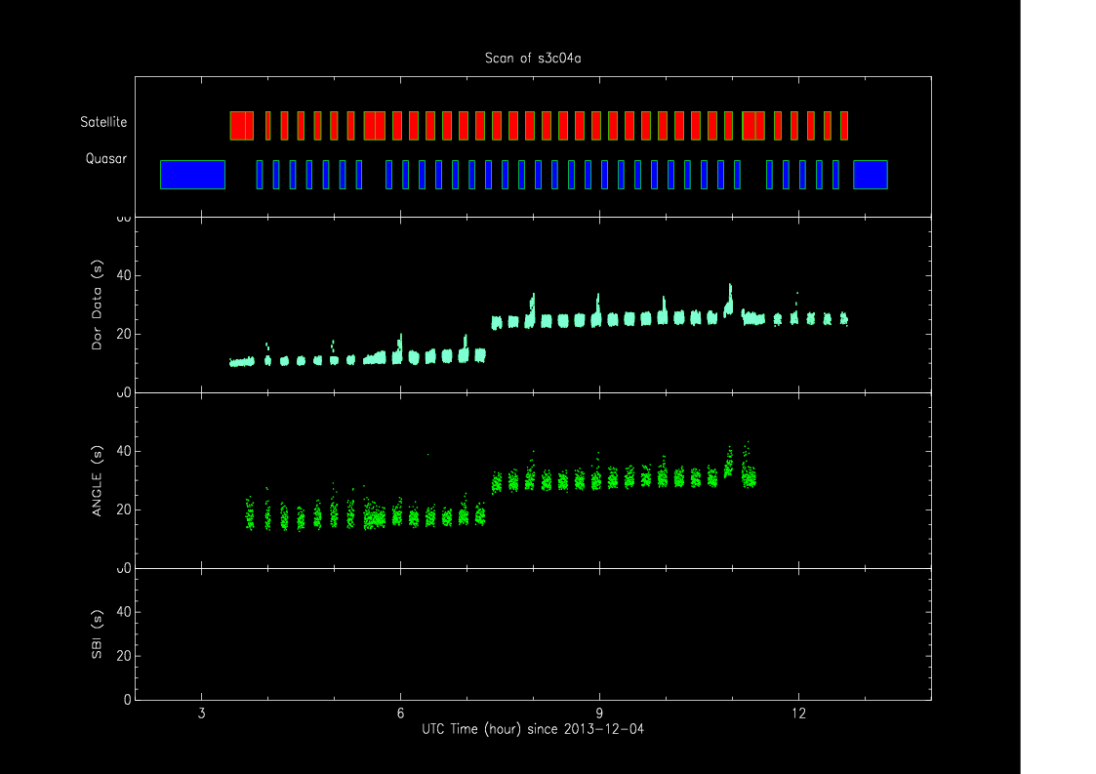
Real time processing performance
System time / Requirements
CE1 5-6min / 10 min
CE2 3-4min / 10 min
CE3 <40s / 1 min

Slide 20
Mesuarement accuracy

Slide 21
Mesuarement accuracy(cont.)
Orbit determination residuals statistical comparison |  | Time dealy（ns） | Time delay rate（ps/s）
CE-1 | Post S-band | 6.15 | 0.7
CE-2 | RT S-band | 4.93 | 0.64
 | Post S-band | 4.04 | 0.63
 | Post Bandwidth synthesis | 1.28 | 0.45
CE-3 | Rt X-band | 0.65(0.78/0.59) | 0.67(0.93/0.55)
 | Post X-band | 0.59(0.85/0.45) | 0.65(0.90/0.53)

Slide 22
Orbit determination precision comparison
VLBI Center and BACC
Independent calculation with same VLBI&USB dataset
Precision Comparison Results
Earth-moon transfer orbit: <1km
Lunar orbit: <100m
Lander positioning accuracy:100m

Slide 23
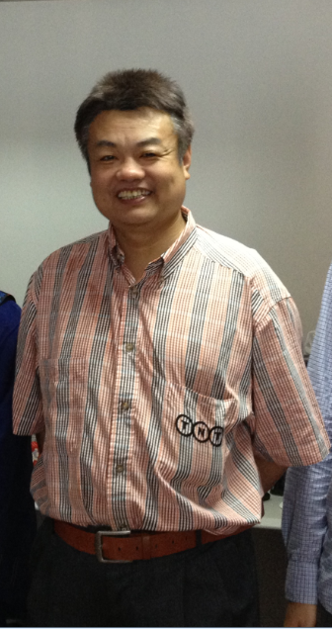
Same beam VLBI for CE3
rover
lander
τ
₁
τ
₂
τ
₃
τ
₄
BJ
UR
SH
KM
Measuring rover relative position by using differential phase delay

Slide 24
Same beam VLBI for CE3
Lander data transmission signal
8496MHz,BW=5MHz
Rover data transmission signal
8462MHz，BW=8MHz
Power
Rover data telemetry signal
Shanghai
65m
Power
BW(MHz)
BW(MHz)

Slide 25
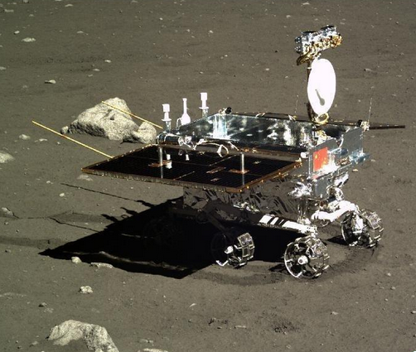
Camera
1.16m
HGA
We confirmed that the accuracy of relative position determination was about 20cm.
LGA
1.5m
Relative positioning results
23

Slide 26
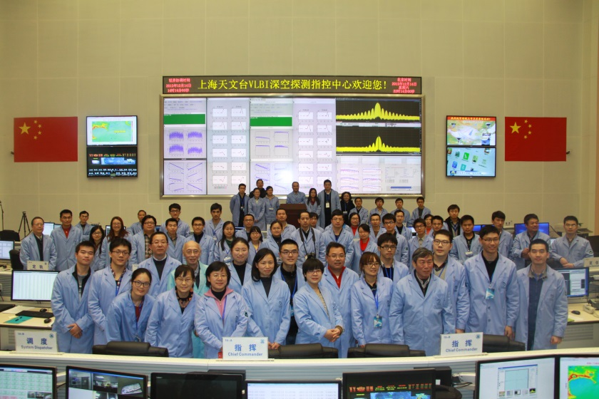
Photo after CE-3 Successful Landing

Slide 27
e-VLBI IPv6 Testing
CNGI-IPv6 Network
Backgroud
CNGI: Chinese Next Generation Internet
Participation：Universities，Institutes，Companies
Target：Demonstrate and Advance IPv6 network service
e-VLBI by IPv6
Jobs
IPv6 network infrastructure construction
Software modification to utilize IPv6
Testing & Demonstration
VLBI Data Center，Sh，Tm，Ur，Km

Slide 28
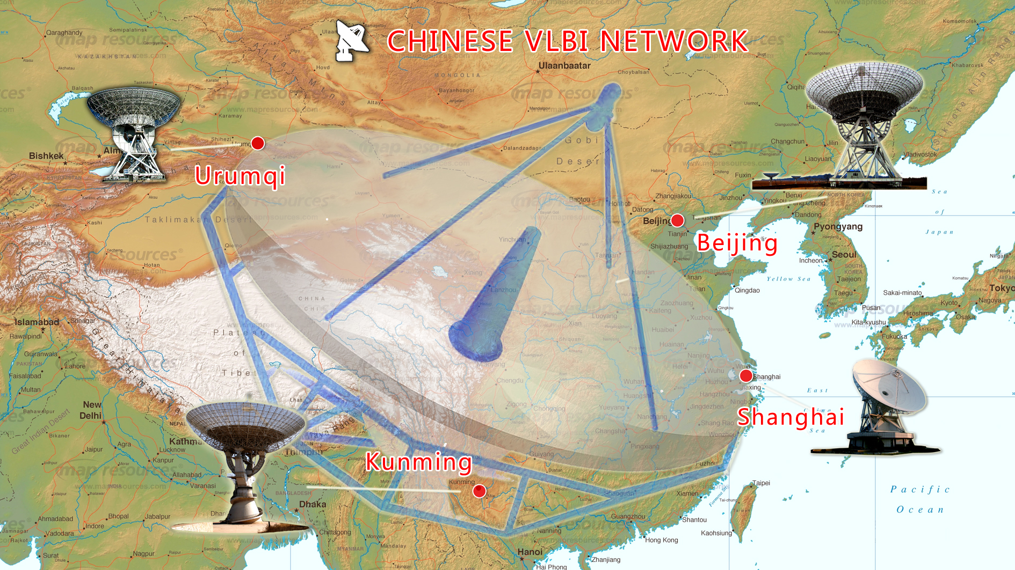
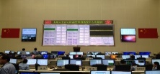
CVN e-VLBI CSTNET Network BW
CSTNET
Shared Network
300Mbps
Last Mile:155Mbps
ADSL
Network
20Mbps
CSTNET
Hybrid Network
Max 1.5Gbps
CSTNET
Shared Network
1Gbps
Fiber
10Gbps
CSTNET: China Science and Technology Network, Chinese Academy of Sciences
Notes:
This cvn concept map of antennas and the shared network link bandwidth via CSTNET inside china.

Slide 29
CVN e-VLBI CSTNET Network BW
ORIENTplus
GLORAID
CSTNET: China Science and Technology Network, Chinese Academy of Sciences
Notes:
This topology show internet network bandwidth to Europe and USA.

Slide 30
CVN e-VLBI IPv6 Connectivity
CSTNET
IPv6
No!☹
CSTNET
IPv6
CSTNET
IPv6

Slide 31
Station IPv6 Connectivity
CNGI-IPv6 e-VLBI Infrastructure
Sh、Tm、VLBI Center support IPv6
Bandwidth：10Gbps
Sh,Tm → VLBI Center Bench
VLBI Center→ CSTNET Beijing Bench
VLBI Data Center - Beijing CSTNET IPv6
BW: 1024Mbps
Free use!☺
Km IPv6 BW：~ 50 Mbps ☹
Ur IPv6 BW：~ 10 Mbps ☹
Km,Ur can apply for more bandwidth, but budget…

Slide 32
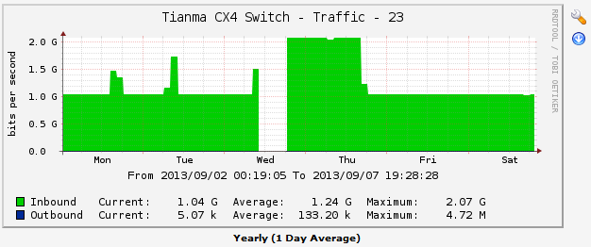
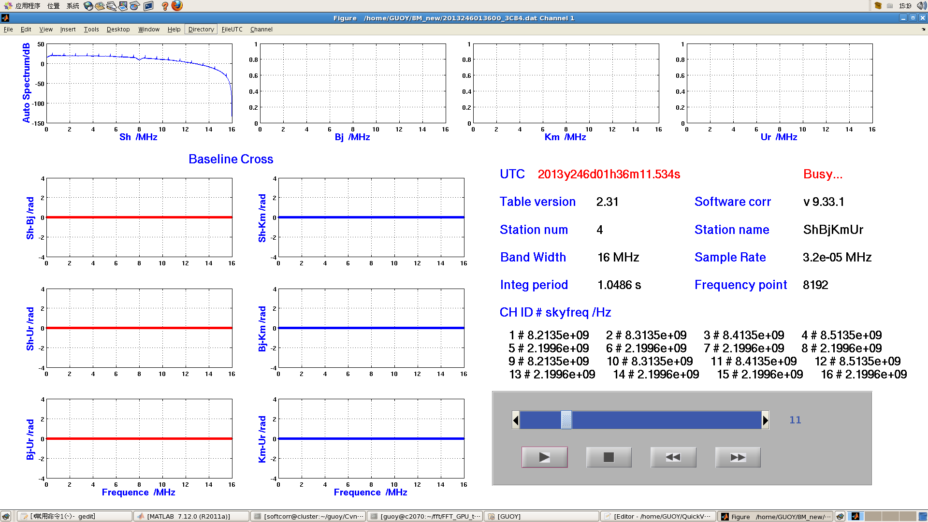
IPv6 e-VLBI Testing
Tm Observation Test
Real-time Netflow
Zero Baseline Testing

Slide 33
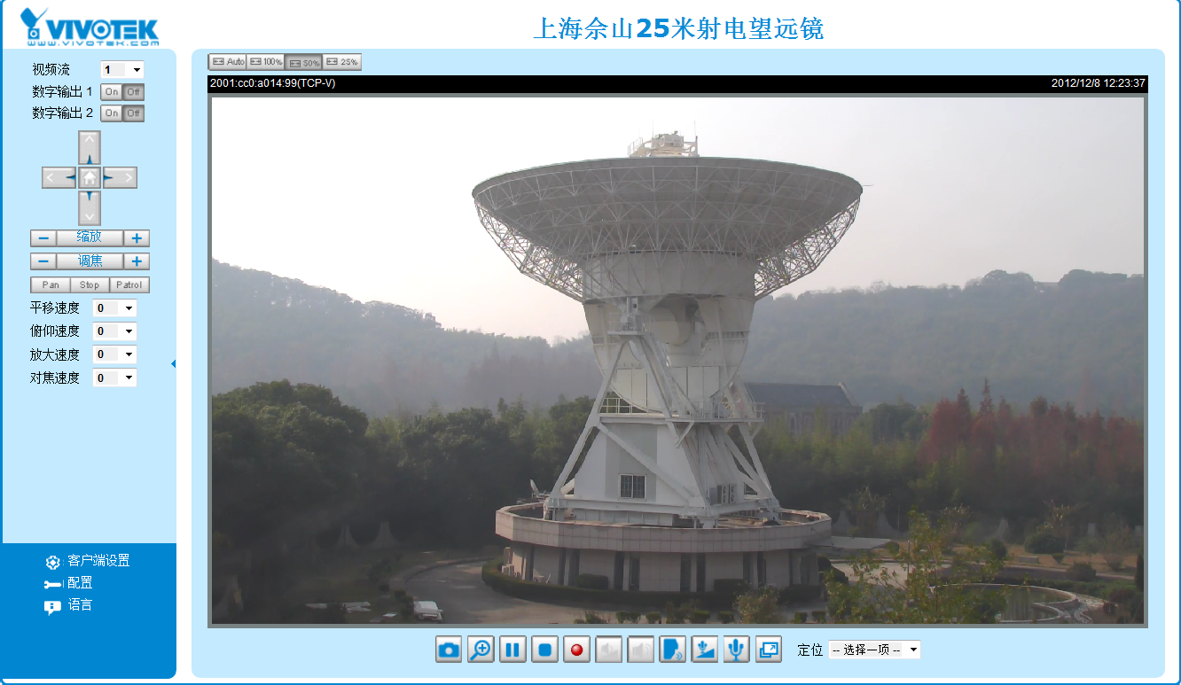
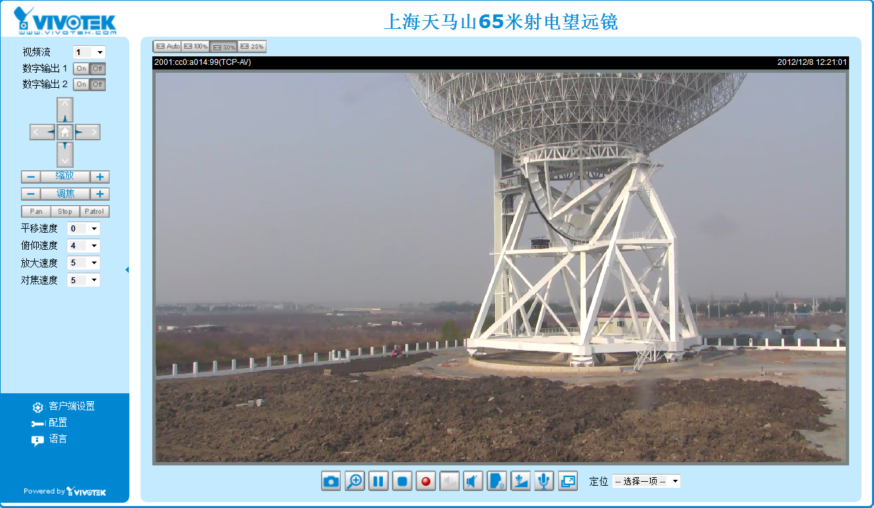
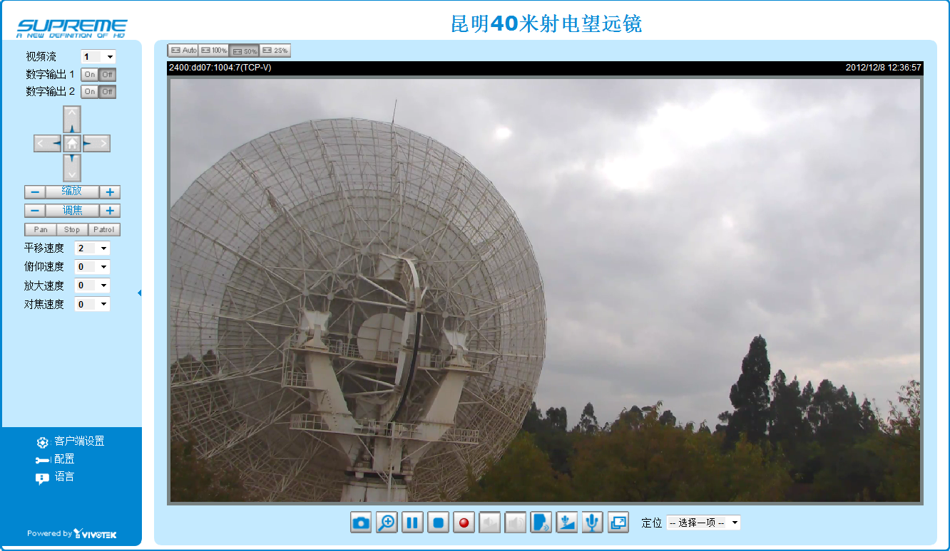
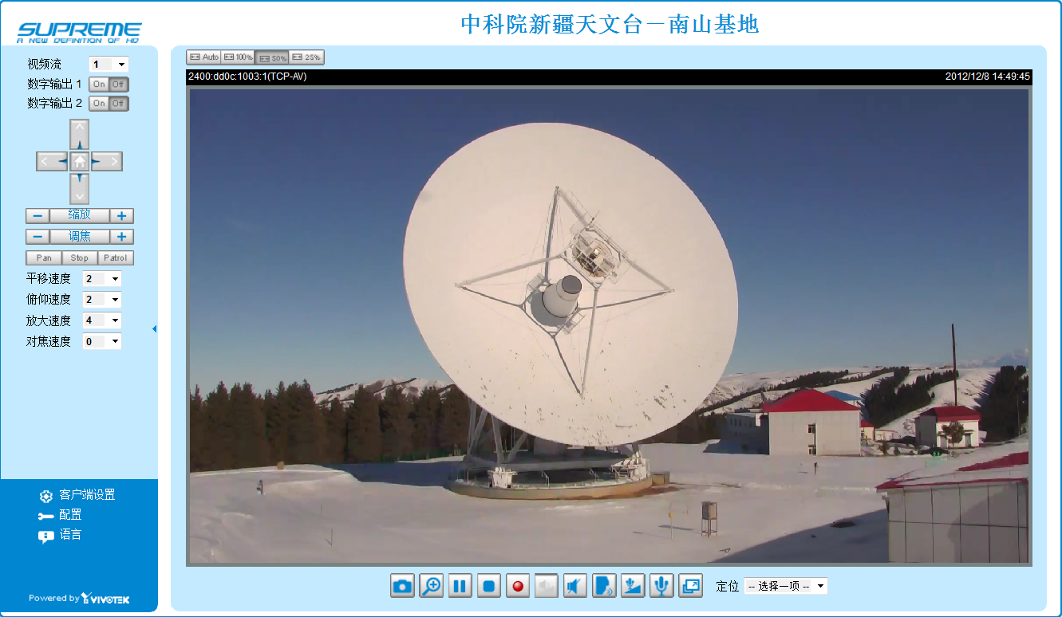
IPv6-based Station Webcam

Slide 34
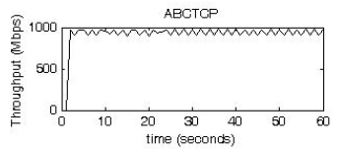
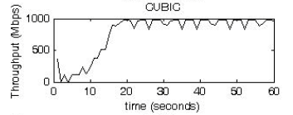
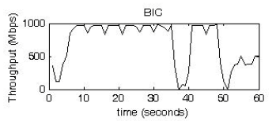
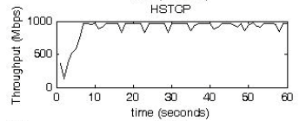
e-VLBI ABC TCP protocol
Shared Internet for e-VLBI
Bandwidth congestion and utilization
VLBI stable raw date rate
Done by CSTNET & ShAO
ABCTCP
Closed-loop control TCP, desired speed as parameter
Testing between ShAO-CSTNET(Beijing)Backbone Network

Slide 35
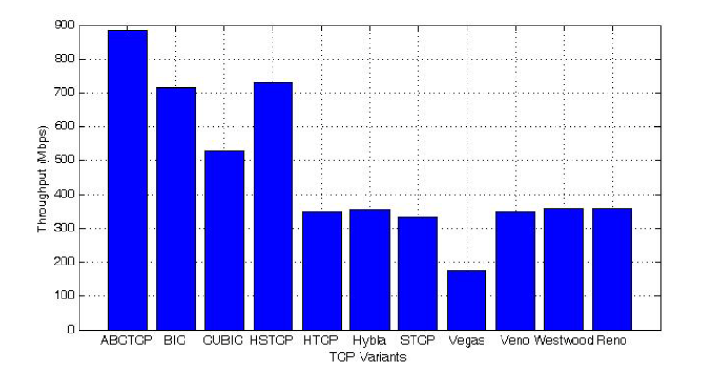
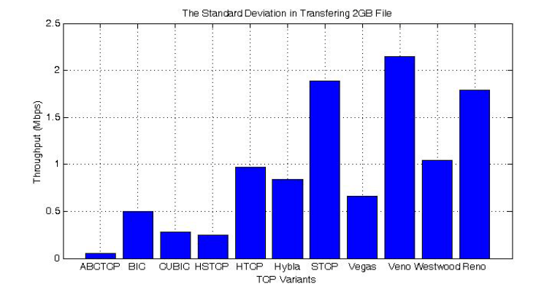
e-VLBI ABC TCP protocol
Average throughput
5 times based standard deviation

Slide 36

e-VLBI ABC TCP protocol
Desired Transfer Speed Testing

Slide 37
Main Specifications of Seshan
VGOSAntenna
Construction time: Middle of 2015
Diameter: 13m
RF frequency range: 2-14GHz, upgradable to Ka band
Polarization: Linear polarizations
Optics: Ring focus
Aperture efficiency: >50%
Surface accuracy: <0.3mm
Pointing accuracy：<18”
Slew rate: az 12º/s, 3º/s² ; el 6º/s, 3º/s²
Slew range: az -270º~+270º; el 0º~90º
Reference point stability: ＜0.3mm
Signal path length stability: ＜0.3mm

Slide 38




CDAS-2
With the new platform, CDAS2 with PFB (Poly-phase Filter Bank) algorithm is under testing. Now it can work in two modes:
512 MHz Dual IF Mode:
For each IF, it has
– 512 MHz bandwidth input
– 16 channels output
– 32 MHz bandwidth for each output channels
1024 MHz Single IF Mode :
– 1024 MHz bandwidth input
– 16 channels output
– 64 MHz bandwidth for each output channels
– Mark6
38

Slide 39



Slide 40



New VLBI Center
Command&Control Hall
Main Server Room
Notes:
I’m duty designer of this new vlbi data center. Top photo is …,, the bottom left photo is …., the bottom right photo is …..,
The design of cold and hot channel segregation is to reduce the cooling system power consumption. The left aisle is for CELP computer
And network devices, the right is for astronomy and astrometry and geodesy data processing system.

Slide 41

Systems in New VLBI Center
Computing system
Software correlator(384 Xeon E5 cores, 2.4G, DAS 72TB )
Post processing/Orbit/Positoin/ WorkStations
Storage
Raw data storage: 300TB+240TB(2015)
Results data storage: 30TB
Networking
10GE Intranet
40Gbps IB software correlator cluster
Distributed LED Display Wall
IP-based Voice Command System
Power and Cooling
UPS: backup support > 2hours
Notes:
The new data center have several components to support computing , communicating， data storage， and control need
Such as computing system， we have … .
For storage capacity , currently we have at least …..
For networking , …..
We also have Distributed LED Display Wall, which is used to show real time results , station monitoring, network conditions
The command system is to send commands and get feedback from people of all stations and control hall, VoIP system
Power and cooling is also very important for space mission

Slide 42

DiFX Platform for Astronomy&Geodesy
ComputeNode
Storage
Mark5

Slide 43
DiFX Platform Upgrade
Computing Node
20 x DELL R630, two cpu E5-2660v3/server
Storage
Raw data storage: 12x MD1400(48TB)
Intranet
10Gb Ethernet Intranet
50Gb IB
Internet
Connected to: AuScope, Noto, Hobart, Kashima, GSI, Brazil
Network Testing: Tsunami

Slide 44
Conclusion
Space mission continuous support
CLEP Phase III, CE-5 mission
Deep space explorations: Mars,
Shanghai Correlator Center & VGOS Station
Real time data transmission
e-Transfer
Correlator
Bandwidth and Cost
Win-win cooperation with CSTNET to get more support

Slide 45
Thanks!☺

