Slide 1
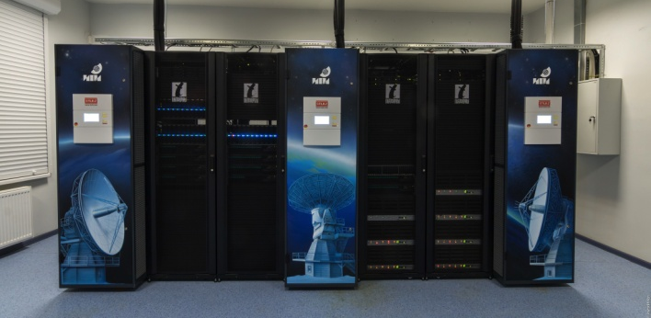
RASFX: A VLBI GPU-based software correlator
Voytsekh Ken
Igor Surkis
Dmitry Pavlov
Alexey Melnikov
Vladimir Mishin
Violetta Shantyr
Institute of Applied Astronomy
Russian Academy of Sciences
www.iaaras.ru

Slide 2
Outline
Design reasons
RASFX equipment - HPC cluster
RASFX software topology
Benchmark tests
Comparison to DiFX
Processing and results

Slide 3
RASFX Design and Processing Team
Dr. Igor Surkis — Leading investigator
Vladimir Zimovsky — Lead for data processing
Voytsekh Ken — GPU software developer, testing, data processing
Ekaterina Krylova — PhD student, software developer (GNSS)
Yana Kurdubova — software developer, data processing
Alexey Melnikov — DiFX data processing, scheduler
Vladimir Mishin — software developer, data processing
Nadezhda Mishina — GUI software developer, data processing
Dr. Dmitry Pavlov — GPU & MPI software developer
Violetta Shantyr — software developer (WOPS)
Dmitry Zhuravov — former software developer

Slide 4
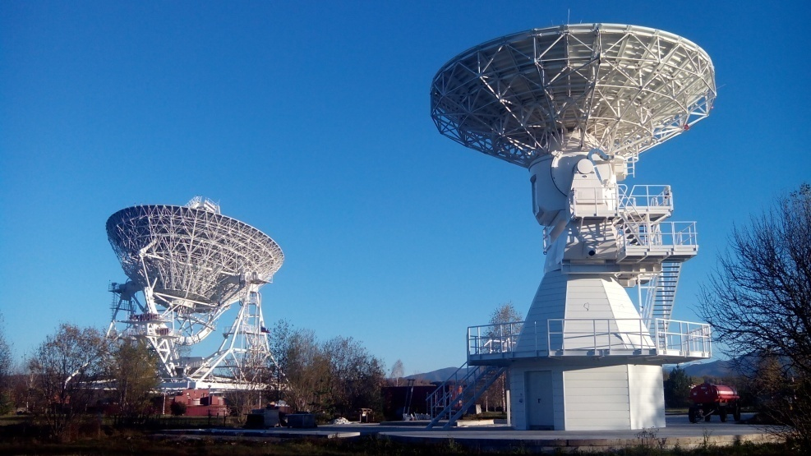
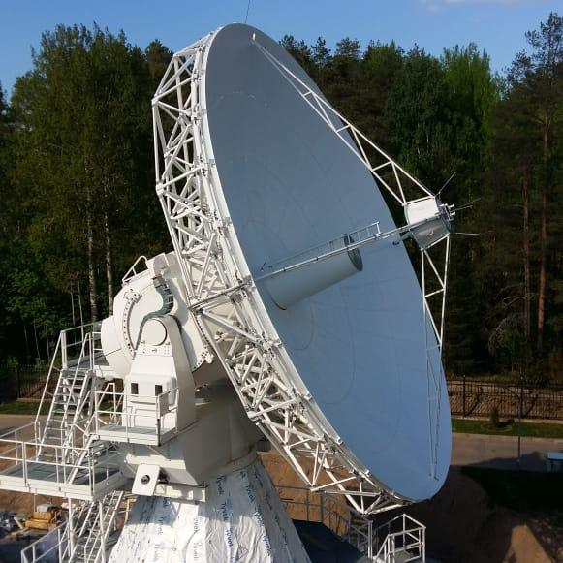
RASFX Design Background
2012-2015: Antennae design for Zelenchukskay and Badary observatories
2016-2018: Antenna design for Svetloe observatory
RT-13 specifications:
Manufacturer: Vertex Antennentechnik GmbH
Mount: alt-azimuth
Main reflector diameter: 13.2 m
Surface accuracy: < 0.15 mm
Azimuth speed: 12 °/s
Elevation speed: 6 °/s
Tracking accuracy: 16 arcsec
Frequency: 2–40 GHz (S/X/Ka)
Zelenchukskaya - 2015
Badary - 2015
Svetloe - 2018

Slide 5
RASFX Design Background
2012-2015: Antennae design for Zelenchukskay and Badary observatories
2016-2018: Antenna design for Svetloe observatory
RT-13 specifications:
Manufacturer: Vertex Antennentechnik GmbH
Mount: alt-azimuth
Main reflector diameter: 13.2 m
Surface accuracy: < 0.15 mm
Azimuth speed: 12 °/s
Elevation speed: 6 °/s
Tracking accuracy: 16 arcsec
Frequency: 2–40 GHz (S/X/Ka)
Zelenchukskaya - 2015
Badary - 2015
Svetloe - 2018
From RT-32 (1-2 Gbps) to RT-13 (8-16 Gbps)
From 2-3 telescopes in Quasar network to 2-6 telescopes in collaboration
From single 1-hour S/X session daily to six 1-hour S/X or S/X/Ka sessions daily

Slide 6
Correlator specs
FX-type
Input data stream of up to 16 Gb/s from each of up to 6 observatories:
2-bit sampling,
4 frequency bands:
2 polarizations, 512 MHz bandwidth, or
1 polarization, 1024 MHz bandwidth
Cross-spectra resolution of up to 4096 spectral channels
Extracting phase calibration tones
Input data format: VDIF/Mark5b
Output data format: Baseline
Near real-time computing (yes, really 96 Gbps!)

Slide 7
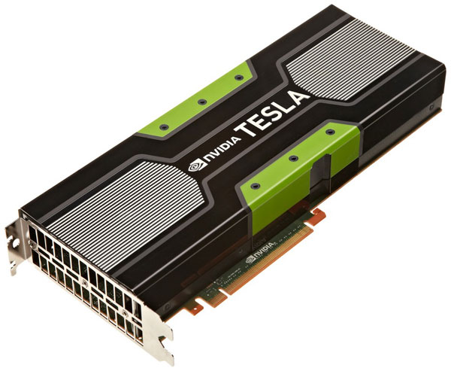
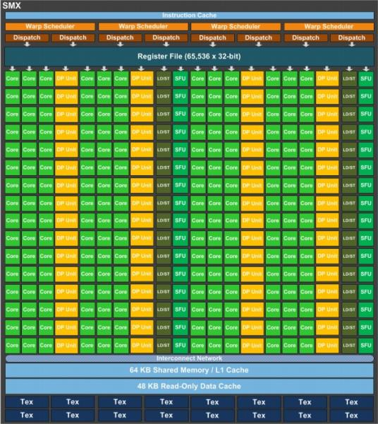
Design Ideas and Concepts
FX-type
Graphical processing units (GPUs) are used for the most laborious computations: bits repacking, fringe stopping, FFT, fractional sample correction, spectra multiplication (correlation), PCal extracting.
HPC cluster based on the hybrid blade servers (2 CPUs + 2 GPUs)
Delay tracking is performed on bit streams
Bit stream transformation is performed on the GPU DRAM

Slide 8
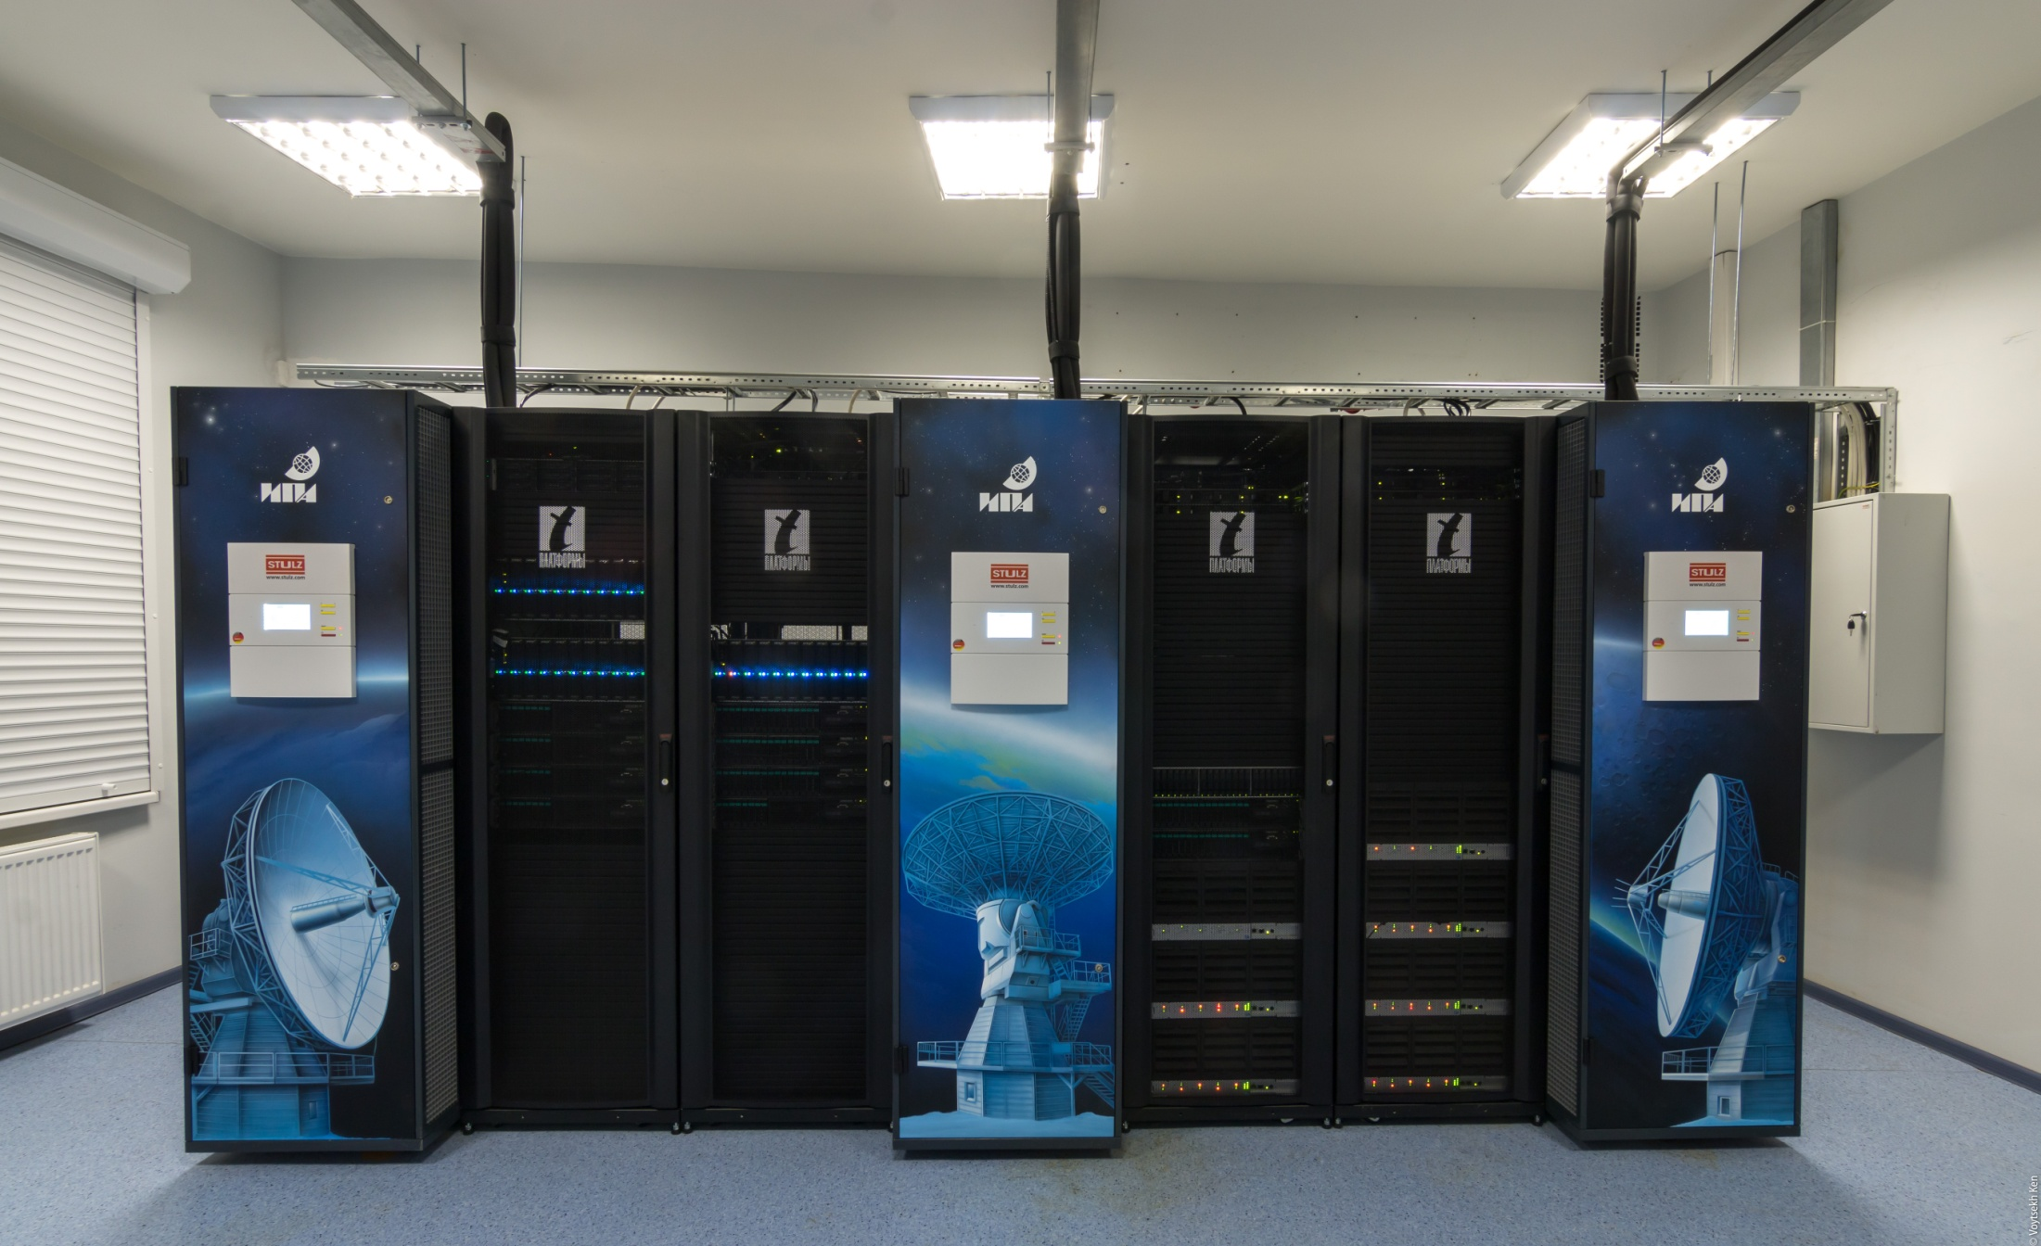
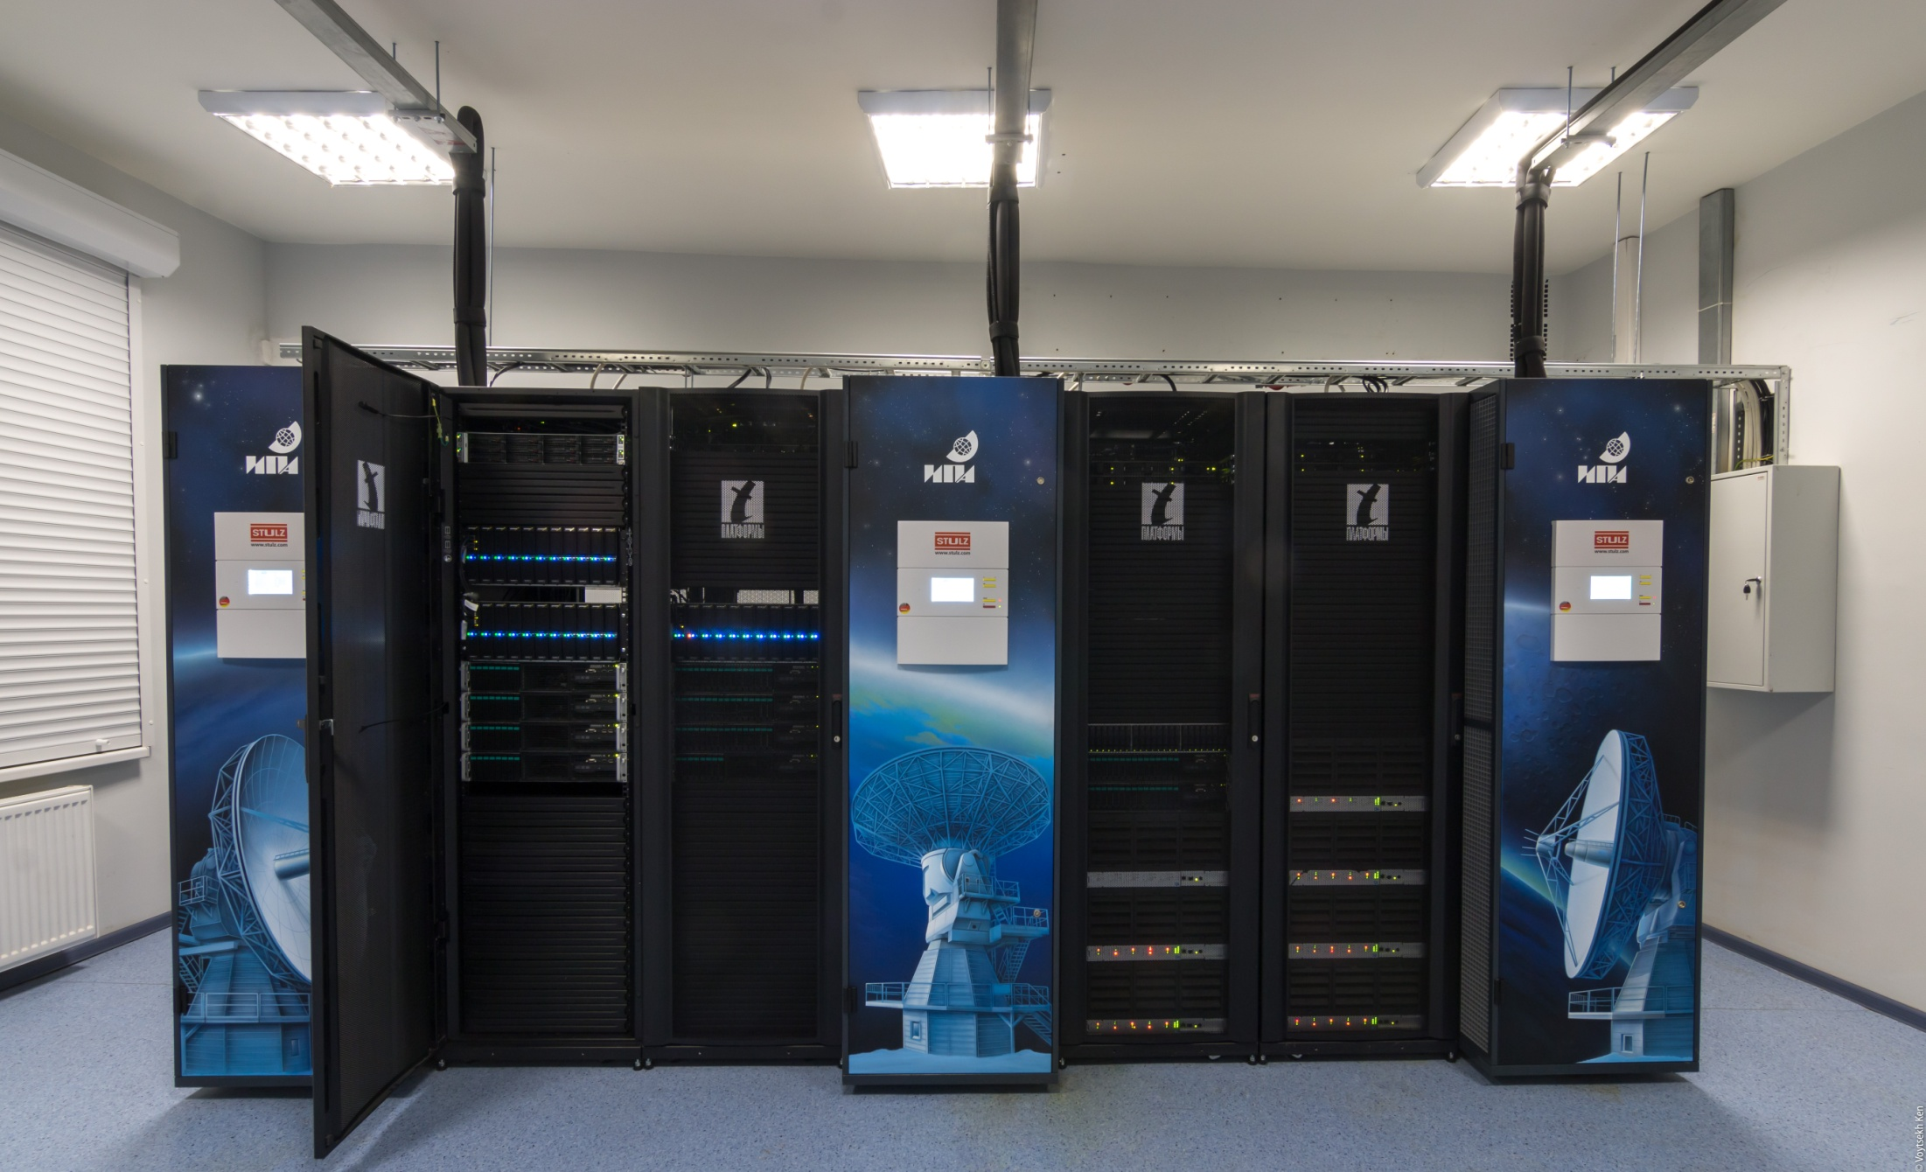
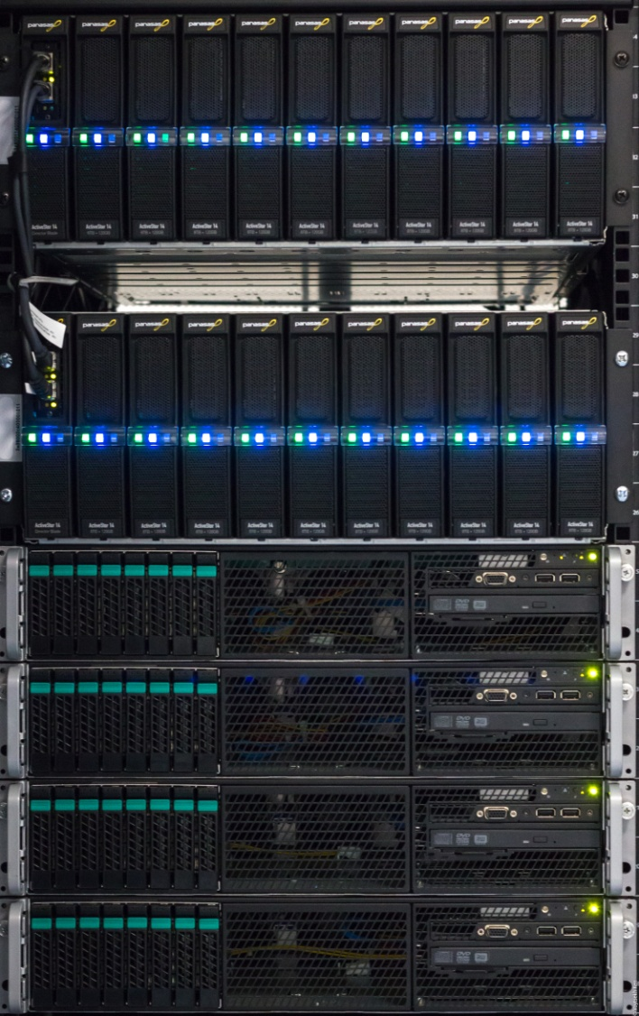
Correlator hardware

Slide 9
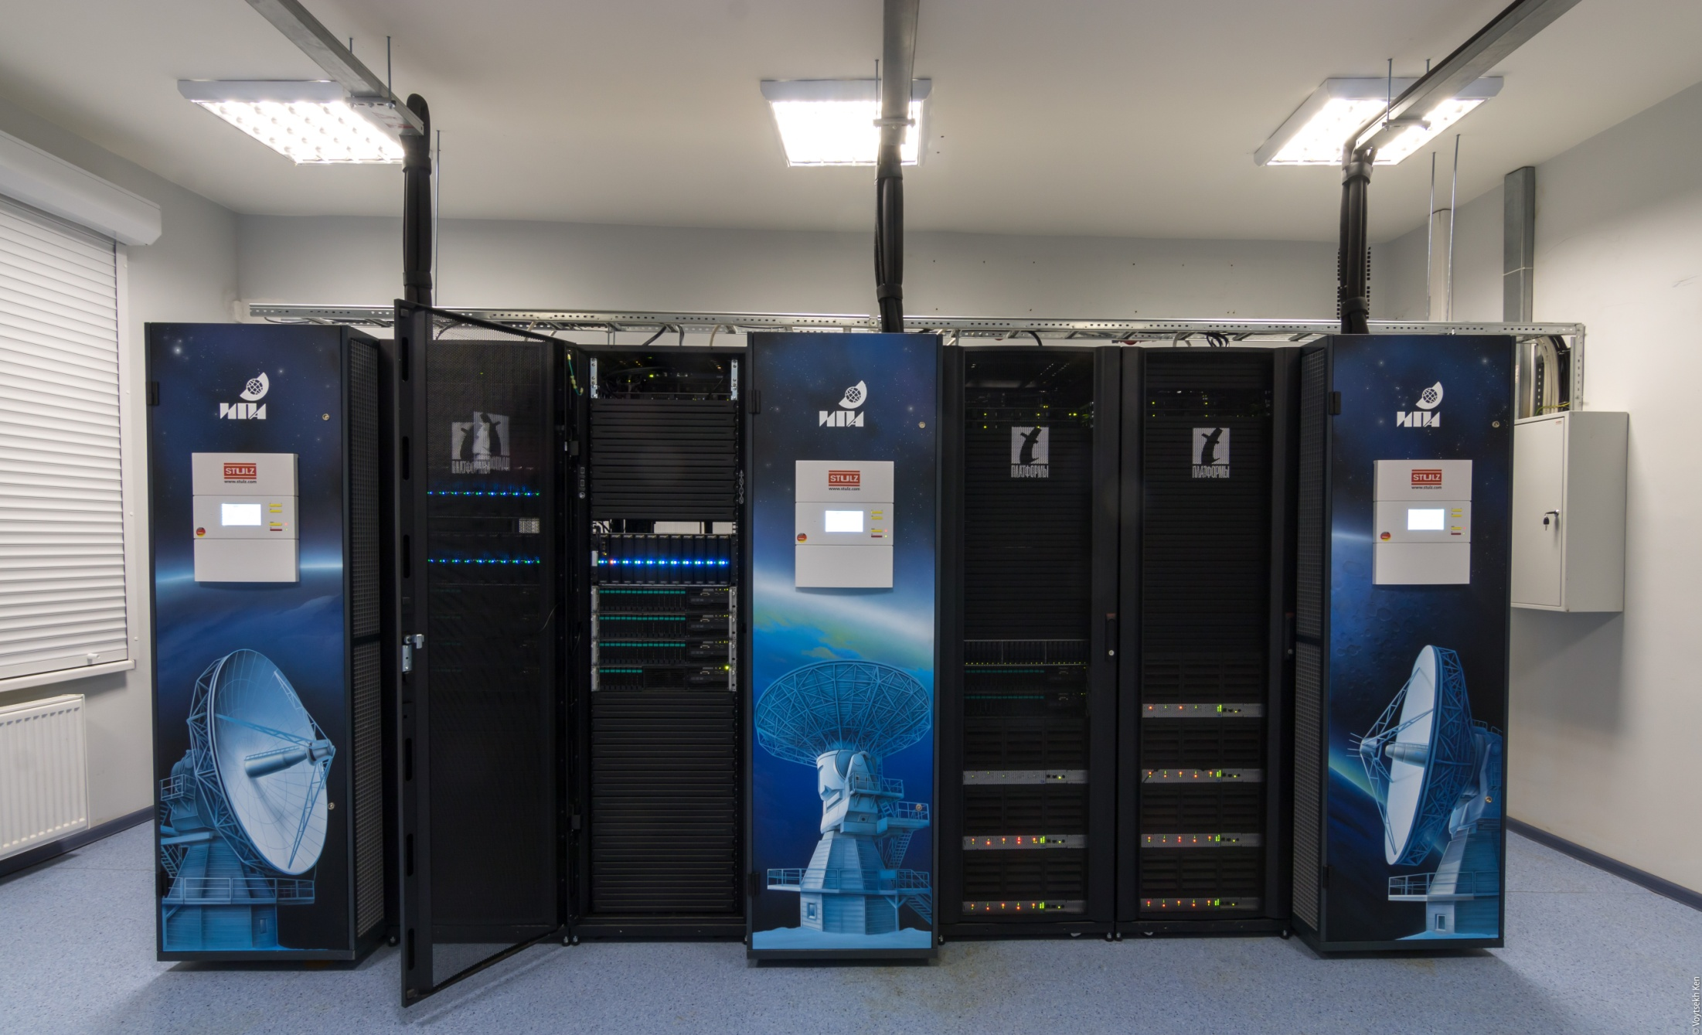
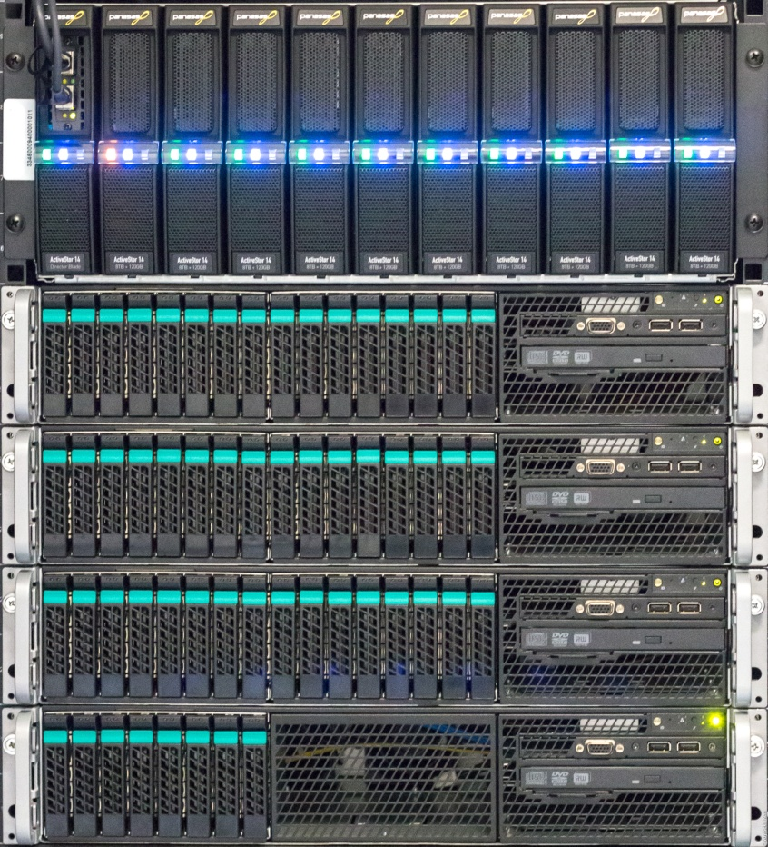
Correlator hardware

Slide 10
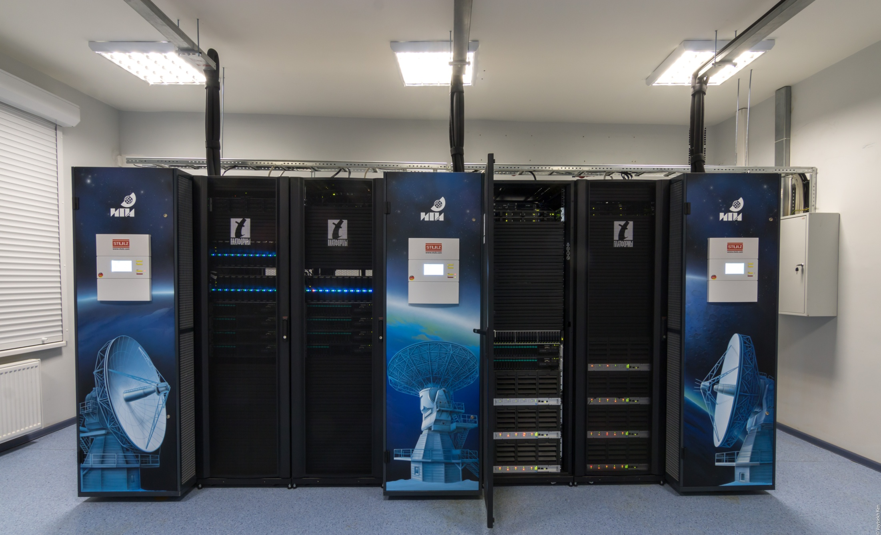
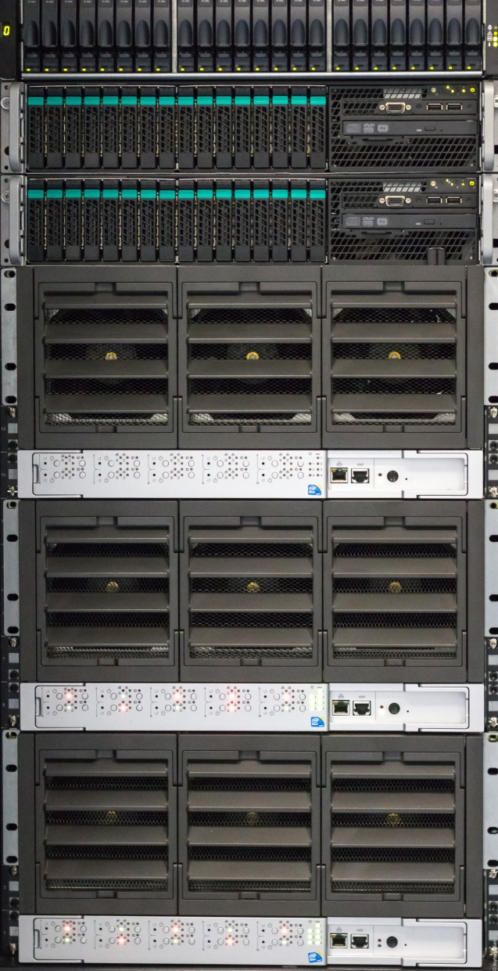
Correlator hardware

Slide 11
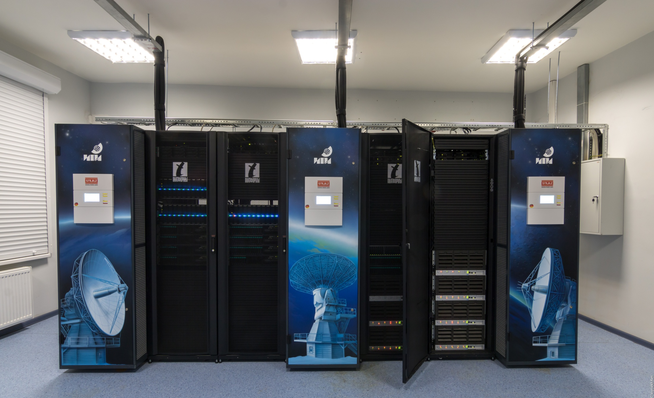
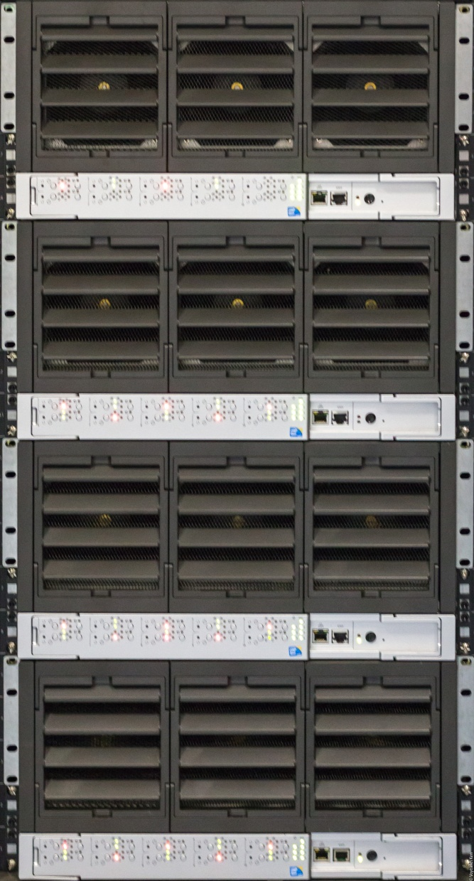
Correlator hardware

Slide 12
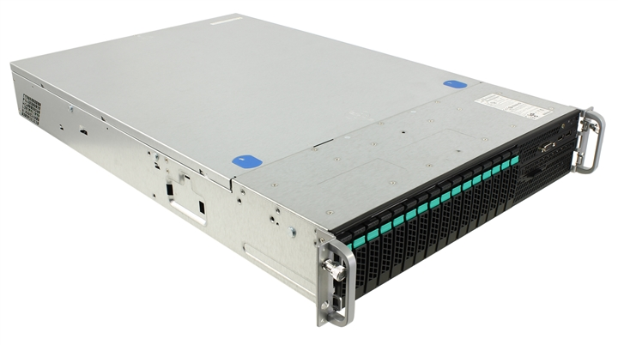
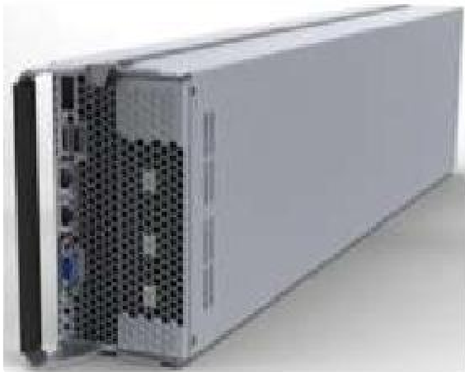
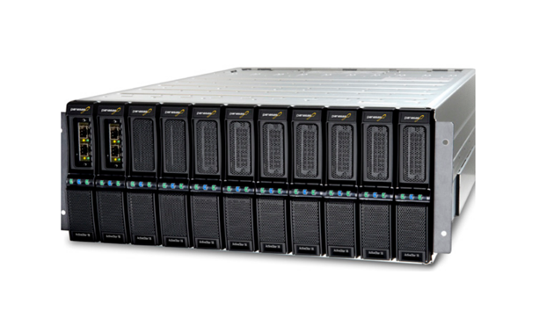
RASFX HPC cluster specs
40 computing servers
2 Intel E6-5-2670 8-core, 2.6 GHz
2 GPUs Nvidia Tesla K20m
256 GB RAM (8 servers)
64 GB RAM (32 servers)
56 Gbps Infiniband (Mellanox)
16x10GbE
Panasas data storage 3x75 TB
Linux Centos 6
96 kW UPS
3 A/C Stulz
Linpack: 85.34 Tflops, Peak: 106.91 Tflops

Slide 13
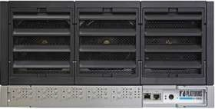
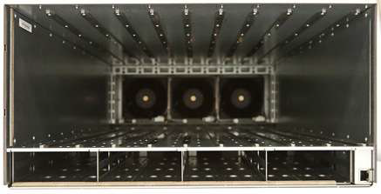
Correlator hardware
V200F computing module
Up to 5 hybrid compute modules per V5000 chassis
Over 14 TFLOPS in 5-node configuration (х86+GPU)
2 Intel E6-5-2670 8-core, 2.6 GHz
2 NVIDIA Tesla K20m (Kepler) GPUs
8 x 8 GB DDR3 RDIMMs (1066/1333/1600MHz)
2 cold swap disks (2.5”, SAS/SATA 3Gb/s, up to 2TB)
2 external GbE ports & one optional FDR InfiniBand /40GbE VPI port
Internal 100Mb/s management port (through the midplane)

Slide 14
RASFX software topology
Head module (Correlator Control System)
RASFX control, streams distribution, logging etc.
Station module (SM)
Input: VGOS data (up to 16 Gbps)
Processing: VDIF/Mark5B decoding, delay tracking, PCal extracting, bits repacking
Output: bit stream (up to 16 Gbps)
Correlation module (CM)
Input: bit stream (max. 1.5 Gbps)
Processing: fringe stopping, FFT, fractional correction, spectra multiplication (correlation)
Output: cross-spectra data (max. 1.25 Mbps per accumulation period)
Wideband observation postprocessing system (WOPS)
Fringe fitting, group delays, signal-to-noise-ratio, NGS cards
Graphical User Interface (GUI)
Visualization and simplifying data processing

Slide 15
RASFX control system
GUI or scripts
Scheduling system
Session schedule
Schedule parser
Ephemeris calculations
Task files generation
Starting and communicating with external processes
RASFX correlator instance
Data transfer system
Control module
Station Modules
Correlation Modules
Postprocessing system
Head module
Notes:
Schedule system

Slide 16
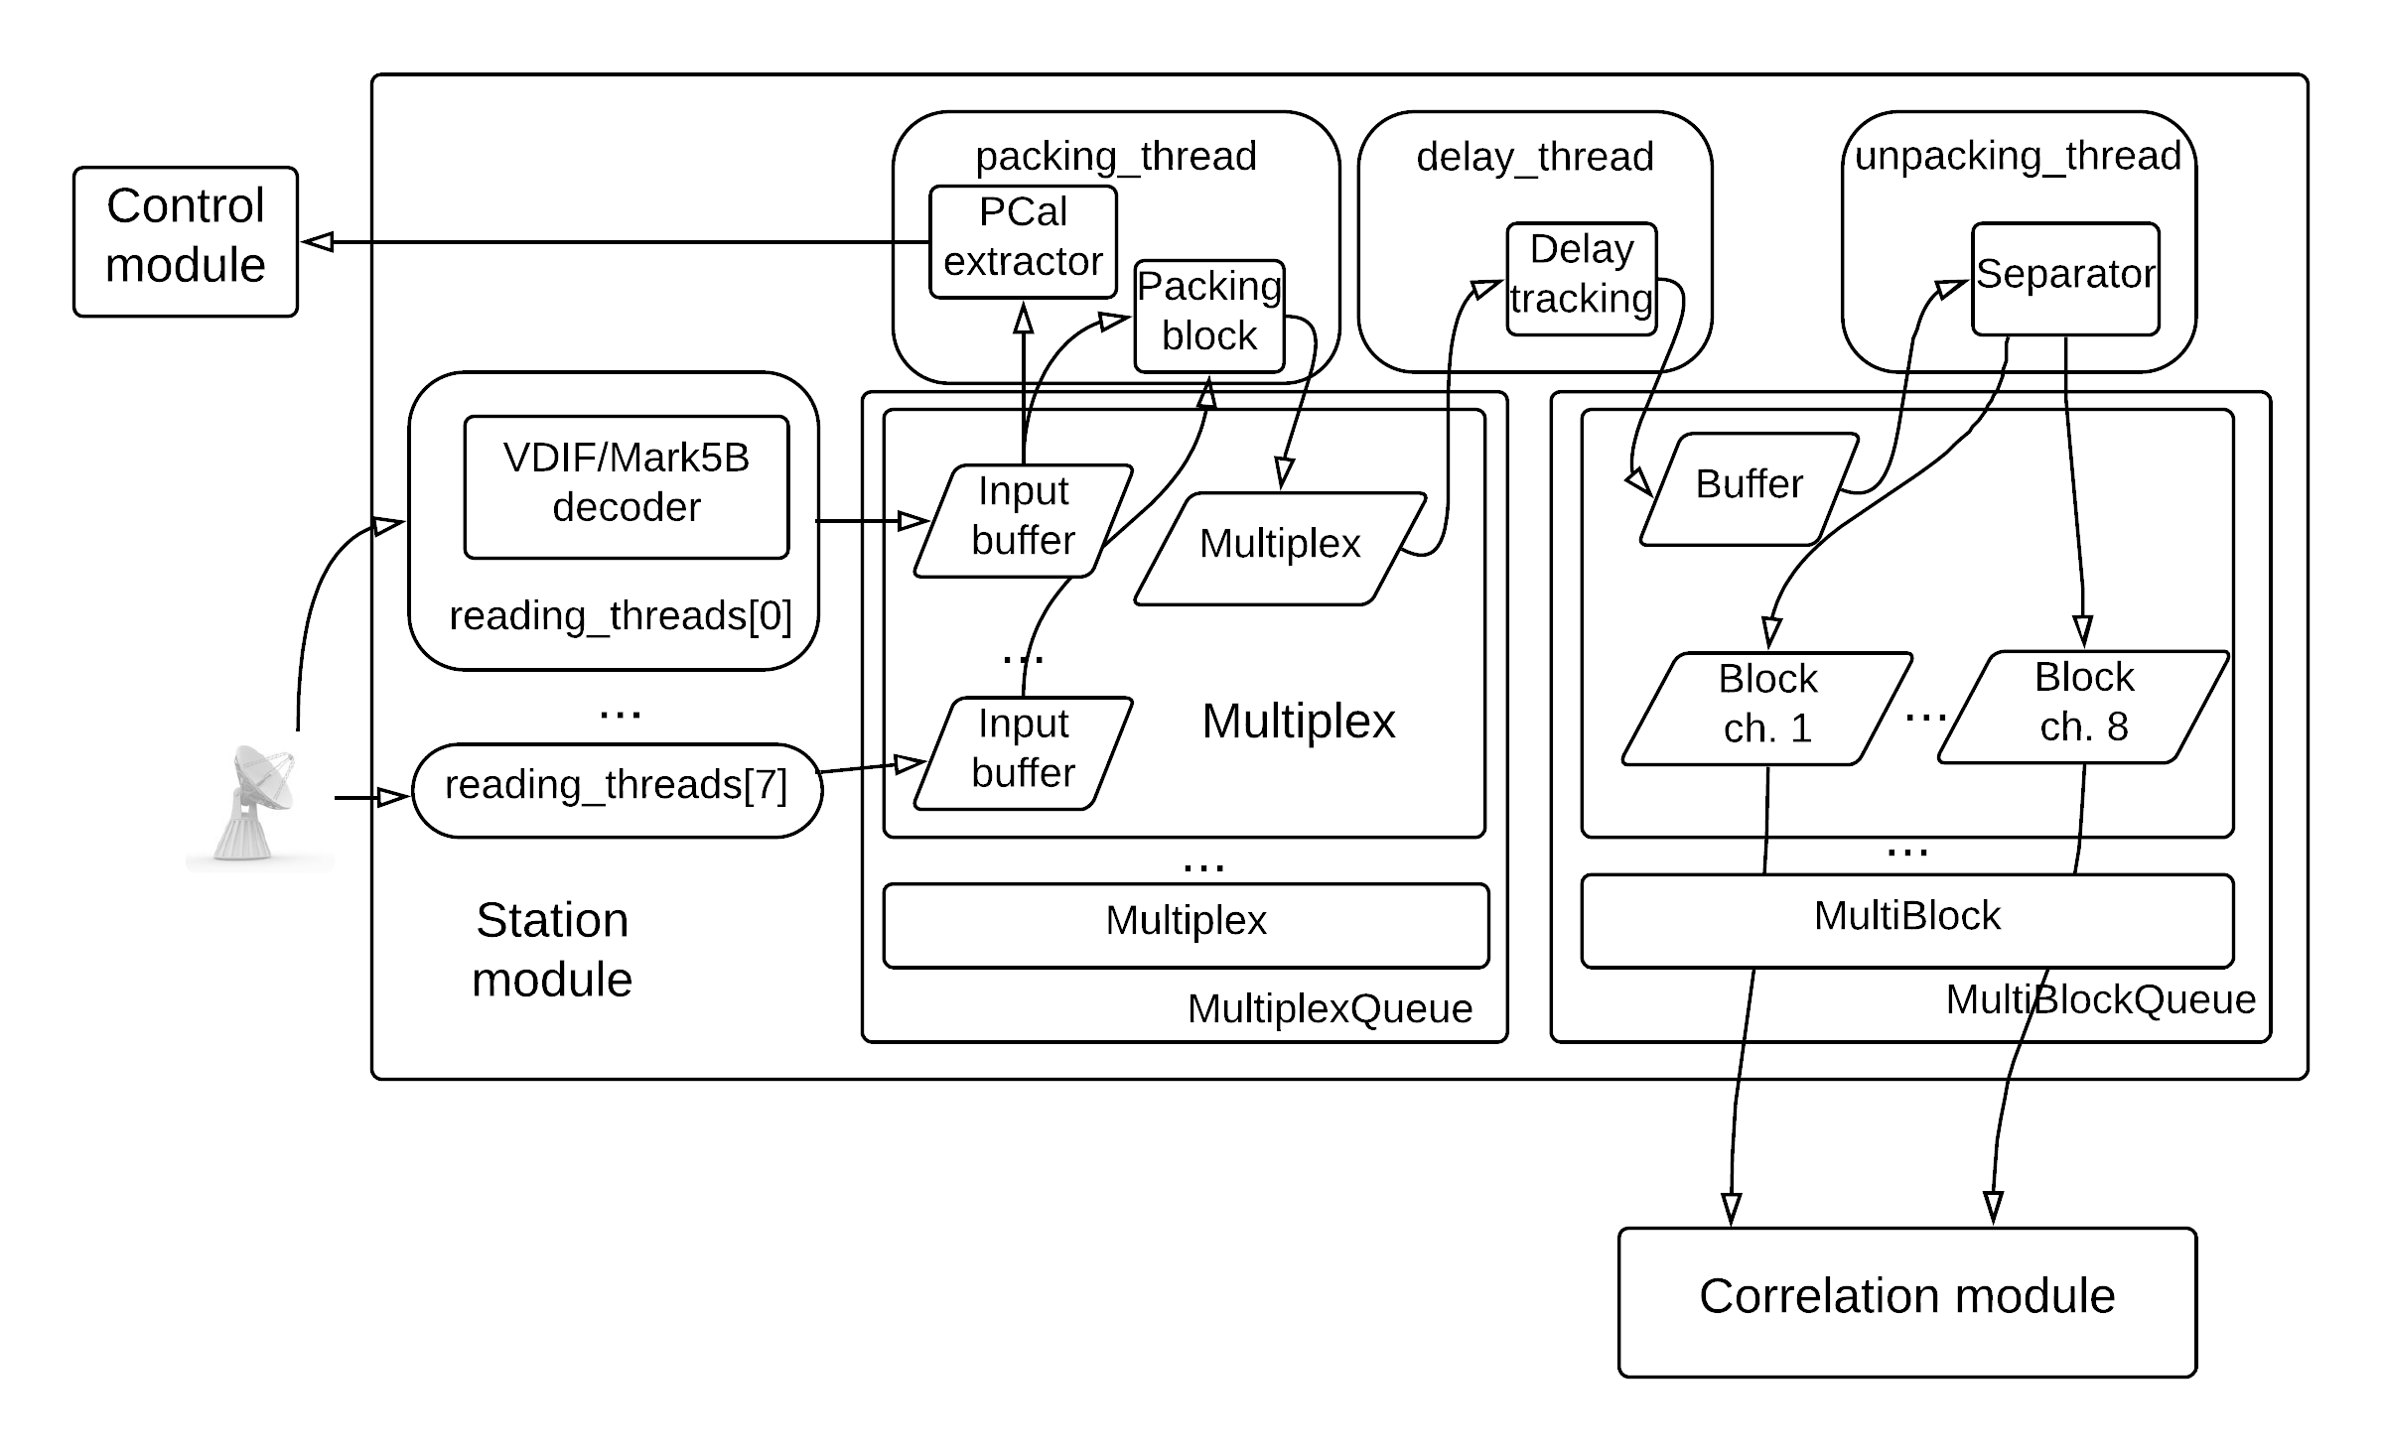
Station module

Slide 17
Correlation module
Doppler
tracking
Fractional
correction
FFT
Constant memory
Shared memory
Correlation
CUFFT
Doppler tracking
Fractional
correction
FFT
Head module

Slide 18
Wideband Observation Postprocessing System
Features:
Input data format: RASFX database
Calculates fringe’s amplitude and phase, group delay, delay rate, SNR, ionospheric delay, total delay
Singleband and multiband modes
The masking of frequency channels of cross-spectra
Interactions with others RASFX modules throw Socket connections. Singleband mode runs in parallel with RASFX processing.
Ability to split scan by integration time and frequency channels for non-routine processing purposes
Developed using C++

Slide 19
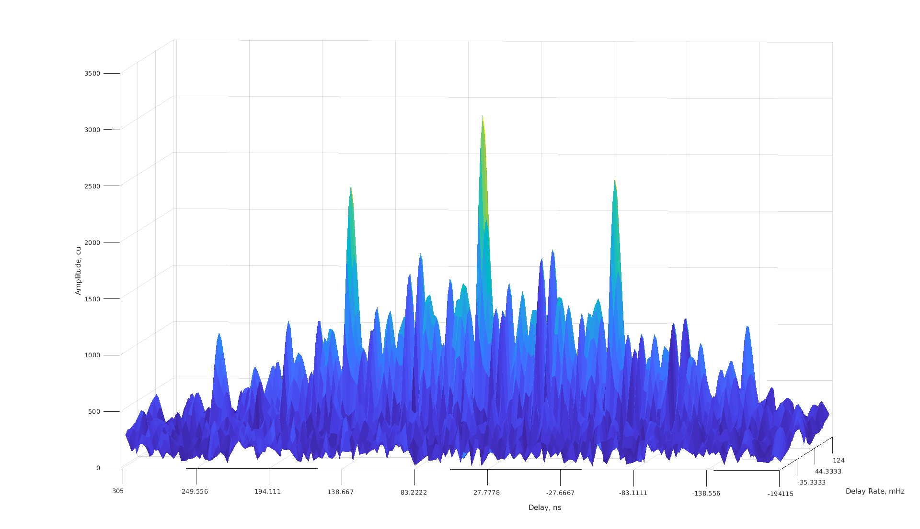
Wideband Observation Postprocessing System
Session: RI2300, scan: 067-1912, Baseline: ZcBd, X-band (8 channels)

Slide 20
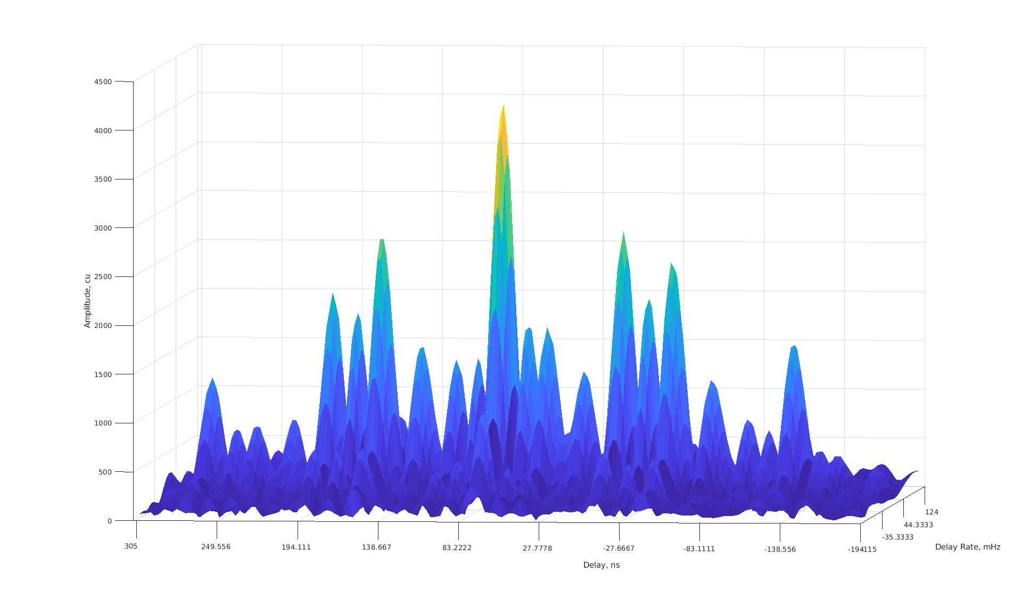
Wideband Observation Postprocessing System
Session: RI2300, scan: 067-1912, Baseline: ZcBd, S-band (6 channels)

Slide 21
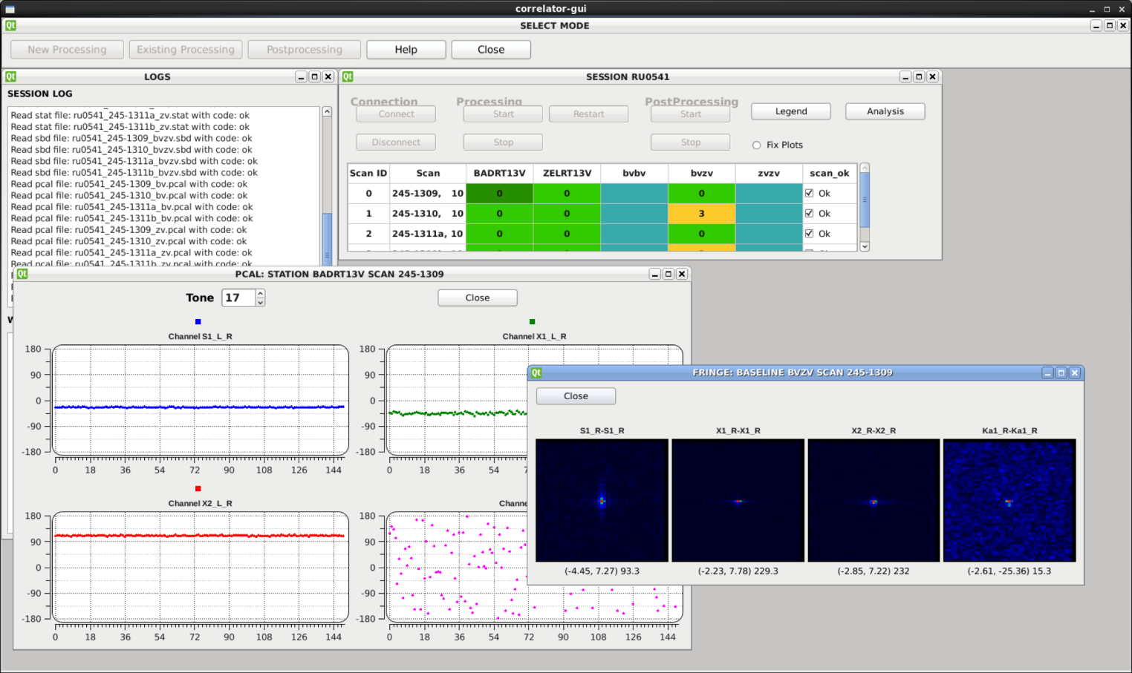
Graphical User Interface
Designed with Qt4

Slide 22
Self-Benchmark Test
Test session was carried out with the following setup:
Zelenchukskaya – Badary baseline
Bandwidth 512 MHz
4 bands / 2 polarization
2 bit sampling
40 s scan duration
2 stations 6 stations
Scans were allocated in /tmpfs in 6 cachers
Benchmark mode:
8 channels
4096 frequency channels
Total data rate 16 Gbps
78 fringes in one frequency band, 312 fringes total
Notes:
96 GBPS!

Slide 23
Self-Benchmark Test
Notes:
96 GBPS!

Slide 24
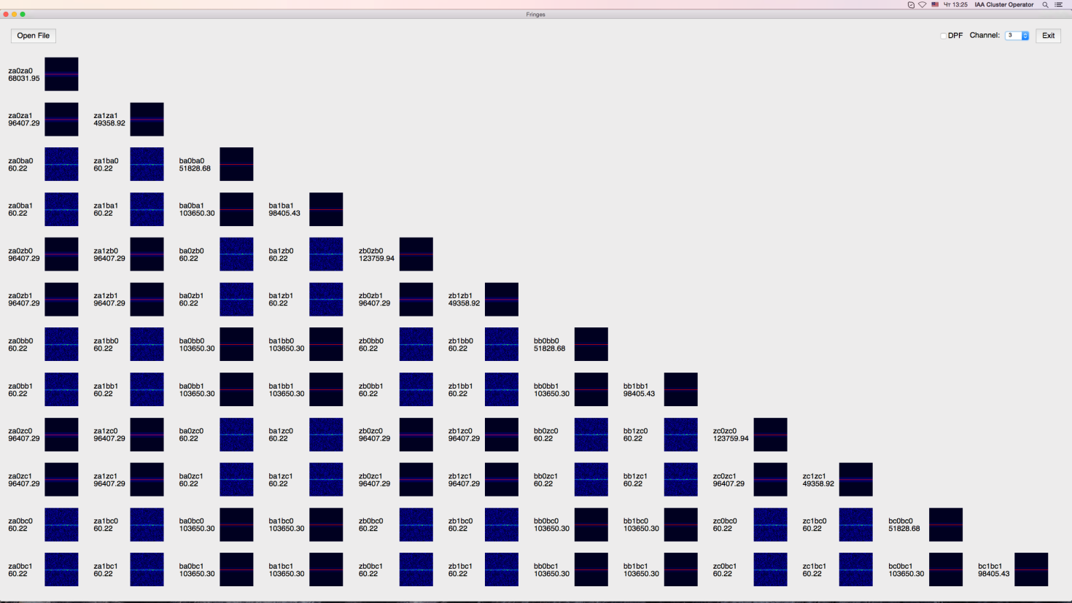
Self-Benchmark Test
42 seconds for 40-s scan processing (incl. initialization operations)

Slide 25
Correlator hardware requirements
16 Gbps input data stream, 4096 channels, 4 frequency bands
Stations | Polarizations | Baselines Cross+auto | GPUs K20 | Blade servers
2 | 1 2 | 3 10 | 8 14 | 4 7
3 | 1 2 | 6 21 | 10 22 | 5 11
4 | 1 2 | 10 36 | 14 27 | 7 14
5 | 1 2 | 15 55 | 16 41 | 8 21
6 | 1 2 | 21 78 | 22 55 | 11 28

Slide 26
DiFX (IAA RAS) vs RASFX Benchmark Test
 | 2 station, 4 chan. | 2 station, 8 chan. | 6 station, 8 chan.
Tint, s | 0.0625 | 0.0625 | 0.0625
Nchan | 4096 | 4096 | 4096
Xpol | No | Yes | Yes
Correlations per band | 3 | 3 | 72
Stations data rate, Gbps | 16 | 32 | 96
DiFX Intel CPU cores V200F servers Ratio to real-time | 95 7 1:1 | 180 12 1.45:1 | 280 19 2.6:1
RASFX V200F servers, 1:1 | 2 | 7 | 28

Slide 27
Сomparison of DiFX (ver. 2.4.1) and RASFX using PIMA (ver. 2.24)
DiFX
RASFX
 | RASFX | DiFX
Integration time, s | 0.0625 | 0.0625
Spectral resolution, MHz | 0.25 | 0.25
Output data format | Baseline | SWIN
Postprocessing software | WOPS | PIMA
SWIN
Baseline
base2swin
difx2fits
correlator models
difx2fits
50+ wideband sessions were processed
S (RCP), S (LCP), X1 (RCP), X2 (RCP)
NGS files for each combinations were calculated (200+)
Differences of IERS C04 and UT1-UTC were performed with Quasar suite
PIMA
WOPS
NGS
QUASAR
UT1-UTC

Slide 28
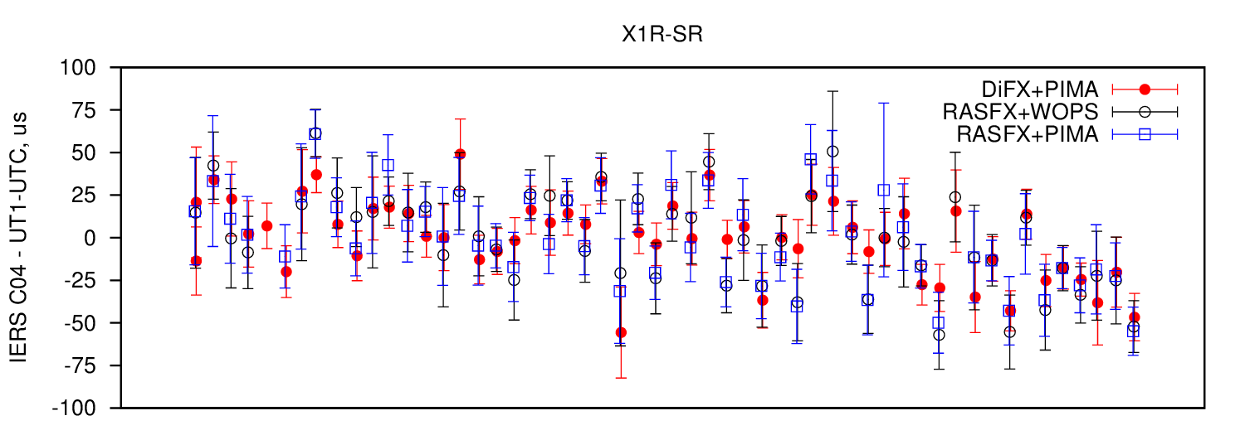
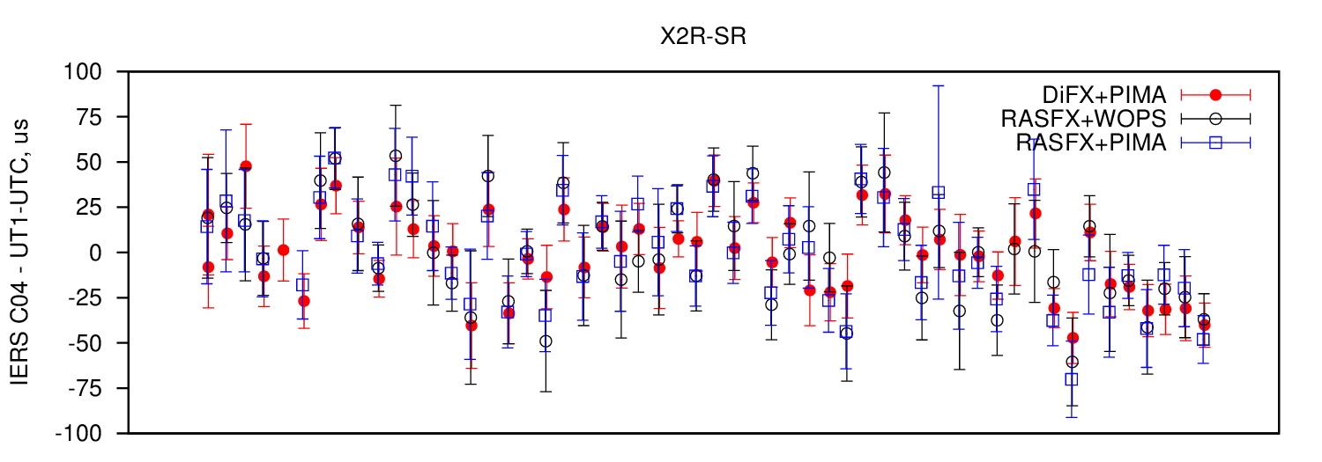
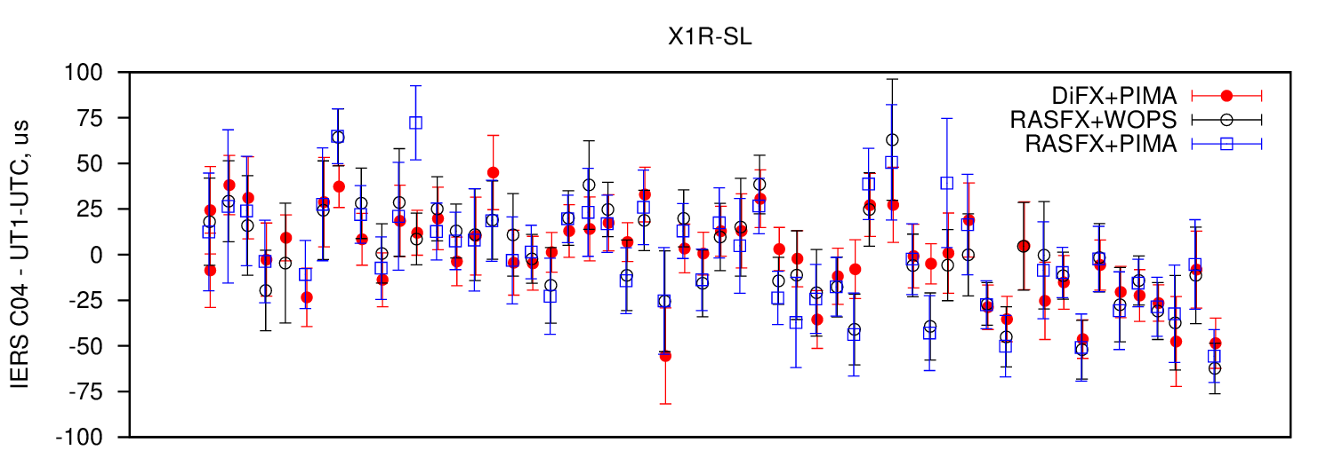
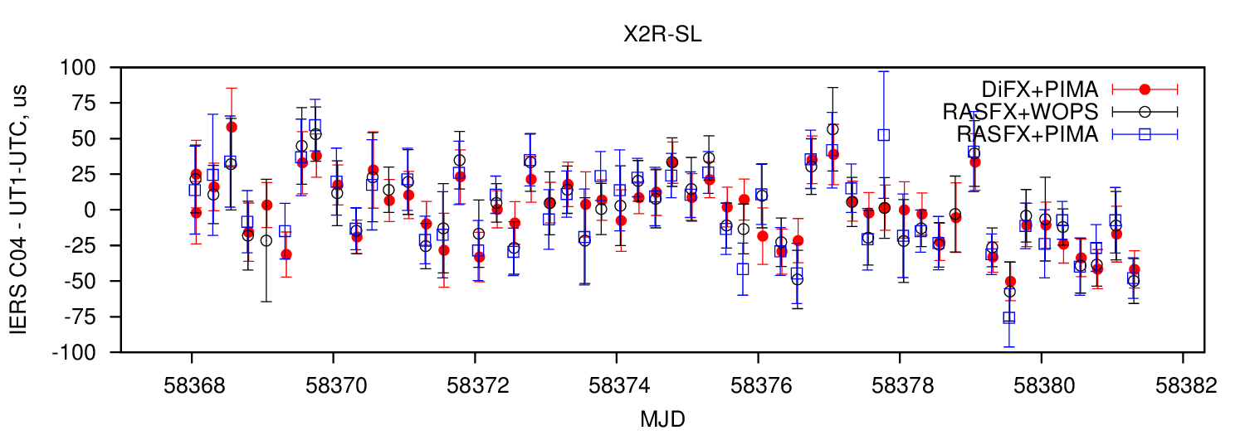
𝝈_{UT1-UTC} ≤ 30 us

Slide 29
Routine processing
Five 1-hour geodetic program in S/X band for UT determination (“R”, 2 x RT-13) daily
(20-24 TB/day)
Single 30-min geodetic program in S/X/Ka band for UT determination (“RX”, RT-13) daily
(1.2 TB/day)
Single 1-hour geodetic program in S/X band for UT determination (“RI”, 3 x RT-32) daily
(120 GB/day)
Miscellaneous test sessions (“Ru-TEST”)
(It depends / day)
During 2015-2018 more than 5400 sessions were processed
And one another has been finished by my talk

Slide 30
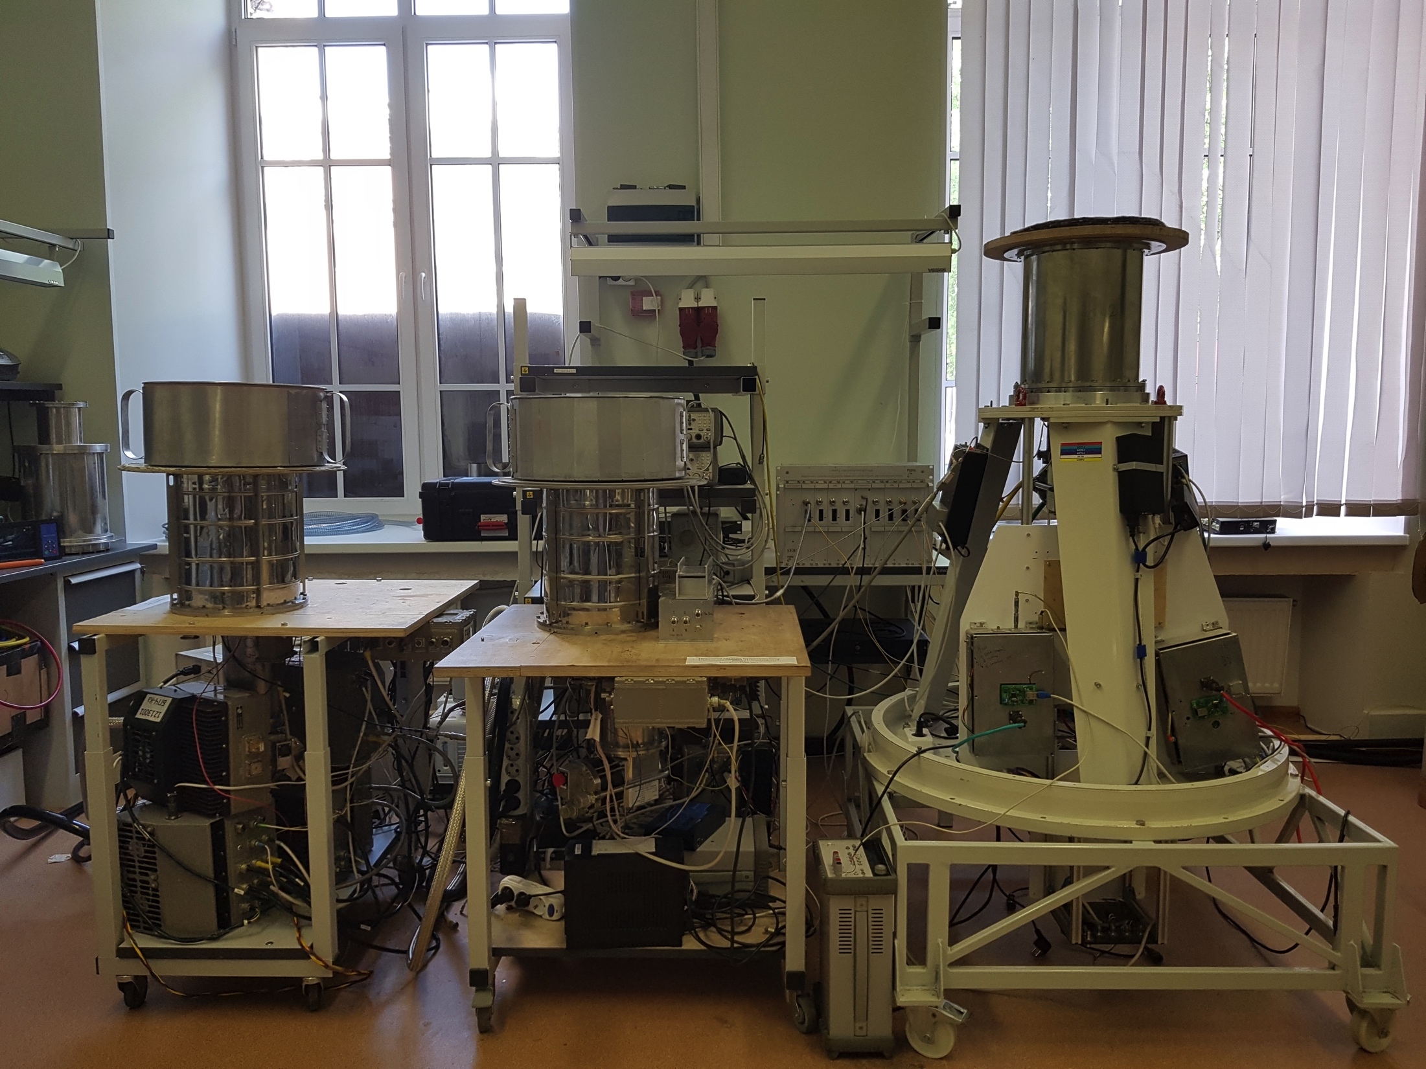
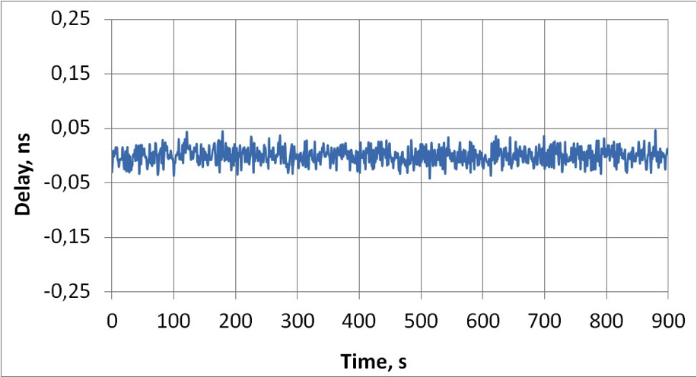
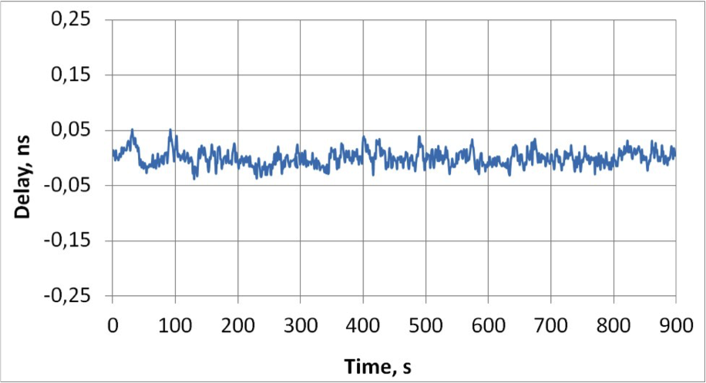
Non-routine processing
Zero-baseline Lab radiointerferometer’ prototype
2 Tri-band (S/X/Ka) receivers
Ultra-wideband (UWB) receiver (3-16 GHz)
Noise source, adjustable SNR
Broadband Acquisition System (512 MHz)
Frequency Standard
Data Transfer System (DTS)
RASFX correlator
200+ sessions were carried out in S/X/Ka
scan duration from 10 s to 20 min
session duration from 5 min up to 2.5 hours
Tri-Tri
X-band
15 min
σ_{delay} = 6.9 ps
Tri-UWB
X-band
15 min
σ_{delay} = 14.2 ps

Slide 31
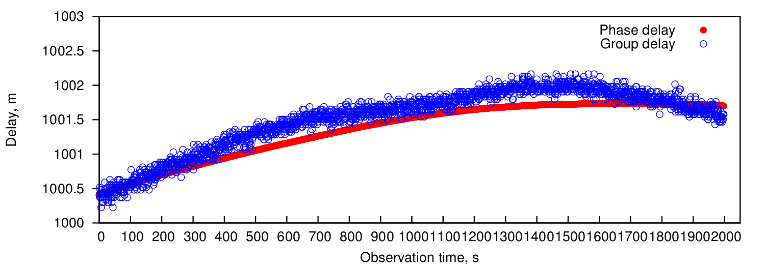
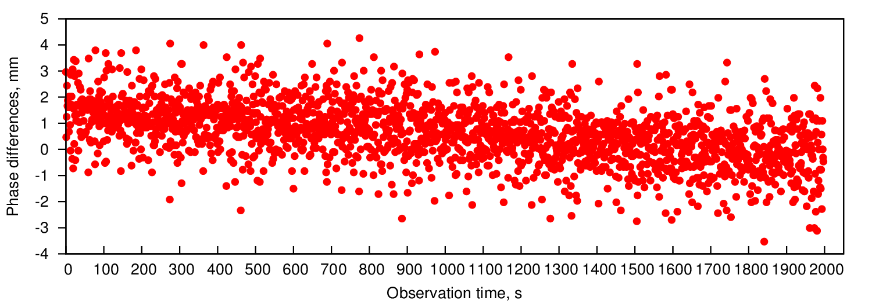
Non-routine processing
GLONASS spacecraft processing
Special postprocessing software was developed, which evaluates spacecraft’s delays
More than 110 h of observations were carried out on Quasar network (RT-32) in L1 band
Group and phase delays were obtained using RASFX correlator
Scan 126_1939 (BdZc baseline)
𝝈 ≈ 3 mm
Notes:
RASFX также используется в обработке сигналов КА Глонасс в режиме РСДБ. Одна из главных задач этих экспериментов является получение значений рассогласований техник ЛЛР, ГНСС и РСДБ. Для решения этих задач была разработана отдельная специальная версия постпроцессорного обеспечения, позволяющая вычислять задержки сигналов КА. В мае 2017 на РТ-32 было зарегистрировано более 110 часов наблюдений КА в L1. На слайде показаны первые результаты этой обработки: групповые и фазовые задержки, а также первая разность фазовой задержки. Видно, что вычисления по фазовой задержке позволили получить значения СКО задержки в единицы мм. Работа будет в дальнейшем продолжаться

Slide 32
Summary & plans
RASFX correlator was designed and implemented in the IAA RAS
HPC cluster with the 85+ Tflops performance
GPUs are used in the most laborious operations
Up to the 96 Gbps near real-time processing from up to a 6 stations
RASFX and DiFX differences of C04-UT1-UTC are in a very good agreement
About 6000 sessions have been processed by November 13, 2018
RASFX correlator is used in quasi-VLBI tests and GNSS processing
Extending output data formats: FITS-IDI, vgos-DB, gvf…
Spacecraft’s signal data processing
Asteroids processing with radar observations in VLBI mode
Pulsars processing (incl. development of pulsar-based timescale)
Further comparison with correlators
Any other ideas?

