Slide 1
Promoting the Earth-Moon Radio-phase Ranging for Astrodynamics and Other Applications
Jinsong PING (Prof. Dr.) jsping@bao.ac.cn
National Astronomical Observatories of CAS, Beijing, China

Slide 2
Contents
Introduction of NAOC
Lunar Radio-phase Ranging
Future works
Other Applications

Slide 3

HQ Address：20A Datun Road, Chaoyang District, Beijing, China
Research Divisions
CAS Key Laboratories
Satellite Observatories
Facilities
    Telescopes
    Labs
    Virtual Observatory

Slide 4
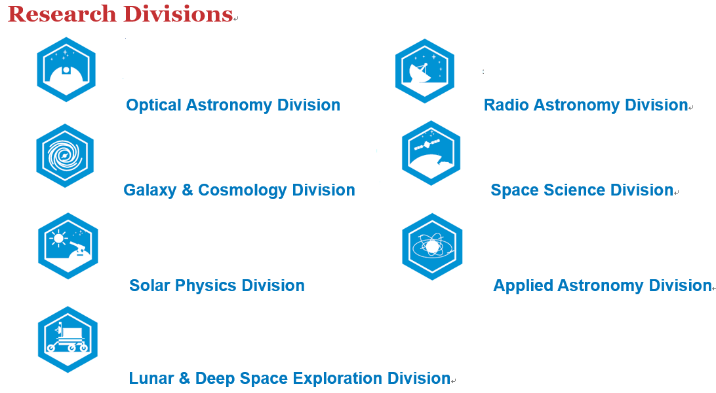

Slide 5
CAS Key Laboratories
Key Laboratory of Optical Astronomy, Chinese Academy of Sciences
Key Laboratory of Solar Activities, Chinese Academy of Sciences
Key Laboratory of Lunar and Deep Space Exploration, Chinese Academy of Sciences
Key Laboratory of Space Astronomy and Technology, Chinese Academy of Sciences
Key Laboratory of Computational Astrophysics, Chinese Academy of Sciences

Slide 6
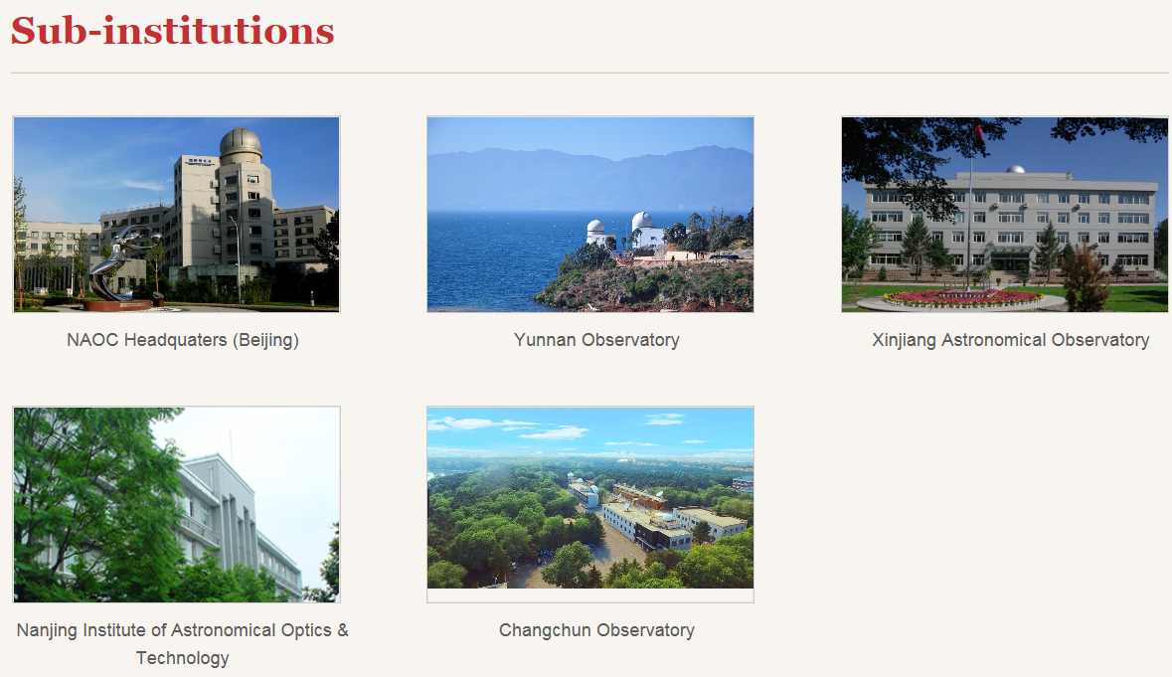

Slide 7
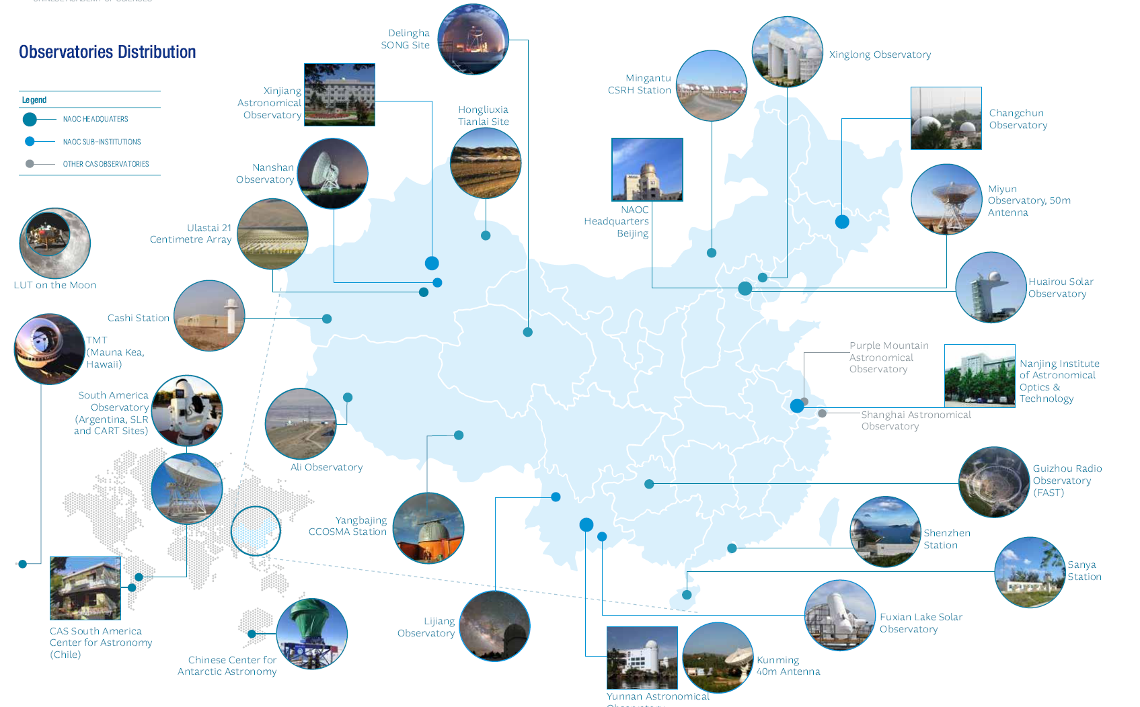

Slide 8
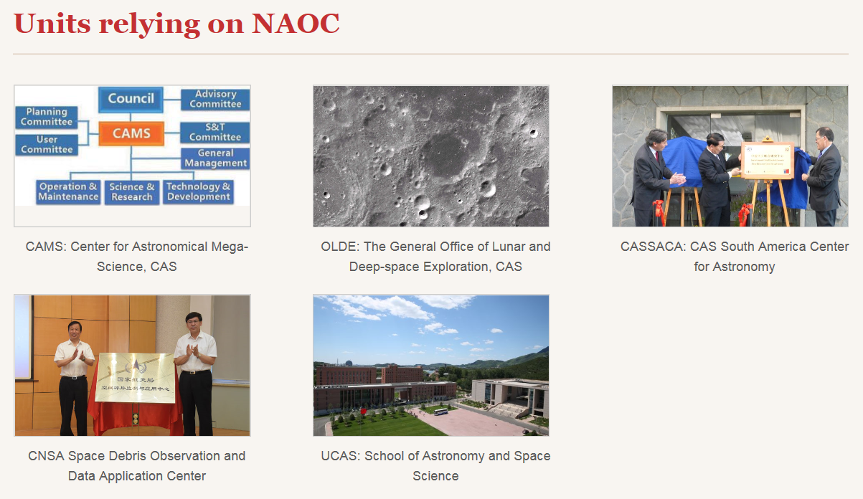

Slide 9
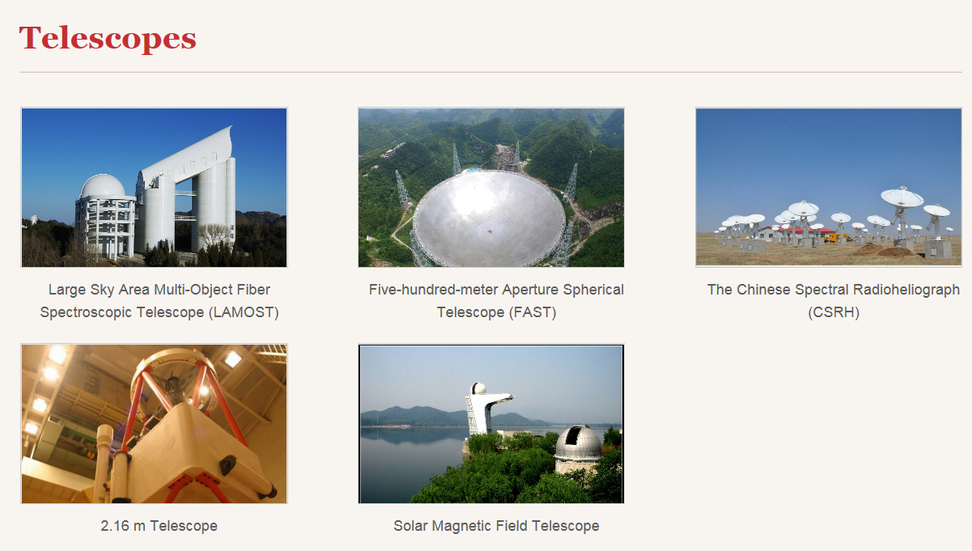

Slide 10
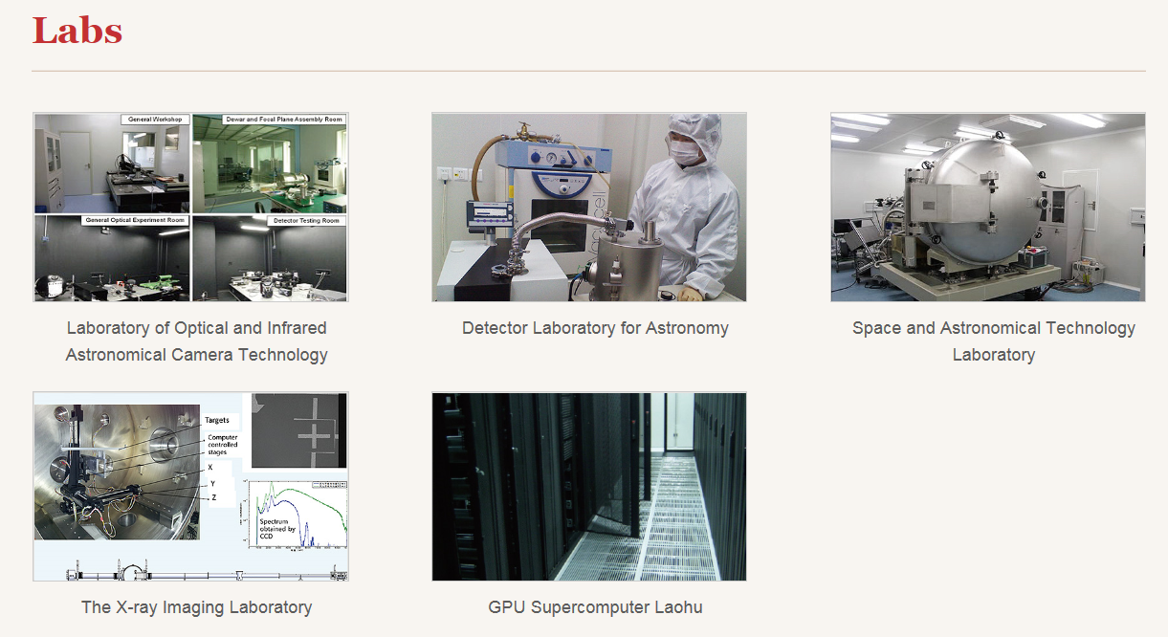
@ HQ

Slide 11
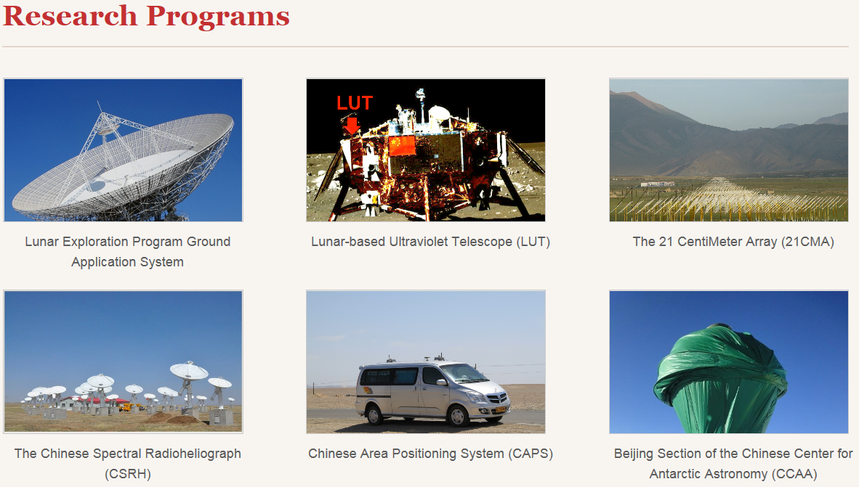
VLBI Involved
Space VLBI Involved

Slide 12
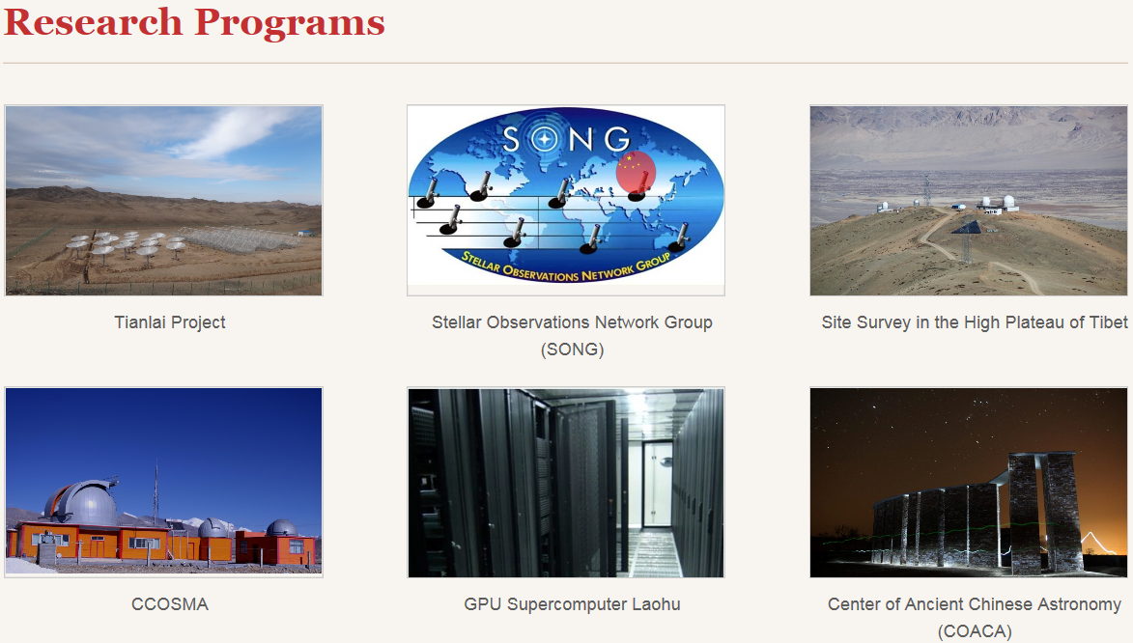
LF/Space VLBI Involved

Slide 13
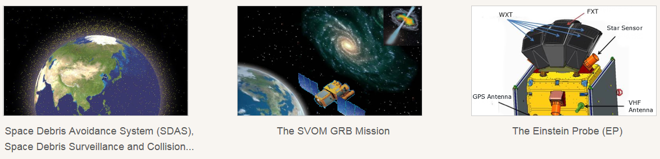
Radar VLBI Involved

Slide 14
Lunar Radio Science Experiments for Studying the Structure and Rodation
Ping Jinsong^{a,} Meng Qiao^{b}, Li Jing^{c}, Li Wenxiaoª, Wang Mingyuanª, Chen Congyan^{b}, Zhang Tianyi^{b}
ªNational Astronomical Observatory of CAS, Datun Rd. 20A, Beijing, China;
^{b}Dongnan University, Sipailou, Nanjing, China;
^{c}State Key Laboratory of Astronautic Dynamics, Xi’an, China;
Contact: jsping@bao.ac.cn

Slide 15
Outline
Radio science experiments have been involved in all of the lunar missions. In Chang’E-3 lander mission, 2 & 3-way Lunar Radio-phase Ranging (LRR) was developed and tested at X-band of 8470MHz.
This LRR method can become a new space geodetic technique to study the geodynamics, lunar dynamics, and to test the theory of relativity, as LLR did.
We successfully realized this new kind of space technique, in CE-3 mission and the preliminary result is presented here.

Slide 16
LLR and LRR
Lunar Laser Ranging
It started from 1969, with 48 years history and data.
Observing requirement, i.e. weather condition, is strict. Pointing accuracy of optical telescope is too high, and the observation is constrained by daylight.
The lunar orbital phase could also affects LLR observation.
Moon
Full Moon
New Moon
Sun
No data
No data
Earth

Slide 17
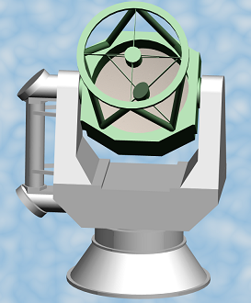
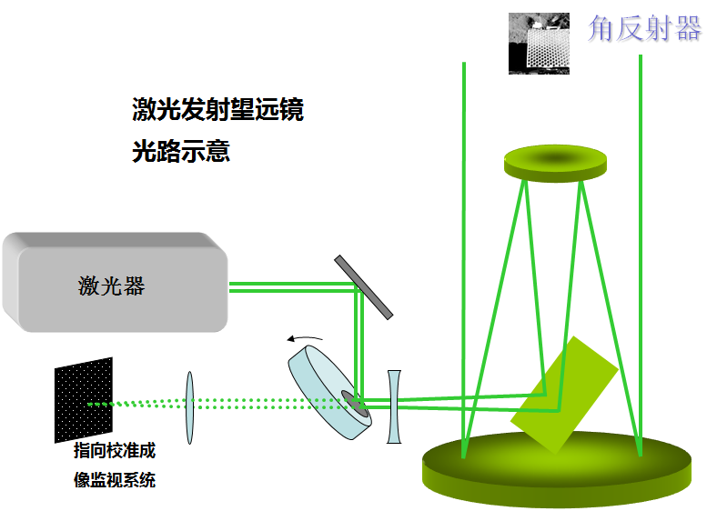
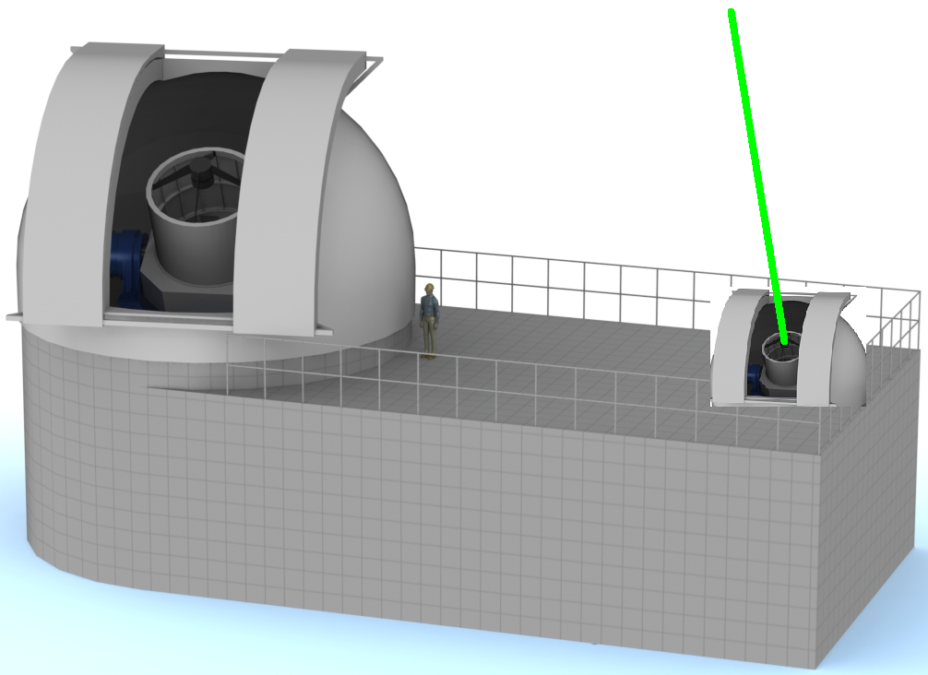
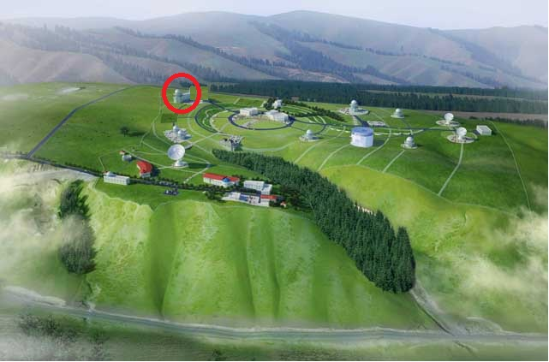
A new LLR ground station
will be built in 4~5 years
in China
532nm and 1064nm kHz
lasers will be used.

Slide 18
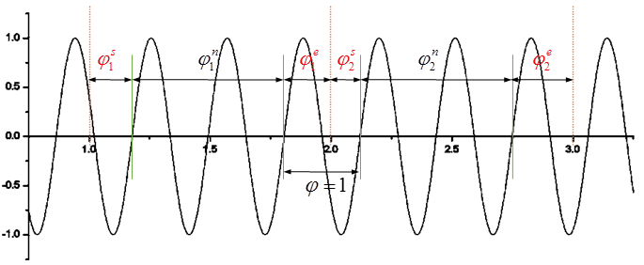
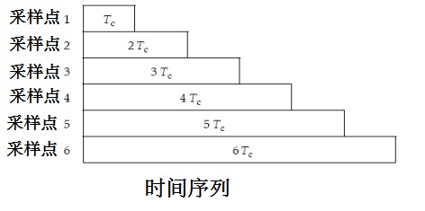
How to measure the radio phase ranging?
Carrier wave from Earth, locked by PLL onboard & sent back to the Earth.
Phase is range measurement
with ambiguity.

Slide 19
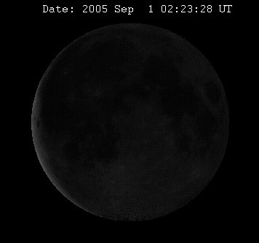
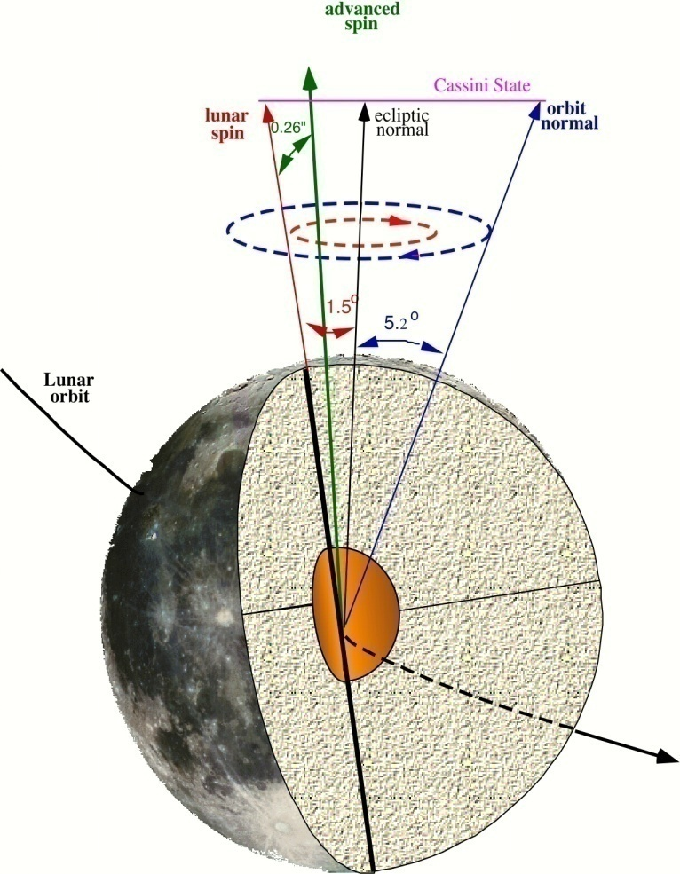
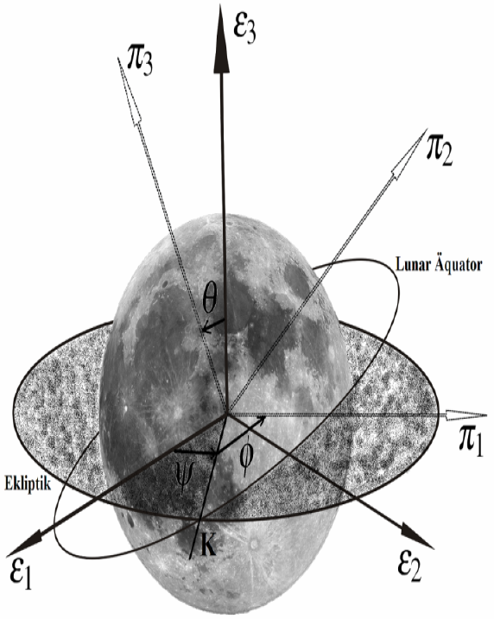
Why Lunar Radio-phase
Ranging (LRR)?
Scientific objectives:
To realize radio ranging (<0.5 mm resolution,
2~3cm post-processing ranging error as LLR)
To monitor lunar orbit and rotation
To measure the LPhL
To prepare for Mars ranging
To study the general relativity

Slide 20
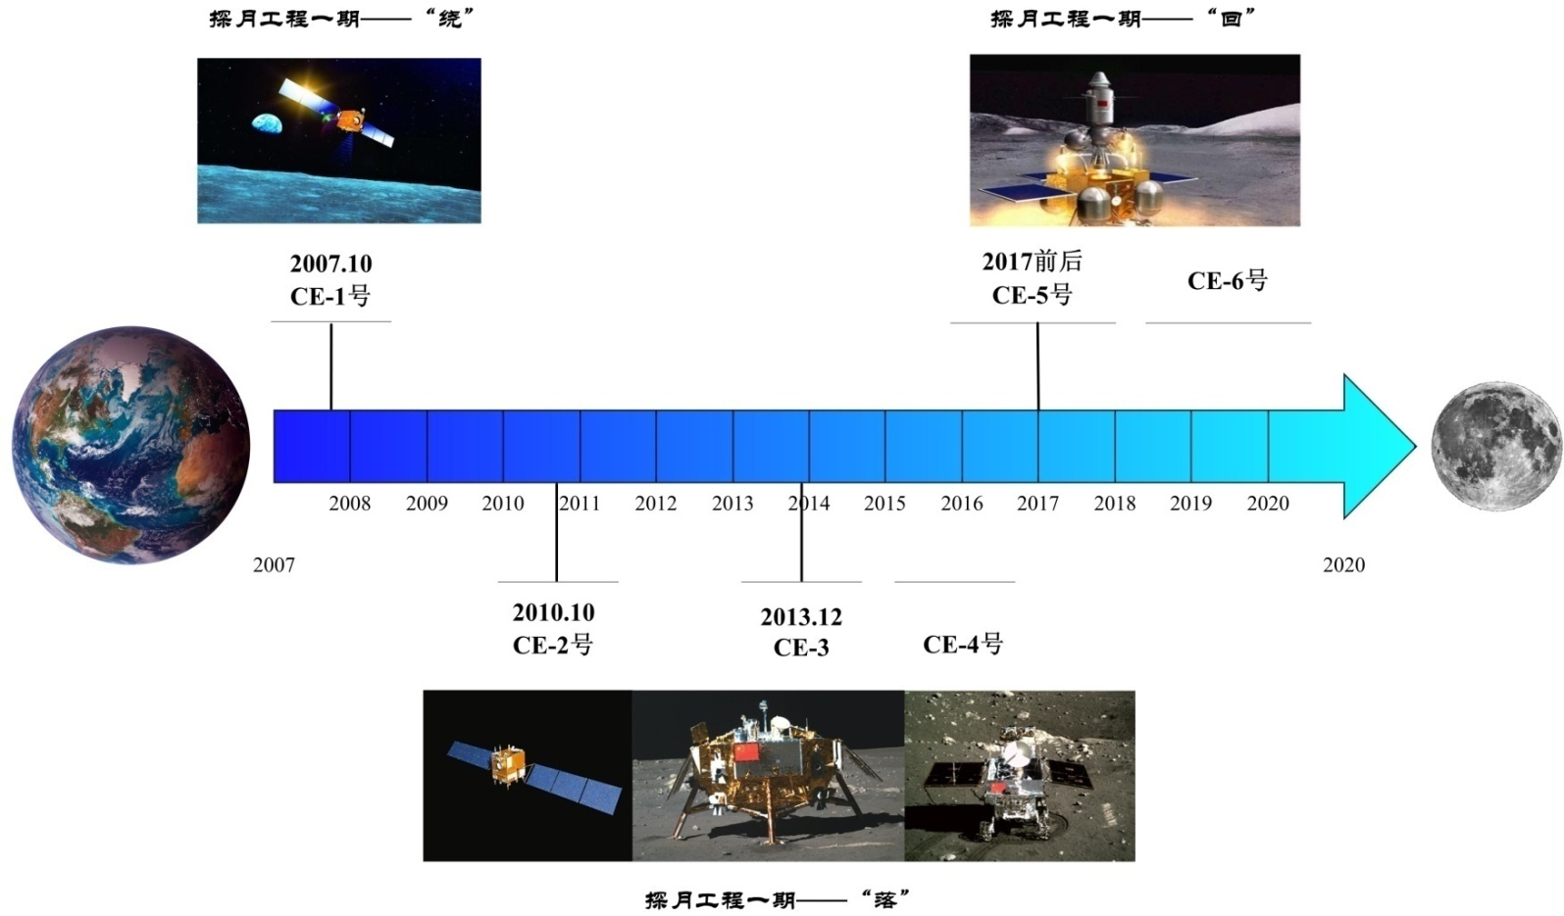
Chang’E Mission Series
Phase One
Phase Three
CE-7 2022?
South Pole Lab
Radio Beacon and LLR
CE-1
CE-5 CE-6
May a Russian Radio
Beacon onboard CE-7 ?
CE-2
CE-3
CE-3
CE-4
Phase Two

Slide 21
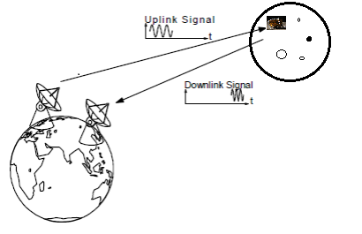
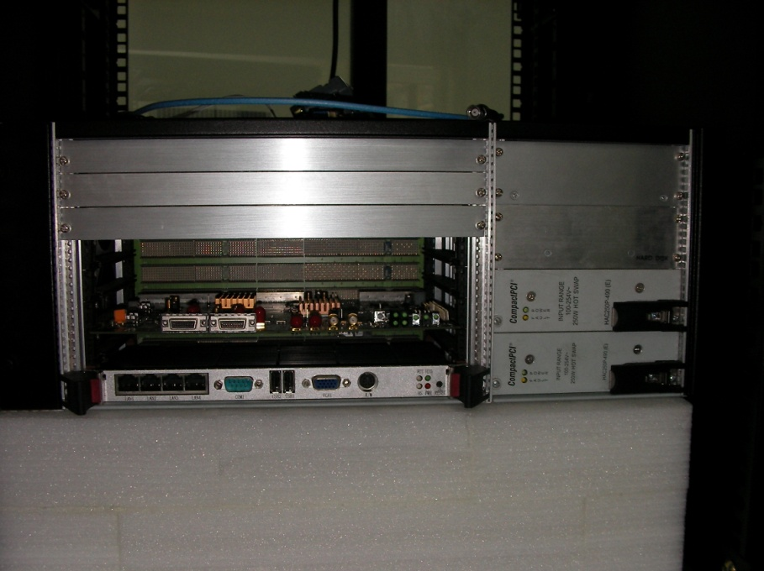
双程上行链路
飞行器
发送和双程接收站
地球
双程下行链路
单/三程下行链路
单/三程接收站
Open loop radio Doppler and phase range tracking with:
(1) H-Clock at each ground station, table and precise;
(2) X-band PLL transponder & transmitter on board;
(3) Many antennas, VLBI & DSN of China TT&C
(4) Open loop multi channel RSR with frequency resolution
of 10^-16

Slide 22
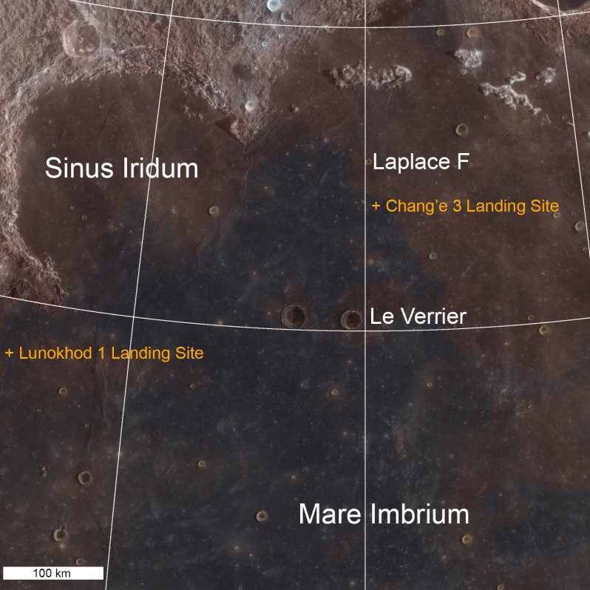
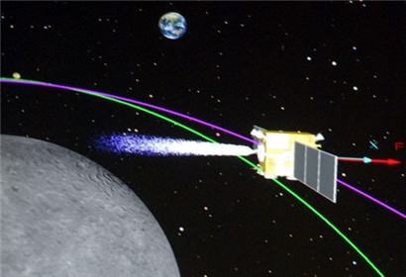
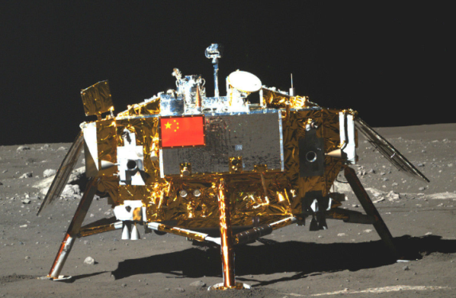
Lunar Radio Ranging
CE-3 explorer successfully soft-landed on lunar surface on Dec. 14th in 2013. The transponder carried by it worked in lunar day, which provided experimental chance for LRR.
The lunar phase influence it less.
There is no interruption on daylight background for LRR.
LRR focuses on carrier wave Doppler and phase ranging. The technology of data collection is ripening.
22
@LRO

Slide 23
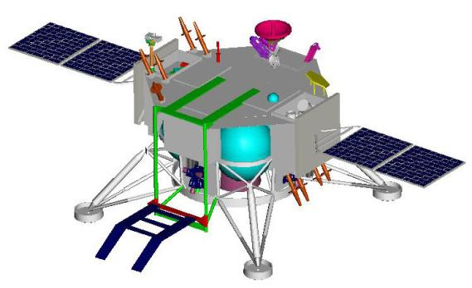
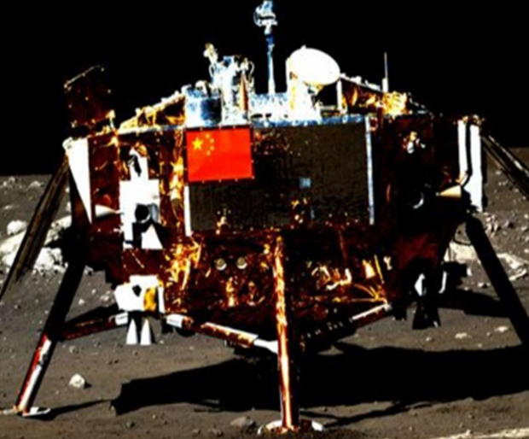
Scientific Instruments on CE-3/4 Lunar Lander
X-band Medium
gain antenna
Panoramic
camera
TT&C
antenna
Mast
HGA
for data transmission
Moon-based optical
astronomical telescope
E-UV telescope
Liberating mechanism
for lunar rover
Solar array
TT&C antenna
cushioning mechanism for landing
Attitude control engine
Main thruster

Slide 24
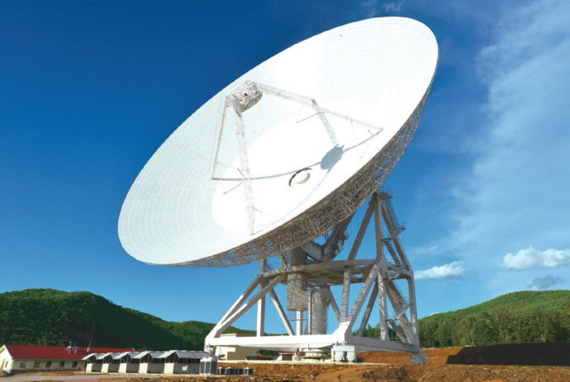
Antenna for 2-way tracking
@ Jiamusi & Kashi, DSN sites of China
66m/35m in diameter
TT&C antenna
With 2 H-clocks
Uplink site
VLBI available
Pulsar obs. available

Slide 25
双程上行链路
飞行器
发送和双程接收站
地球
双程下行链路
单/三程下行链路
单/三程接收站
Open loop radio Doppler and phase range tracking with:
(1) H-Clock at each ground station, table and precise;
(2) X-band PLL transponder & transmitter on board;
(3) Many antennas, VLBI & DSN of China TT&C
(4) Open loop multi channel RSR with frequency resolution
of 10^-16

Slide 26
Comparing Space Geodetic Tools
 | Geo -center | ICRF | Lunar center | EOP UT1 fast | Precession Nutation | Single site work | Ephemeris Earth & Moon
VLBI | no | yes | no | Yes yes | Yes | no | no
GNSS | no | no | no | No no | no | no | no
SLR | yes | no | no | No no | no | no | no
LLR | yes | yes | yes | Yes no | yes | yes | yes
DORIS | yes | no | no | No no | no | no | no
LRR | yes | yes | yes | Yes yes | yes | yes | yes

Slide 27
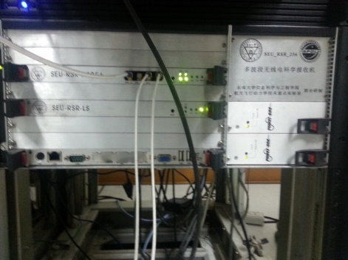
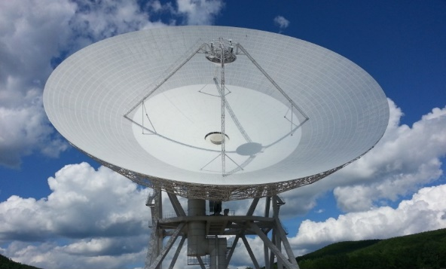
Tracking and obtaining data
CE-3 lunar lander
-> radio beacon
-> transferring signal
Uplink and downlink for 2/3-way ranging
Uplink station:
Jiamusi, Kashi
2015~2017 data obtained
Downlink station:
Jiamusi, Miyun, Kunming, Sheshan25, Tianma65, Urimuqi
Uplink site
66m in diameter
TT&C antenna
With 2 H-clocks
VLBI available

Slide 28
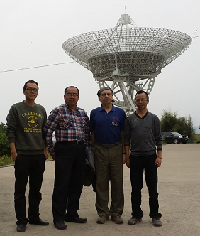
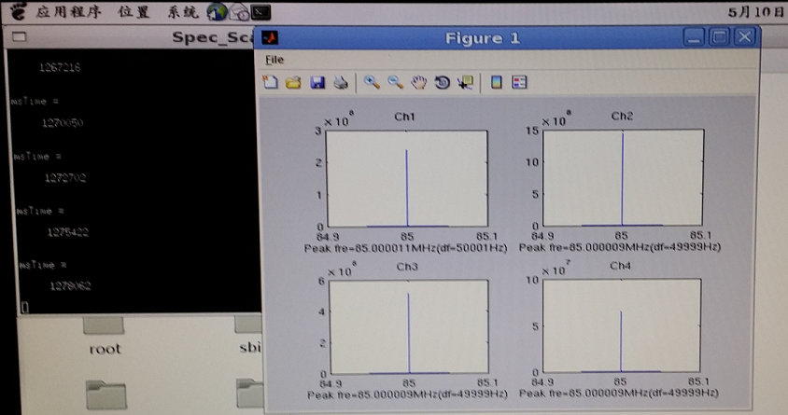
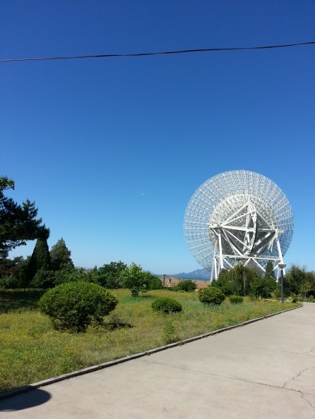
Photo by XI Y.
Chang’E-3 3Way Ranging/Doppler
Tracking
Ranging Observation 2014.11 – 2017.10
Doppler Observation 2013.12 – 2017.10
1st Miyun/Beijing Observation

Slide 29
Data Processing for LRR
Followed the idea of LLR technique
Rejecting the low elevation angle (<20°) measurement,
Calculating and removing the atmospheric delay series by using a Saastamoinen-NMF model based on the metereological data.
An IONEX GIM global ionospheric TEC product released by IGS-GNSS of IERS was used to calculated the ionospheric delay between the ground station and lander.
The position of lander was estimated with some fixed parameters, EOP from IERS products, lunar liberation from LE430/DE430, solid earth tide model of the ground station from IERS standard.
The radii value was calculated from LOLA/LRO DEM model.

Slide 30
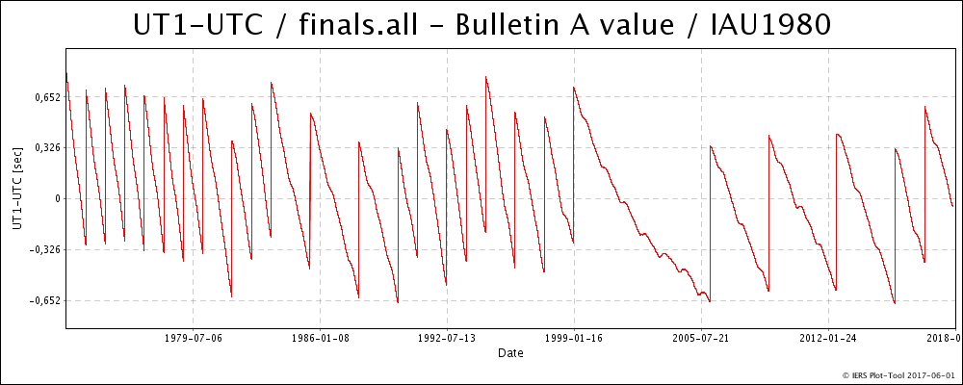
Scientific objectives:
Positioning the Lunar lander and ground stations
-> long-term and dynamical resolution
Earth Orientation Parameter
-> short-term (~minutes) character of UT1
-> independent solution in contrast with VLBI & DORRIS
Lunar Physical Libration
-> accurate and independent solution on short-period part

Slide 31
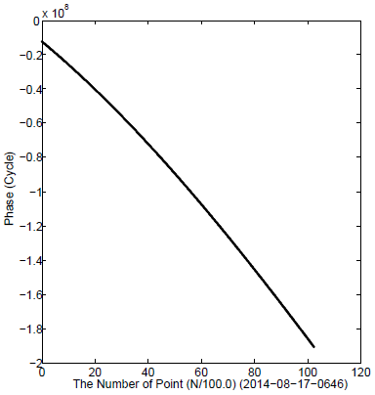
Data of low elevation
angle
1st example
2-way LRR result
L_up：1sps CE-3 LRR in one pass
R_up: O-C range and elevation angle
R_low：1sps range residual
-9mm~27mm atmospheric disturbulance
can be reduced by using micro-wave radiometer
or by filting the high frequency signal out

Slide 32
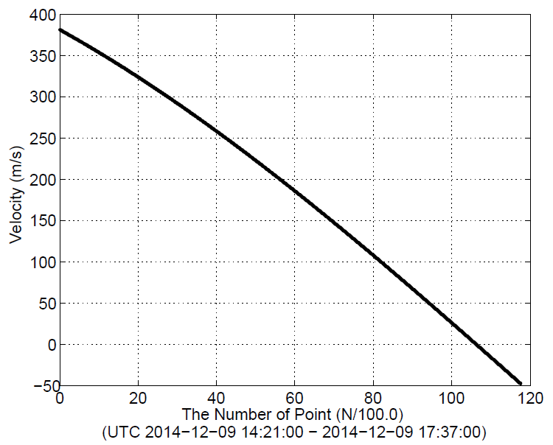
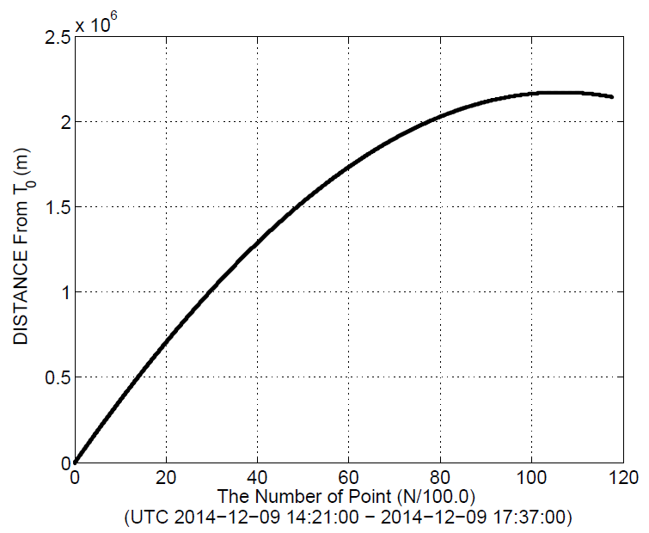
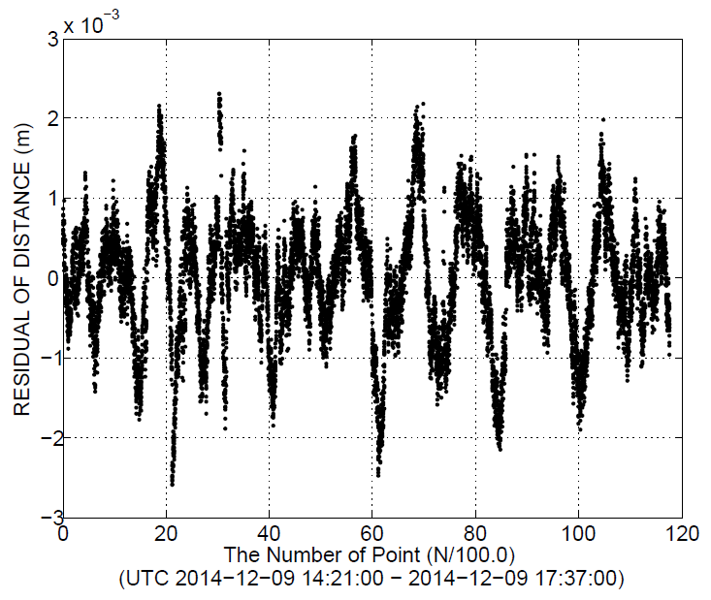
Velocity trend
Ranging trend
Data of high elevation
angle
L_up：1sps CE-3 LRR in one pass
R_up: O-C range and elevation angle
R_low：1sps range residual
~0.8mm atmospheric disturbulance
can be reduced by using micro-wave radiometer
or by filting the high frequency signal out
Ranging residuals RMS: 0. 8mm
CCSDS T2B or T4B Ranging will be added
Into LRR in future lunar missions, so as to
solve the ambiguity problem.

Slide 33
Comparison of solutions for CE-3 lander position
 | Lon ME | Lat ME | Ele ME
LRO | 19.5116°W | 44.1214°N | -2640.0
Di K C | 19.51256°W | 44.11884°N | -2615.451
Cao J F | 19.5093°W | 44.1189°N | -2637.5
Li P J | 19.5124°W | 44.1206°N | -2632.0
LRR | 19.4983°W | 44.1265°N | -2632.1
P. S.: The difference between LRO and LRR is about 130m,
The estimated coordinates for lander position are read as 19.4983°W and 44.1265°N at landing area.
Next step of LRR solution: ut1, ground tracking station, improved lander position. Then, the next to next solution will be the short periods LPhL

Slide 34
LLR Data and our LPhL Model
Data from 1969 O-C

Slide 35
O-C Pre-fit

Slide 36
O-C Pre-fit

Slide 37
LRR O-C residuals: blue---SHAO/NAOC LPhL model
orange --- JPL LPhL model from DE430

Slide 38
Future works 1: CE-3 lander LRR observations to improve data analysis for
(1) EOP, LPhL, ground site position;
(2) combining 2- & 3- way data;
(3) combining LRR and LLR data

Slide 39
Other Applications

Slide 40
A--Remote Frequency Standard Validation
Using lunar lander(s)
Advantages:
1—VLBI small antenna (3~13.2 m in diameter) and H-maser clocks
2– one uplink only, lander PLL tansponder there
3– X-band now, s/x/ka band in the future
4– very stable and accuracy motion of Earth and Moon system
X-band frequency accuracy in 1000~6000km
10^-13 ~ 10^-14 in 10~15 minutes scan.
Dual Frequency, better than ~ 10^-14
is expected.
双程上行链路
飞行器
发送和双程接收站
地球
双程下行链路
单/三程下行链路
单/三程接收站

Slide 41
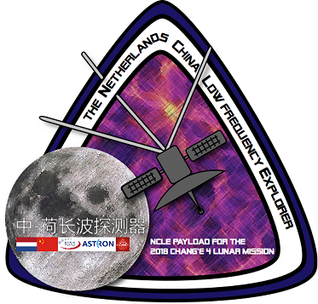
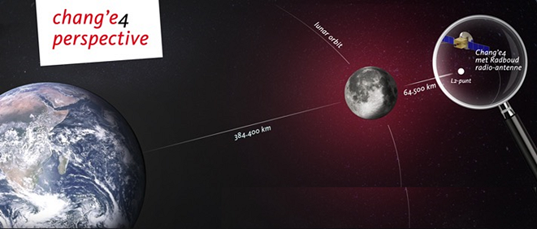

Brief Introduction Of
Low Frequency Radio Astronomical Missions At The Lunar Far-side Space

Slide 42

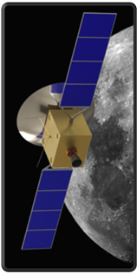
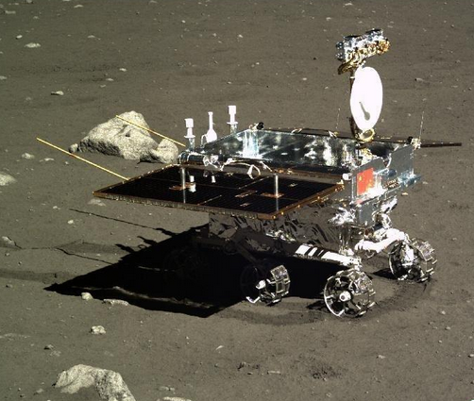
CHANG’E-4 Lunar Mission
The Chang’E 4 explorer is a mission to the lunar far side which will be designed, manufactured, assembled, integrated and tested by CNSA. The mission includes a relay satellite orbiting the Earth-Moon L2 point, a lunar lander and a lunar rover.
The Chang’E 4 explorer will be launched by Chinese carrier Long March rocket at China's satellite launch center from 2018 to 2019. The Lander and Rover follow half a year later at Aitken Basin
Lander & Rover_back up of CE-3
Relay Communication
Satellite

Slide 43
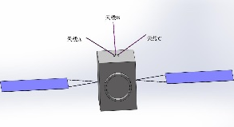

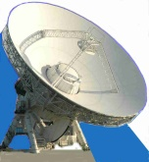
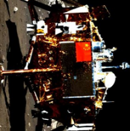
Chang’E-4 lander mission tracking link:
1Embedded 2-way in 4-way to save hardware
and software resource onboard.
2VLBI for CE-4R POD is strongly
required
Carriers (S/X)
L2 Point
~65KKM
TT&C stations
4-way link between the Earth tracking station, Relay S/C and lander was established with S-band/X-band signals.
Notes:
This is the configuration of VLBI observations in Kaguya
VRAD mission is differential VLBI observation of two sub-satellites of KAGUYA, Rstar and Vstar.
Perilune attitude of two sub-satellites is same to main orbiter of KAGUYA and apolune is 800 km for Vstar and Rstar.
Who orbit around the Moon is this.

Slide 44
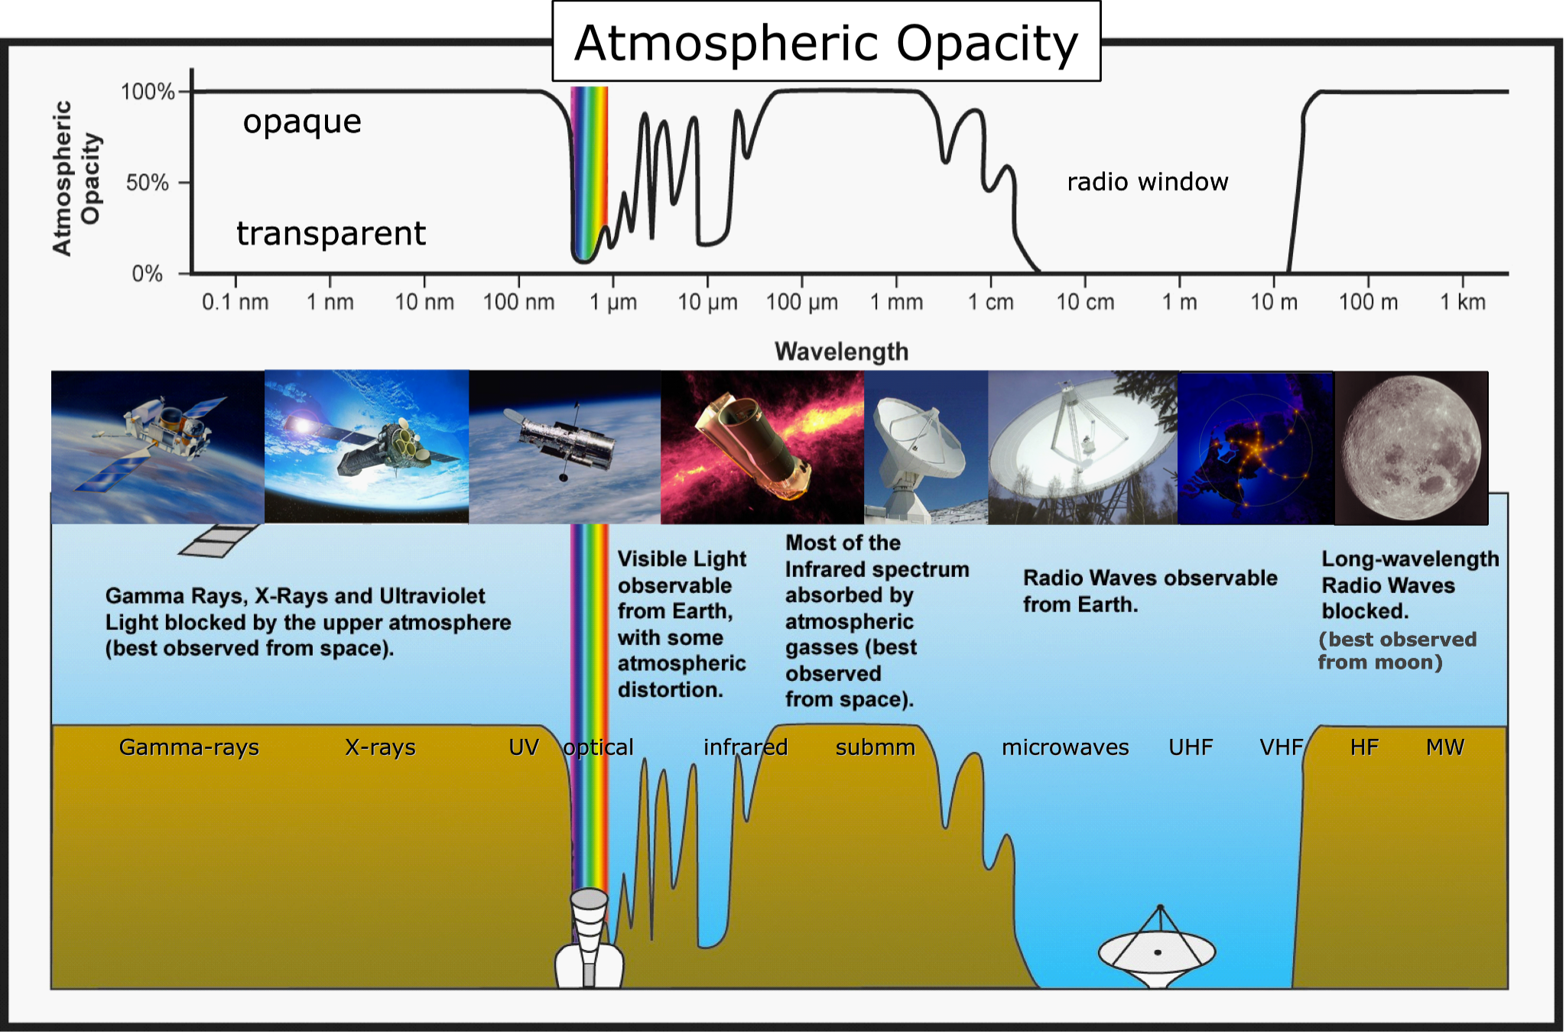
Opening the last unexplored frequency regime

Slide 45
Low Frequency Spectrometer on lunar far-side lander of CE-4
A very low frequency radio astronomical detector will be settled on the far side surface of the Moon, in Chinese Chang’E-4 lunar lander mission. The 3 monopole detector of 5 meter long each will mainly investigate the type II and type III solar burst, and will also to investigate the possible lunar ionosphere above the landing site, by means of taking the advantage of radio quiet environment of lunar far side. Similar antenna will be set on board the relay satellite.

Slide 46
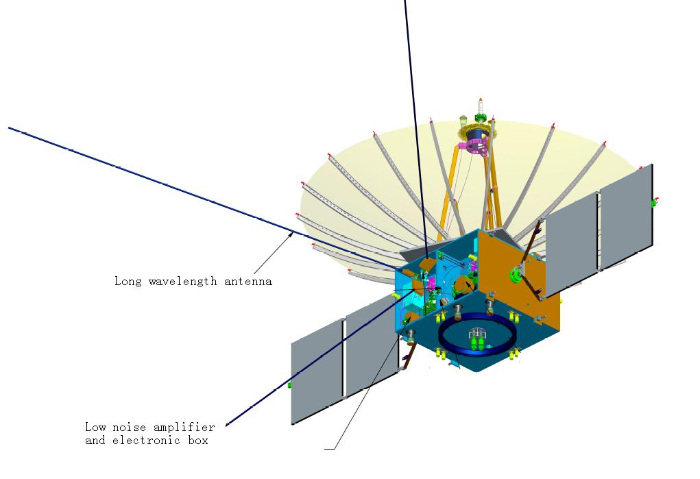
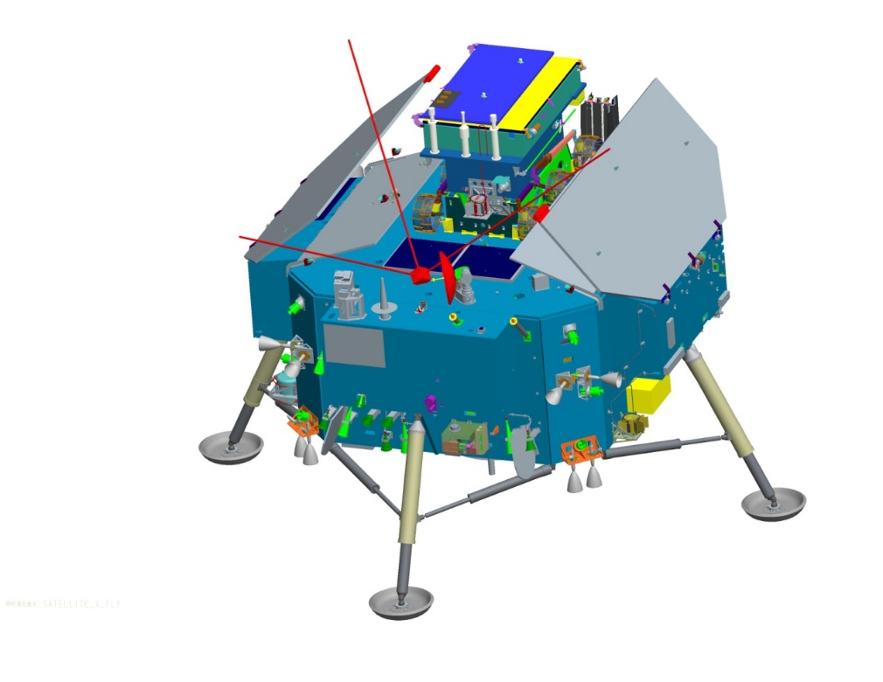
Fig.1 Three monopole HF
antenna onboard lander
And on board relay satellite
To the Earth
To the Lunar Lander
Low frequency radio astronomical detector will be firstly settled on the far side surface of the Moon to detect the solar burst, and to investigate the lunar ionosphere.
Additionally, it will be tested technically as a pathfinder mission for the future lunar surface low frequency radio observatory.

Slide 47
Pre-research for Future missions
Due to the absorption by the Earth’s ionosphere and hampered by the man-made low frequency signals (RFI), the radio sky below ~15 MHz cannot be viewed from earth-based facilities. In fact, up to date the range from several kHz to 15-30 MHz remains the least explored electromagnetic frequency range and is expected to conceal many scientific discoveries. Hence, the future advent in radio astronomy is expected by the realization of low-frequency radio space-based facilities to open up this frequency domain for astronomical exploration.
NCLE in CE-4 lunar mission as a path finder;
Simulation and pre-design an LF/MF/HF array on the far side of the moon;
Simulation and pre-design a LF/MF/HF constellation for moon space like a follow on as CE-4 relay satellite;
Simulation and pre-design a LF/MF/HF constellation for Earth-Sun L2 points.

Slide 48
Low Frequency radio astronomy explorations and studies in CE-4 Relay Satellite
Low-frequency radio emission back ground at Lunar space;
Type II & III Solar bursts at LF\MF\HF and connects with CME;
Planetary radio emission, AKR and others;
The radio sky maps at LF\MF\HF\VHF;
HF~VHF space VLBI experiments between Earth and Moon space;
Cosmological path-finder studies.
This will allow us not only to study the radio- and plasma physics of the earth-moon system, but also to explore mitigation and calibration techniques for exploring radio emission from the early universe and compare it with measurements made in true lunar far-side locations made by the future Chinese Lunar Lander mission.

Slide 49
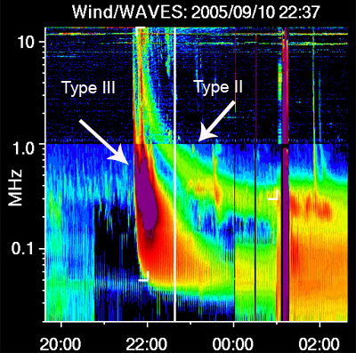
Solar Burst
Solar radio burst may cover whole radio spectrum, with strong CME event. Low frequency spectrometer may track the CME travelling from the outside solar corona to 2AU，may supply more information of the CME structure and dynamics.

Slide 50
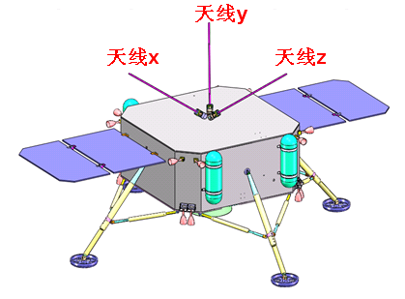
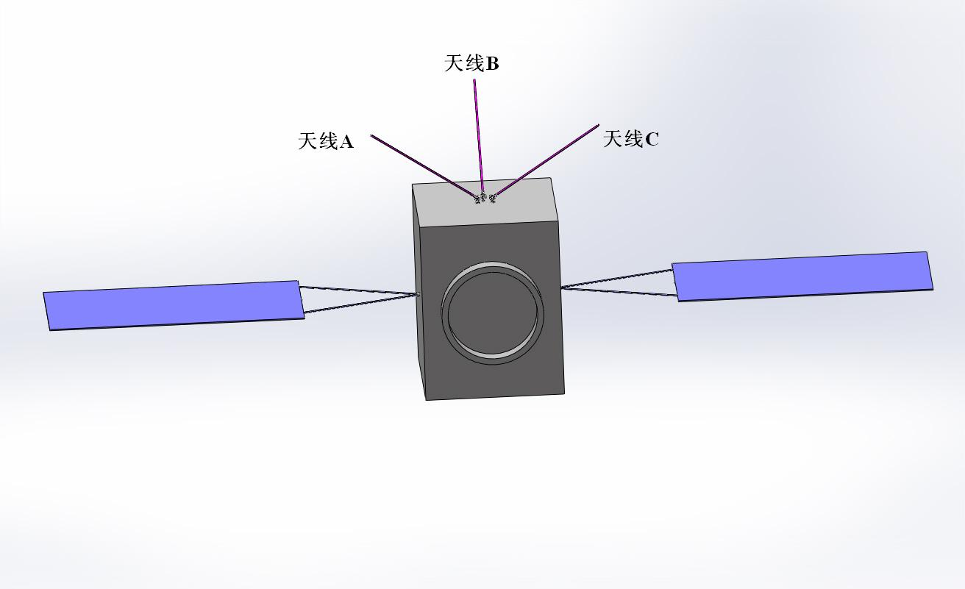
Lander and Satellite VLBI
Lander part；
Relay satellite；
Payloads are designed
for VLBI and other joint observations.
1~5s time synchronization
To UTC for lander
USO on lander:
Stability 10⁻¹²（~100s），
Draft 10⁻¹⁰（/day）。
Mean distance R=~63000km
5~50ms or worse time synchronization
To UTC for satellite

Slide 51



Radio Science Experiment on Lunar Ionosphere -Radio science experiment of the service module of the circumlunar return and reentry spacecraft
Mission: the circumlunar return and reentry spacecraft
  Launched on 23 Oct. 2014.
  Is a Chinese precursor mission for the Chinese lunar sample return mission.
  After the return and reentry experiments, the service module went back into a Lunar Orbit on 11 January 2015 for extension science period.
Experiment related
  Orbital inclination 43°, height is about 200 km
  S/X coherent signal， short-term stability of frequency source 10⁻⁹
  Orbiter is three-axis stabilized
  Ground station: Jiamusi, Kashi
Fig 4 The illustration of the service module of the circumlunar return and reentry spacecraft

Slide 52


Lunar Ionosphere
Lunar plasma environment above the surface has been still an open question. Luna-19 and 22 obtained several profiles in 1970s, SELENE have more after 40 years. A dawn exosphere of dust may contribute of 80% of the possible lunar ionosphere. This sphere may block the radio wave below 1MHz. Low frequency spectrometer may have chance to do in-situ observation during the solar burst observation. It can also be observed in CE-4 low frequency mission.

Slide 53


Data analysis
SELENE
The service module of Circumlunar return and reentry spacecraft
LUNA 19 & 22
Apollo 14，~100m，10⁴ el/cm³
The maximums of electron column concentrations are between 0.4 - 0.5×10¹⁶ el/m², are two times of the maximum result from Luna 19/22, are 1 - 2 orders higher than the SELENE result, but well-matched with the result from CPLEE.
These results show that the lunar ionosphere is clearly exist and much stronger than we expected.

Slide 54
A newly descended method for detecting low-frequency gravitational waves from radio range and range-rate in Earth-Moon space
In the field of space low-frequency gravitational-wave detection, the high-precision microwave Doppler measurement based on the ground tracking station has been performed for more than 40 years.
During the extension phase of Chang’E-3 lander, lunar microwave ranging technology of sub-millicycle accuracy was realized based on the independent development planetary radio receiver. Then use the raw data of lunar-earth ranging measurement in X-band, after the deduction of the earth atmospheric aberration, ionospheric disturbance, ground equipment thermal noise and the interplanetary plasma influence, the microwave differential ranging and velocity measurement of higher accuracy was verified.
Using this technology, a scheme which is using differential ranging and velocity measurement in Chang’E-4 2-way and 4-way measurement is proposed as a precursor technology. On these bases, using the microwave link of Chang’E-3 lander and the communication navigation satellite in L4 / L5 libration point, a new method of low-frequency gravitational-wave detection, which has the sensitivity of 10^–17 ~ 10^–19, is suggested.

Slide 55


Using CE-4 as an experiment
Check the method, develop the key technology
To detect the upper limitation of energy density at frequency from 10⁻⁶Hz to 0.01Hz background gravitational wave.

Slide 56



New concept of space low frequency gravitational detection
using radio ranging in Earth-Moon space
Relay with USO PLL
Lunar surface center area
E1-R-L4 and E1-R-L5 link keeps range difference
Less than 1500 KM, then in 0.01second, atm/iono/intr
effects can be removed by differenctial way.
Atmospheric,
Ionospheric
Instrumental effects cancelled
月球微波测距探测
空间低频引力波
概念方案：平动点
卫星、中继着陆器
四程距离与同路径
双程或三程距离差分
L5 S/C with USO
L4 S/C with
USO
E1---R---E 1 2-way close loop
E1---R---L4---R---E1 4-way close loop
E1---R---L5---R---E1 4-way close loop
E1---R---E2 3-way loop
E1---R---L4---R---E2 4-way loop
E1---R---L5---R---E 3 4-way loop
1秒采样~1微米相对距离和
速度测量能力。
地球大气电离层
E1 Earth site
1 up 3 down
link
E2只收不发射
3路返回

Slide 57

Possible detection ability
Ground-Space method, focus on 0.01~0.0001Hz with sensitivity of 10^{–17} ~10^{–19} ，using Doppler and Phase ranging.
1~3 orders better than CASSINI.
Space only method, focus on 1mHz~0.001mHz with sensitivity of 10^{–18} ~10^{–20} .

Slide 58
Спасибо!
谢 谢！
Thank You!

