Slide 1
The Software Correlator Status of
Chinese VLBI Network
Li TONG,Juan ZHANG,Lei LIU,Yun Yu
tongli@shao.ac.cn
Shanghai Astronomical Observatory
Chinese Academy of Sciences

Slide 2
Outline
The history of CVN software correlator
The development status of CVN software correlator
The future work

Slide 3
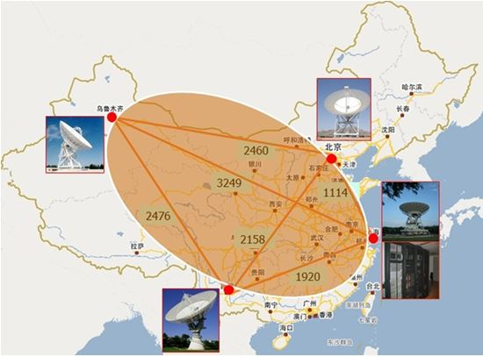
Chinese VLBI Network(CVN)
Notes:
Chinese VLBI Network has 5 stations and 1 data processing center, including SH 25m and 65m radio telescope,BJ 50m radio telescope,UR 25m radio telescope , KM 40m radio telescope and SH data processing center. It play an very important role in the China lunar exploration project.
Five radio telescopes and one data processing center:
Beijing 50meter radio telescope
Urumqi 25meter radio telescope
Kunming 40meter radio telescope
Shanghai 25 and 65meter radio telescope
Data Processing Center in Shanghai Astronomical Observatory

Slide 4
The history of CVN software correlator
Development was begun in 2007.The early version implement parallel using pthread –it took part in CE1(2007),CE2(2010) mission as a primary equipment and did good jobs .
The current version implement parallel and distributed computing using MPI and OpenMP –it executed the CE2 extend mission of flying over the Solar-terrestrial Lagrange point. The real-time parallel version software correlator completed the CE3(2013) task successfully.

Slide 5
Data flow diagram
Get data over network by TCP/IP protocol
Enables real-time (applied in the Chinese lunar exploration project)
Data Flow Diagram in Chang’E 3 Mission

Slide 6
Specifications of CVN software correlator
Processing Mode | Real-time & post-processing
Station number | 1~20
Real-time fast fringe search | 4 stations
IF number | 1,2,4,8,16
Frequency channel | 32~16384/IF
Integration period | 0.1~60 second
Maximum data speed | About 1.9Gbps/station totally 4stations

Slide 7
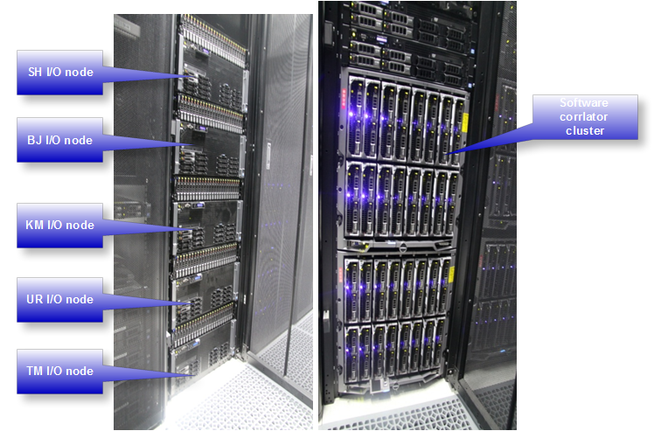
Computing platform
Standard Linux cluster
5 I/O nodes
- E7-4820*4/ 128GB/ 300GB+12TB
32 compute nodes, 12cores/node
- E5-2640*2/ 32GB/ 300GB
- about 7.5Tflops
2 manage nodes
- E5-2620*2/ 24GB/ 900GB+214GB
Compute network
- InfiniBand(40Gbps)
Notes:
teraflops

Slide 8
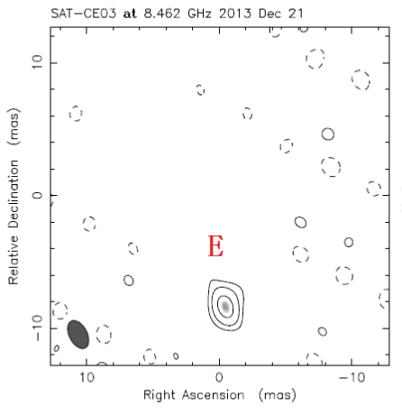
Input and output data format
Input data format
-Mark 5A, Mark 5B
-Now adding VSR and VDIF
Output data format
-CVN specific data format
-Converted into FITS-IDI
can be loaded by AIPS directly

Slide 9
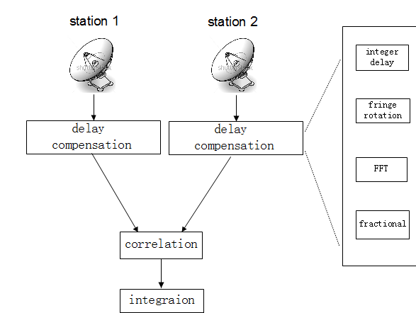
The structure and algorithm
FX correlator

Slide 10
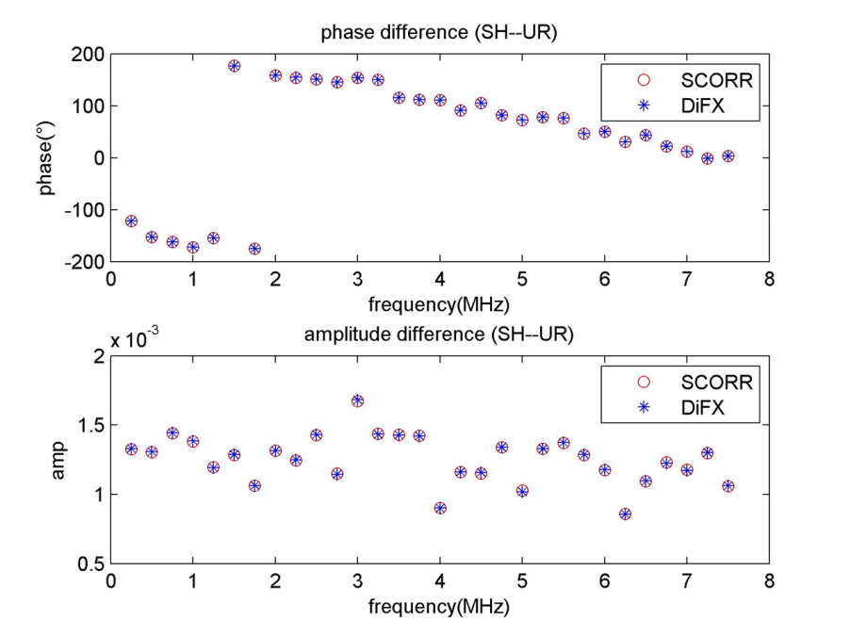
Compared to the DIFX’s result

Slide 11
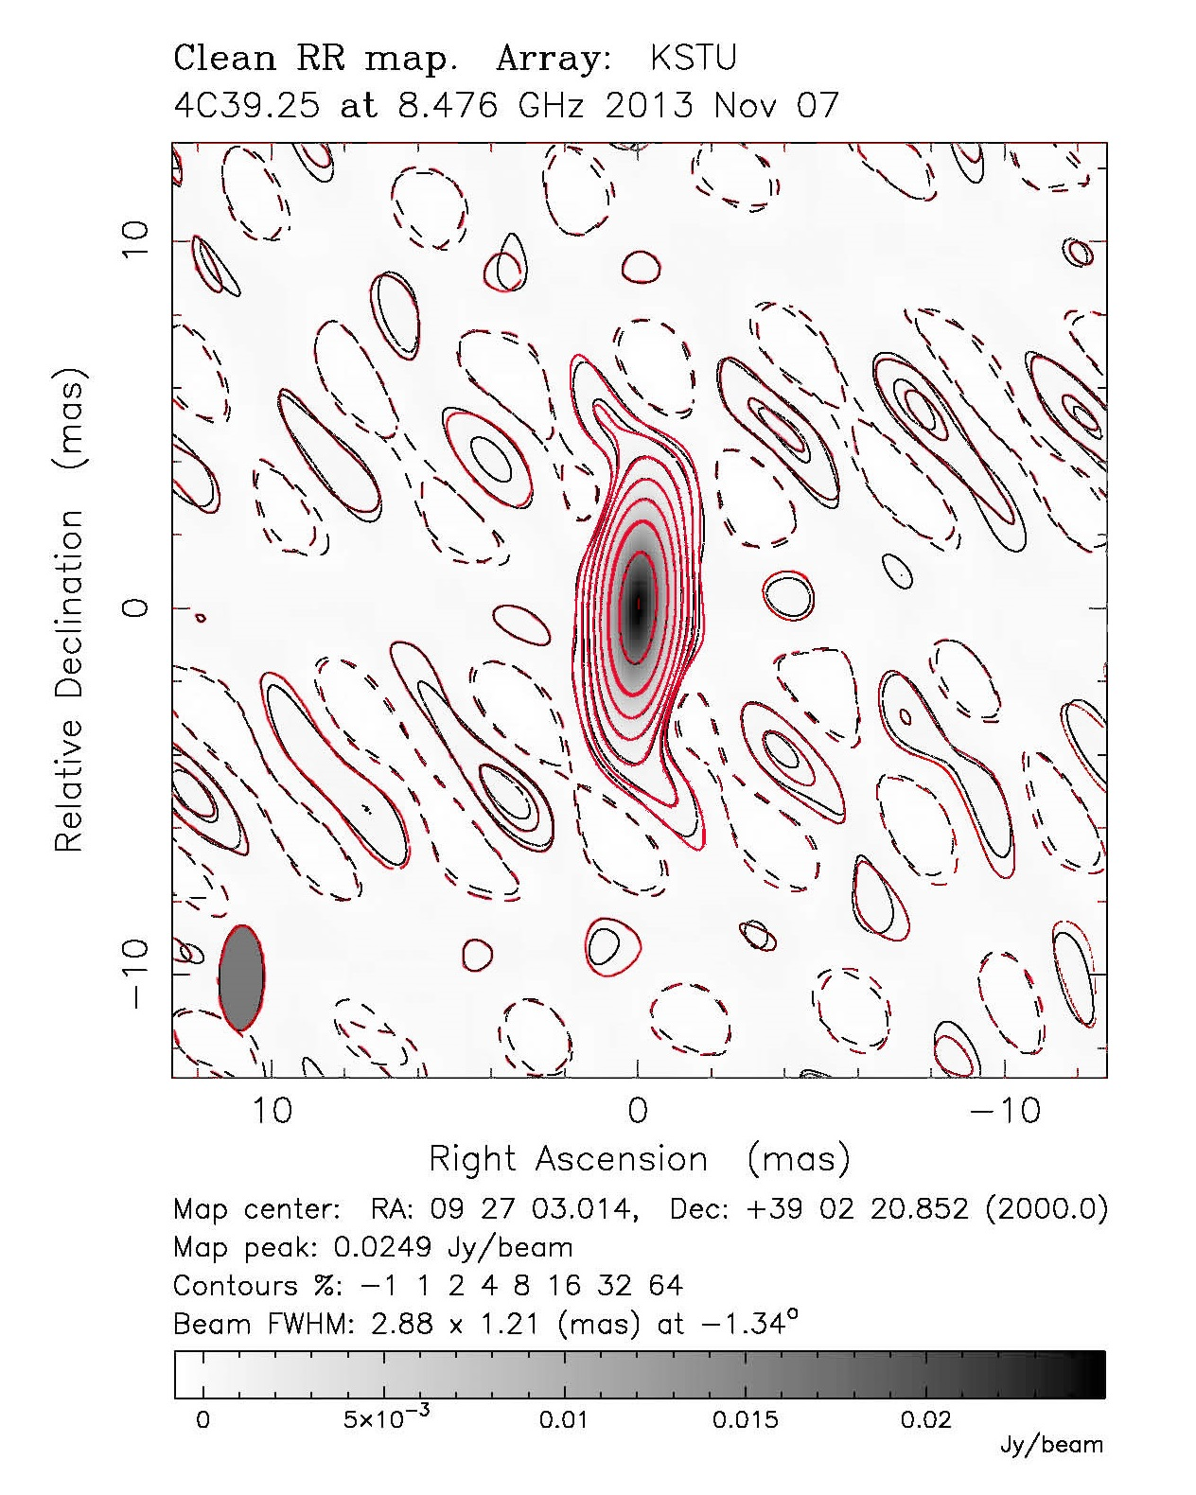
It’s nearly the same!

Slide 12
Software Engineer
Written in C
- with Python scripts
- with Matlab to show the intermedia result
Optionally uses Intel IPP(Intel Integrated Performance Primitive) library
- enables taking advantage of the parallelism of the single-instruction, multiple-data (SIMD) instructions ,such as SSE and AVX.
GPU version is in development

Slide 13
The development of GPU version
Currently, this version can only run on the single GPU development board.
GPU: C2070(compute ablity 2.0)
Raw Data: 4 Stations, 2Bit Sampling
Speed: about 300Mbps/Station
Notes:
mega

Slide 14
For spacecraft tracking: Chinese lunar exploration
- fast fringe search
In general, during orbital maneuver phases, the accurate orbit cannot be provided in advance, so the correlator can not work properly in such conditions. Fast fringe search module firstly extracts the main carrier frequencies from the signals of different stations, produces the delay-rate, and then compensates the delay and delay-rate.
- real-time visibility monitoring
Notes:
maneuver [mə’nuvɚ]

Slide 15
The result of CVN software correlator using the fast fringe search function. The show tool is real-time monitoring tool developed by ourselves.
Fast fringe search is closed!
Fast fringe search is opened!
Notes:
power spectrum
[‘paʊɚ spɛktrəm]

Slide 16
The furture work
For geodesy
  -Used in Crustal Movement Observation Network of China
  For astronomy
  -Pulsar
  be in the experimental stage.
Notes:
[dʒi:'ɒdəsɪ]

Slide 17
The furture work
Develop the high speed CPU-based/GPU-based software correlator
-the new CPU-based software correlator is nearly three times over the current one.(testing)
Add new functions
- the multiple phase centers function
- the polarization function

Slide 18
Thanks you very much!

